Slide 1
Discussion of Jonathan Wright’s
“Options-Implied Probability Density Functions for Real Interest Rates”
Eric T. Swanson
University of California, Irvine
IJCB/Banco de Mexico Conference
Mexico City
November 23, 2015

Slide 2
What the Paper Does
Use new data on TIPS options to compute implied probability distributions for real interest rates.

Slide 3
Difficulties
Short sample
Options on TIPS began trading in January 2009
Low volume
Total trade volume is about 49 contracts/day
Large bid/ask spreads (18%!)
Even midpoints of bid/ask quotes have problems:
Only available for about 10 strikes/day
These 10 strikes are not well distributed (many are deep in the money), which makes them less informative
Financial Crisis occupies a significant part of the sample
Risk premia large and variable

Slide 4
Financial Crisis
TIPS-Treasury mispricing (Fleckenstein-Longstaff-Lustig 2014)

Slide 5
Comment #1: Data Are Weird
Quotes not available for nearly as many strikes as you’d expect
Quotes that do exist are oddly distributed:
Many quotes are for deep in-the-money strikes
Only 15% of quotes are for out-of-the-money strikes
Only about 2% of quotes are for strikes that are >10% out of the money
Seem to be very few puts early in sample
Comment/Suggestion: Check with CBOE/data provider so we understand better what’s going on

Slide 6
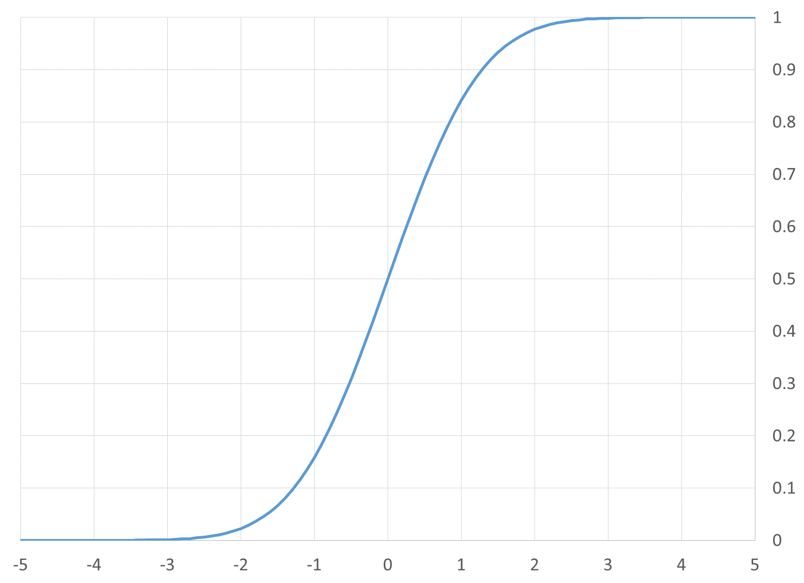
How to Evaluate Implied PDFs
Literature on evaluating forecast densities (Diebold, Gunther, Tay, 1998; Berkowitz, 2001)
Convert PDF to CDF, then map CDF to unit interval:

Slide 7
Results for TIPS Options-Implied PDFs

Slide 8
TIPS PDF Forecasts Were Biased Upward
Options consistently over-predicted TIPS yields
r = i – π
So options either
over-predicted i, or
under-predicted π
(Recall: predictions are for 7-year TIPS 3 or 6 months ahead)

Slide 9
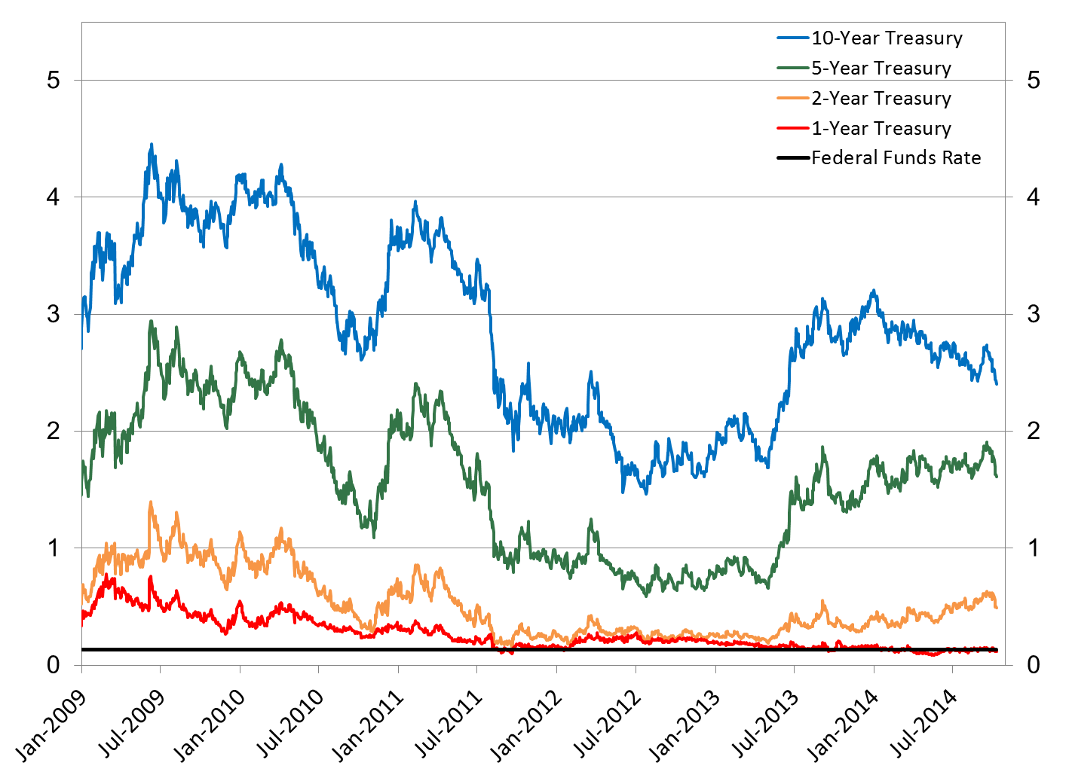
Nominal U.S. Treasury Yields, 2009-2014
source: Swanson and Williams (2014)

Slide 10
Blue Chip Forecasts of Time to First Tightening
source: Swanson and Williams (2014)

Slide 11
Comment #2: Discuss Bias in Implied PDFs
Test for bias
Discuss reasons for bias/nonuniformity:
Risk premium?
Or forecast errors?
Currently, paper takes a strong position that it’s risk premium
But there’s substantial evidence of nominal interest rate forecast errors during this period

Slide 12
Estimating Options-Implied PDFs
Two main approaches:
1. Assume a parametric form for PDF and estimate parameters to fit observed options prices
2. If options pricing function p(K) is known, can compute PDF for the underlying as d²p/dK²
(In practice, p(K) is not known but must be estimated)

Slide 13
Parametric Form for PDF
Step function is one common parametric form:
Implied PDF for Eurodollar rate 5 quarters ahead, 11/2/2011
Another common form is mixture of 2 or 3 normals (fewer parameters than step function)

Slide 14
Estimating Option-Pricing Function p(K)
Assume options pricing function has form
p(S,K,σ,d,τ,r)
S = spot price of underlying
K = option strike price
σ = volatility (and higher moments of stochastic distribution)
d = dividends from underlying
τ = time to expiration
r = risk-free interest rate (nominal) from now to expiration
Can estimate function p parametrically or nonparametrically

Slide 15
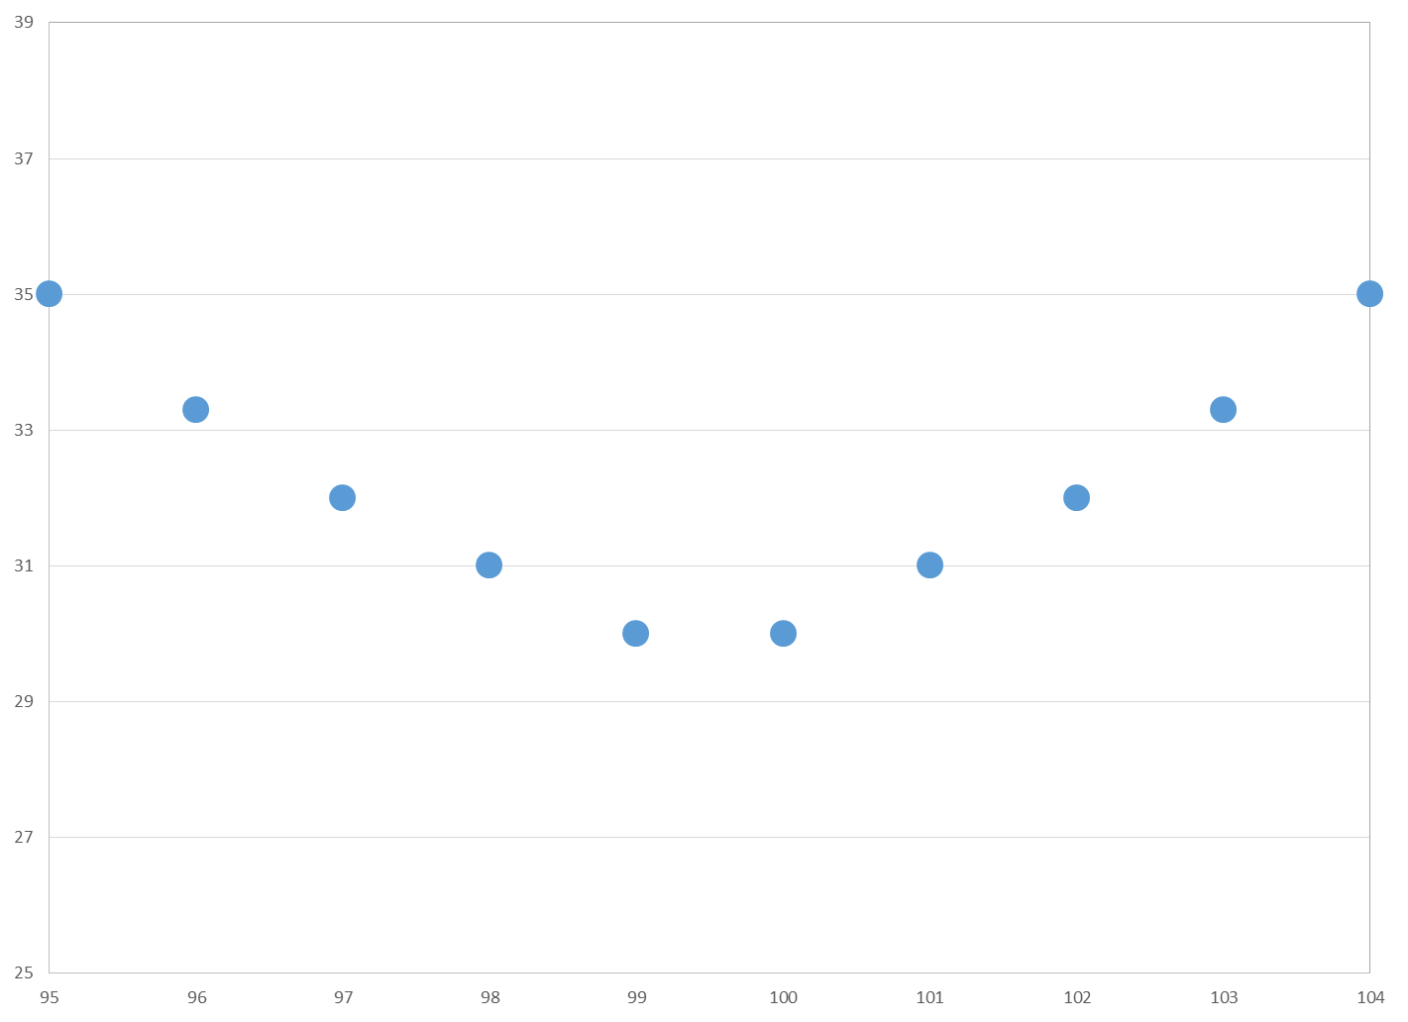
Estimating p Parametrically
Transform options prices to Black-Scholes implied vols
Fit quadratic or spline to implied vols to get smooth function
Transform implied vol function back to pricing function p(K)

Slide 16
TIPS Implied Volatility Smile

Slide 17
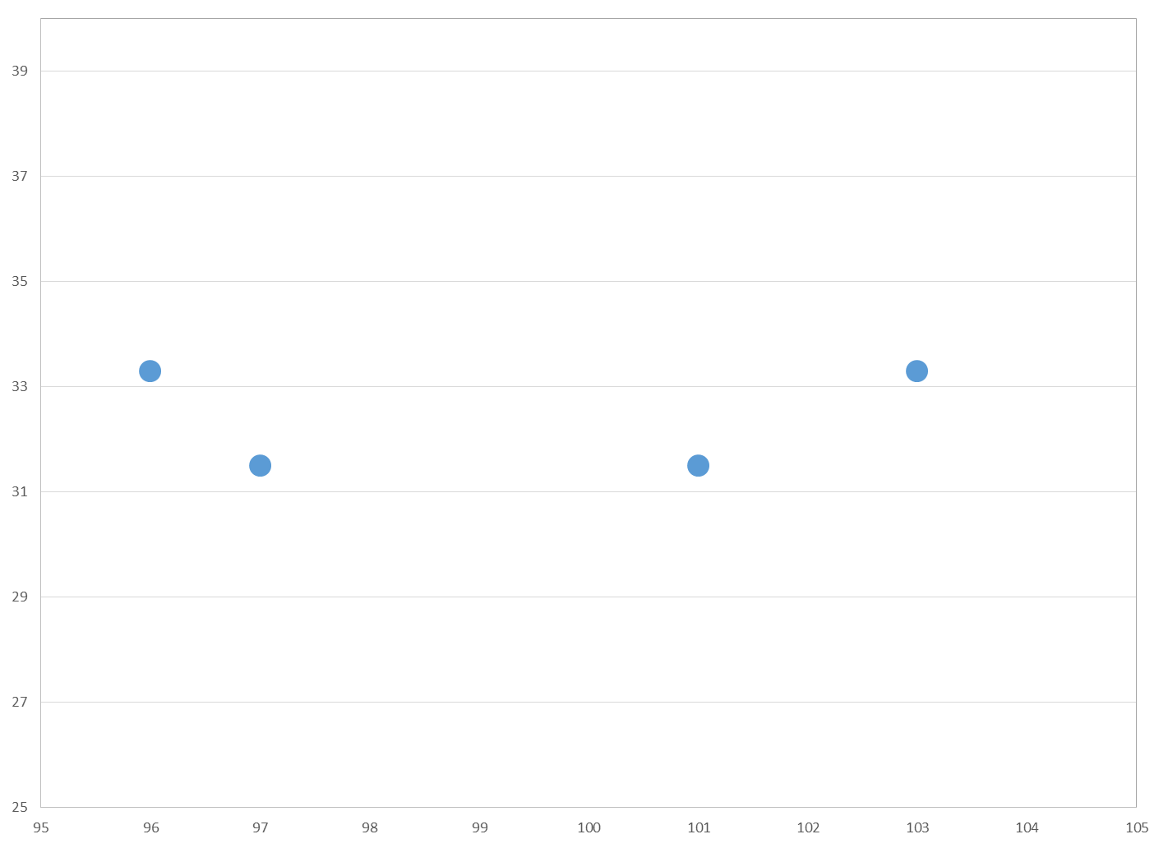
Sparse Data Can Be a Problem
But 10 observations/day is not bad

Slide 18
Estimating p Nonparametrically
Sparse data not normally a scenario for nonparametric estimation
Idea: combine data from similar days
Instead of estimating p(K) on a single day, estimate
p(S,K,σ,d,τ,r)
nonparametrically over whole sample
Let σ be a function of state of economy
Case 1: σ(S,K,τ)
Case 2: σ(S/K,τ,σ_{EGARCH})
Case 1 problematic: averaging uncertainty over whole sample
(uncertainty about real rates in 2009 same as in 2013)

Slide 19
Comment #3: Justify Nonparametric Estimation
Case 1 is too crude—better to drop it
Case 2 is reasonable, but requires the EGARCH model to be good to produce good results. It’s also very complicated.
Parametric estimation is simpler, removes dependence on auxiliary model
10 observations/day should be plenty to get a good implied volatility fit (Bliss-Panigirtzoglou (2002) had 10.8 strikes/day for short sterling futures, found parametric implied vol smile method worked very well)
Need to justify nonparametric approach for these data

Slide 20
Comment #4: Standard Errors Seem Too Small
Given data sparseness and giant bid-ask spreads, these standard error bands seem far too narrow

Slide 21
Summary of Comments and Suggestions
Data are weird in a number of respects
check with CBOE/data provider for insights
Implied PDFs were upward biased
risk premium, or forecast errors?
Justify nonparametric estimation method
parametric implied volatility smile an appealing alternative
Standard error bands around PDFs seem too narrow

