Slide 1
Discussion of Chin, Filippeli, and Theodoridis,
“Cross-Country Co-Movement in Long-Term Interest Rates: A Regime-Switching DSGE Approach”
Eric T. Swanson
Federal Reserve Bank of San Francisco
Aarhus/CREATES Macro-Finance Workshop
June 4, 2014

Slide 2
Model Overview
Two-Country New Open Economy Macro Model
Monopolistic Domestic Producers
Monopolistic Importing firms
Monopolistic Exporting firms
Monopolistic labor supply
Markup shocks to all of these
plus shocks to G, i
and two shocks to household preferences
and two shocks to bond values
…
In addition, two new features:
Financial Intermediaries
Regime switching

Slide 3
Financial Intermediaries
Financial Intermediaries take deposits
Buy short- and long-term government bonds
… and long-term foreign government bonds
Maximize profits
But there are adjustment costs to changing bond holdings
Breaks the link to the Expectations Hypothesis
Compare to Andres-Lopez-Salido-Nelson (2004),
Chen-Curdia-Ferrero (2012)

Slide 4
Adjustment Costs
Costs of adjusting short-term relative to long-term bonds:
Costs of adjusting foreign debt holdings relative to GDP:

Slide 5
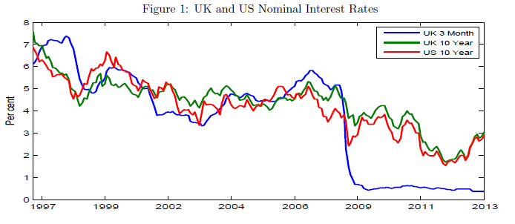
Co-Movement between US and UK Long Rates

Slide 6
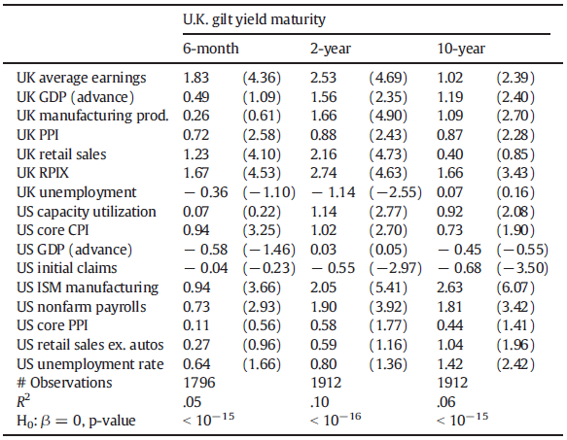
UK Long Rates Respond Strongly to US News
Swanson-Williams (2014)

Slide 7
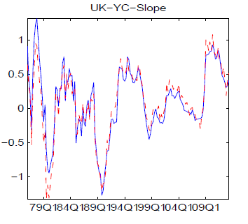
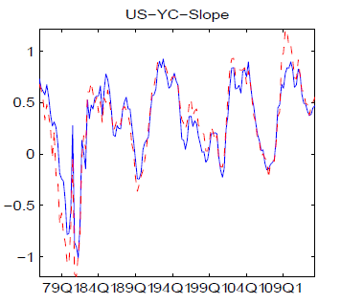
Model Generates Co-Movement

Slide 8
But the Mechanism is Unclear
A rise in long-term U.S. interest rates
causes U.S. long-term bond prices to fall
Financial intermediaries’ balance sheet:
Adjustment costs:
To generate co-movement, exchange rate q must be playing an important role

Slide 9
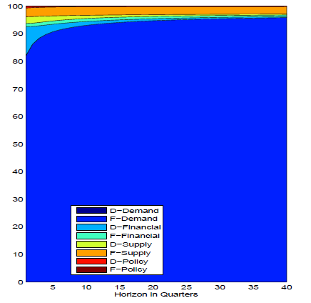
UK Long-Term Rate Forecast Variance Decomp

Slide 10
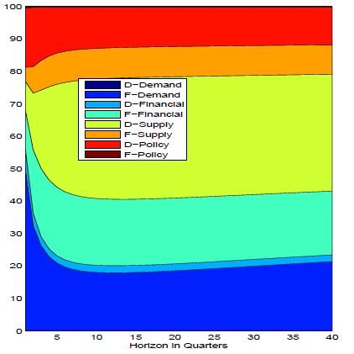
UK GDP Forecast Variance Decomposition

Slide 11
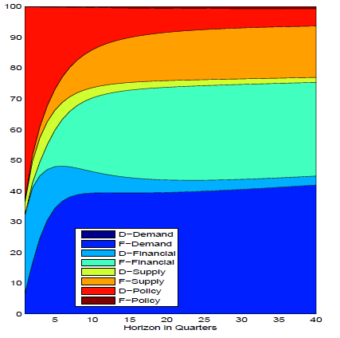
UK Yield Curve Slope Forecast Variance Decomp

Slide 12
Regime-Switching Doesn’t Seem to Add Much
Basic model is already very complicated
And fits the data very well
“Marginal Likelihood” of the regime-switching model is very close to the baseline model
Why not drop it?

Slide 13
Summary of Comments & Suggestions
Drop Regime-Switching
Main point of the paper is the co-movement between US and UK long-term rates
Focus on the mechanism driving this correlation
If the mechanism is related to the exchange rate, is there any evidence for this in the data?

