Slide 1
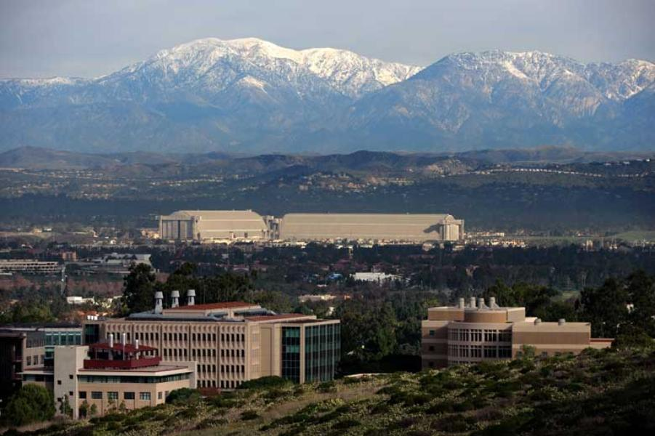
Discussion of Kroencke, Schmeling, and
Schrimpf, “The FOMC Risk Shift”
Eric T. Swanson
University of California, Irvine
ASSA Meetings
Philadelphia
January 5, 2018

Slide 2
Background
Kuttner (2001), Gurkaynak, Sack, and Swanson (2005), Bernanke and Kuttner (2005), and others look at high-frequency response of financial markets to FOMC announcements
These previous studies focus on interest rates and stock price responses
In this paper, authors include measures of “risk appetite”:
CDS spreads
VIX
Treasury yield VIX
US dollar index

Slide 3
What This Paper Does
Collects one-day responses of 9 asset prices to 80 FOMC announcements from 2006-2015
Extracts first three principal components from this matrix of asset price responses
Following GSS (2005), Swanson (2017), rotates these principal components to give the three factors a structural interpretation:
Short-term interest rate factor
Long-term interest rate factor
Risk appetite factor
Authors also look at quantities (ETF flows) as well as prices

Slide 4
Short-term Interest Rate Factor

Slide 5
Long-term Interest Rate Factor

Slide 6
Risk Appetite Factor

Slide 7
What the Paper Finds
Risk appetite shocks have big effects on stocks, other risky asset spreads (i.e., risky assets co-move)
Short-term and long-term interest rate shocks move interest rates, but have very little effect on stocks, other risky asset spreads (surprisingly)
Effects of risk appetite shocks die out quickly—within about 4 weeks
High-frequency ETF flows reinforce the “risk appetite shock” story

Slide 8
Comment 1: Bernanke-Kuttner vs. Lucca-Moench
Is this a paper about the response of stocks to FOMC announcements? (Bernanke-Kuttner, 2005)

Slide 9
Comment 1: Bernanke-Kuttner vs. Lucca-Moench
Is this a paper about the response of stocks to FOMC announcements? (Bernanke-Kuttner, 2005)

Slide 10
Comment 1: Bernanke-Kuttner vs. Lucca-Moench
Or is this a paper about the pre-FOMC-announcement drift (Lucca-Moench, 2015)?

Slide 11
Comment 1: Bernanke-Kuttner vs. Lucca-Moench
The authors interpret their findings as a response of stock prices to a risk appetite factor (like Bernanke-Kuttner)
But there is also a large pre-FOMC-announcement drift component:
Note: FOMC announcement time is 2:15pm (not 2pm and not 12:15pm)

Slide 12
Comment 1: Bernanke-Kuttner vs. Lucca-Moench
According to the previous figure, when there is no pre-FOMC-announcement drift:
Risk appetite shock will tend to be negative when the FOMC announcement is made
Stocks and other risk asset spreads will then fall after the FOMC announcement
These effects are predictable ex ante
This is an interesting interaction between the pre-FOMC-announcement drift and the FOMC announcement itself
But the paper currently ignores this interaction

Slide 13
Comment 1: Bernanke-Kuttner vs. Lucca-Moench
If the paper is about response of stocks, risky assets to FOMC announcements (Bernanke-Kuttner):
Should focus on intraday data
Should include unscheduled FOMC announcements
If the paper is about pre-FOMC-announcement drift (Lucca-Moench):
Daily data approach is more justifiable
Should include only scheduled FOMC announcements

Slide 14
Comment 2: Monetary Policy and Stock Prices
The present paper finds short-term and long-term interest rate shocks have no effect on stock prices
This claim needs to be reconciled with Bernanke-Kuttner (2005), Gurkaynak, Sack, and Swanson (2005), Swanson (2017), and others who do find a significant effect
The present paper’s use of daily data is probably part of the reason
Gurkaynak, Sack, Swanson (2005):

Slide 15
Comment 2: Monetary Policy and Stock Prices
Swanson (2017):

Slide 16
Summary of Comments and Suggestions
Risk appetite factor is very interesting
Is the paper about Bernanke-Kuttner (2005) or Lucca-Moench (2015)?
Response to FOMC announcement or pre-FOMC-announcement drift?
It looks like both components are present and interact in an interesting way
Dig a little deeper into effects of short-term and long-term interest rate factors
Based on previous authors’ work, they almost certainly have an effect (and that’s OK here)

