Slide 1
Discussion of Pflueger and Rinaldi,
“Why Does the Fed Move Markets So Much?
A Model of Monetary Policy and Time-Varying Risk Aversion”
Eric T. Swanson
University of California, Irvine
Advances in Monetary Economics Conference
International Monetary Fund (online)
July 19, 2021

Slide 2
Overview
Summary of Paper:
Incorporates Campbell-Cochrane habits into standard NK model
Explains quarterly risk premia, volatility, correlations for equities, debt
Explains high-frequency stock market responses to FOMC announcements
Preview of My Comments:
Paper uses two high-frequency empirical facts as motivating evidence
one of those two facts is not really right (and also not necessary)
Incorporation of Campbell-Cochrane habits into NK model is very elegant
Compare and contrast Campbell-Cochrane habit approach to Epstein-Zin preferences approach

Slide 3
Comment #1: Two High-Frequency Empirical Facts
Paper treats federal funds rate surprise and 10Y breakeven surprise on FOMC dates as independent dimensions of monetary policy
Paper interprets each of these figures as causal, with second shock a “long-term inflation” shock

Slide 4
Comment #1: Two High-Frequency Empirical Facts
But a long literature finds substantial effects of federal funds rate surprises on far-ahead forward nominal interest rates and breakeven inflation:
Gurkaynak-Sack-Swanson (2005 AER)
Gurkaynak-Sack-Swanson (2005 IJCB)
Gurkaynak-Levin-Swanson (2010 JEEA)
Beechey-Wright (2009 JME)
Bu-Rogers-Wu (2021 JME)
All of these papers find substantial correlation between the two
note: the correlation between fed funds rate and breakeven inflation is stronger when you focus on far-ahead forward breakeven inflation
Natural to interpret the change in the federal funds rate as causing change in long-term inflation expectations or inflation risk premia
see Gurkaynak-Sack-Swanson (2005 AER), Gurkaynak-Levin-Swanson (2010 JEEA) for more details

Slide 5
Comment #1: Forward Interest Rates
Gurkaynak, Sack, and Swanson (2005 AER) plot nominal forward interest rate responses to federal funds rate surprises:
short-term forward rate responses are positive
far-ahead forward rate responses are negative

Slide 6
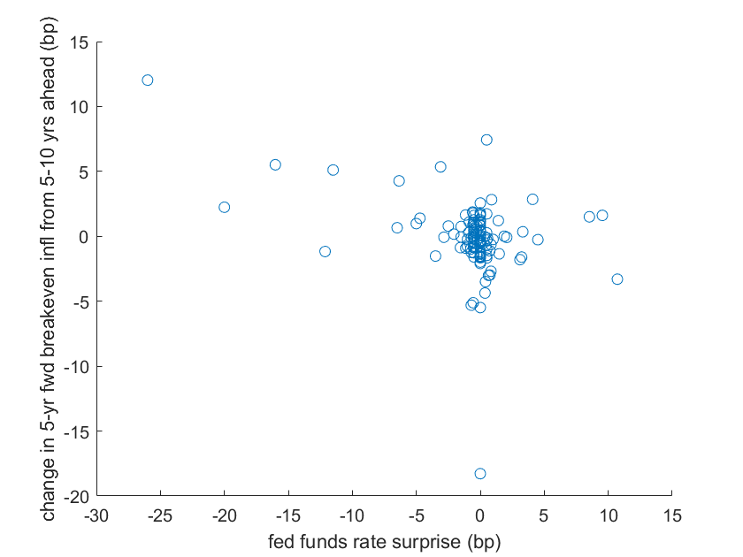
Comment #1: Updated Plot of Forward Breakeven Responses
Scatter plot of high-frequency (30-minute) changes in 5-year forward breakeven inflation rate from 5 to 10 years ahead against federal funds rate surprises:
sample: all FOMC announcements from 3/2004 – 6/2019

Slide 7
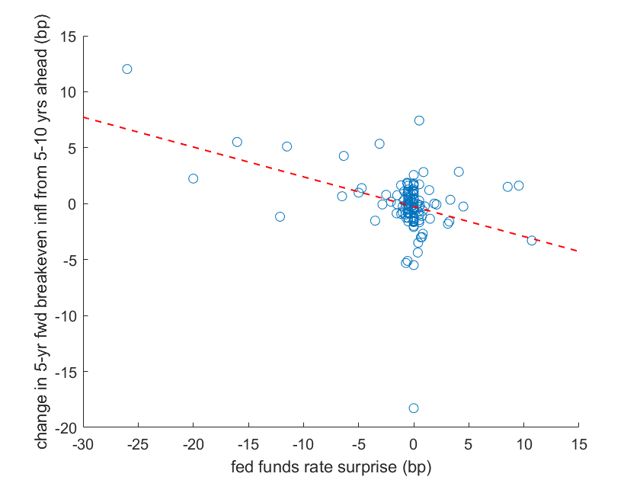
Comment #1: Updated Plot of Forward Breakeven Responses
Scatter plot of high-frequency (30-minute) changes in 5-year forward breakeven inflation rate from 5 to 10 years ahead against federal funds rate surprises:
sample: all FOMC announcements from 3/2004 – 6/2019
slope: ̶ .27
t-statistic: ̶ 4.91
(outlier is 3/18/2009; t-statistic excluding outlier is ̶ 6.27)

Slide 8
Comment #1: Long-Term Inflation Expectations
Negative response of far-ahead forward inflation expectations to fed funds rate surprises is intuitive:
A surprise tightening in i_{t} could be due either to a positive
or to a negative change in (both of which are unobserved)
market participants seem to price in both possibilities
See Gurkaynak, Sack, and Swanson (2005 AER), Gurkaynak, Levin, and Swanson (2010 JEEA) for more discussion, details

Slide 9
Comment #1: Bottom Line
Long-term breakeven inflation changes around FOMC announcements are closely related to fed funds rate surprises
The second figure is not surprising and is not evidence of an independent “long-term inflation” shock

Slide 10
Comment #1: Bottom Line
The second figure is also not necessary:
The paper accomplishes a great deal already
It’s interesting enough to match quarterly asset price data and high-frequency response of stock prices to federal funds rate surprises

Slide 11
Comment #2: Incorp. of C-C Habits into NK Model is Very Elegant
Incorporating Campbell-Cochrane habits into a NK model is very difficult:
Campbell-Cochrane habits imply very high risk aversion (CRRA of 60 on average, over 100 in recessions)
Households that are so risk averse want to insure themselves in any way possible
C-C habits also imply households hate high-frequency variation in consumption the most (Otrok, Ravikumar, Whiteman, 2002 JME)
So households will do everything possible to smooth consumption:
use precautionary savings
vary labor supply as necessary to maintain consumption
C-C habits shut down the first channel by exactly balancing precautionary savings and intertemporal substitution motives
But the second channel is usually a big problem…

Slide 12
Comment #2: Incorp. of C-C Habits into NK Model is Very Elegant
Campbell-Cochrane (1999 JPE) is an endowment economy
shuts down labor variation by assumption
Lettau-Uhlig (2000 RED) and Rudebusch-Swanson (2008 JME) show that allowing for labor variation drives risk premia back to almost zero
Campbell-Pflueger-Viceira (2020 JPE) is a reduced-form 3-equation NK model (with no labor)
shuts down labor variation by assumption
This paper is a fully structural NK model
uses GHH preferences to solve the problem:
$$\sum_{t=0}^{∞}{{ β}^{t} u(C_{t}−v\left(L_{t}\right))}$$
labor supply only varies in response to real wage changes (no income/wealth effect)

Slide 13
Comment #2: Incorp. of C-C Habits into NK Model is Very Elegant
GHH preferences:
Elegant solution to a long-standing problem in habits models
Note: normally, GHH preferences not consistent with balanced growth
but by formulating leisure in term of home production, this problem is also solved

Slide 14
Comment #3: Campbell-Cochrane Habits v. Epstein-Zin Preferences
In Macro-Finance, there are two main approaches to matching risk premia on assets:
Campbell-Cochrane habits
Epstein-Zin preferences
This paper takes the first approach; my own work has taken the second:
Rudebusch and Swanson (2012 AEJMacro)
Swanson (2019), “A Macroeconomic Model of Equities and Real, Nominal, and Defaultable Debt”
Epstein-Zin preferences:
α = 0 corresponds to standard expected utility preferences
α > 0 increases risk aversion without affecting intertemp. elast. of subst.

Slide 15
Comment #3: Campbell-Cochrane Habits v. Epstein-Zin Preferences
Both approaches can explain:
quarterly risk premia, volatility, correlations for equities, debt
countercyclical risk aversion
countercyclical risk premia
high-frequency stock market responses to FOMC announcements
mechanism is essentially just countercyclical risk premia
Some advantages of Epstein-Zin preferences:
functional form for Campbell-Cochrane habits extremely complicated, special in order to balance precautionary savings and intertemp. subst.
EZ preferences separate risk aversion from intertemp. subst.
EZ preferences work with any period utility function
high risk aversion in EZ preferences can be viewed as a stand-in for uncertainty (Barillas, Hansen, Sargent, 2009 JET) or heterogeneous households with uninsurable idiosyncratic risk (Schmidt, 2016)

Slide 16
Summary
Summary of Paper:
Incorporates Campbell-Cochrane habits into standard NK model
Explains quarterly risk premia, volatility, correlations for equities, debt
Also explains high-frequency stock market responses to FOMC announcements
Summary of My Comments:
Paper uses two high-frequency empirical facts as motivating evidence
one of those two facts is not really right (and also not necessary)
Incorporation of Campbell-Cochrane habits into NK model is very elegant
Compare and contrast Campbell-Cochrane habit approach to Epstein-Zin preferences approach

