Slide 1
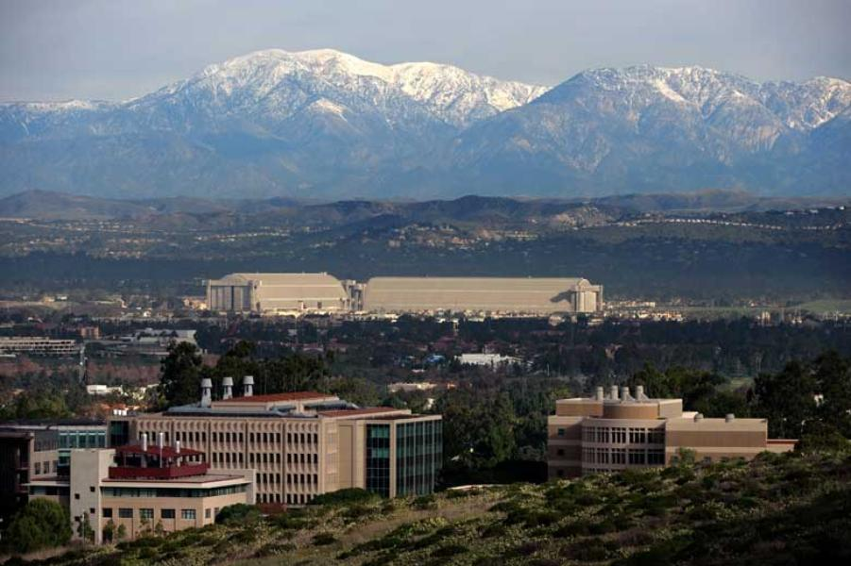
Discussion of Carvalho, Eusepi,
Moench, and Preston,
“Anchored Inflation Expectations”
Eric T. Swanson
University of California, Irvine
ASSA Meetings
Philadelphia
January 7, 2018

Slide 2
Background
Inflation was fairly low in the early 2000s
Financial Crisis in 2007-8 led to very large negative output gaps
Estimated Phillips Curves at the time predicted large declines in inflation and significant deflation
But inflation fell only a little bit, to about 1%
One explanation is that inflation expectations were very well anchored
But if inflation expectations are well anchored and ϕ is small, how did inflation move so much in the 1970s-80s?

Slide 3
What This Paper Does
Models long-term inflation expectations endogenously
Extends a standard New Keynesian model to include endogenous inflation expectations
Central bank’s inflation target is unknown by private sector
Private sector agents update estimates via a Kalman-filter type process with an endogenous gain
Provides an explanation for why inflation expectations were well anchored in 2000s but not 1970s:
Long history of stable inflation by 2008 implies a low Kalman gain

Slide 4
What This Paper Does

Slide 5
What This Paper Does

Slide 6
What This Paper Does

Slide 7
Learning Process in the Model
The learning process in the model has three features:
Feedback: strategic complementarity in firms’ price setting means unstable inflation expectations cause larger inflation fluctuations today, which causes inflation expectations to be more unstable
Decreasing gain: agents’ beliefs converge toward truth over time
Regime switching: agents switch to constant gain if forecast errors are large:

Slide 8
Learning Process in the Model

Slide 9
Learning Process in the Model

Slide 10
Learning Process in the Model

Slide 11
Comment 1: High-Frequency Evidence
Gurkaynak, Sack, Swanson (2005): bond market acts as if surprises in near-term inflation will partially pass through to long-term inflation (with some probability > 0):

Slide 12
Comment 1: High-Frequency Evidence
Gurkaynak, Sack, Swanson (2005): bond market acts as if surprises in near-term inflation will partially pass through to long-term inflation (with some probability > 0):

Slide 13
Comment 1: High-Frequency Evidence
In response to this evidence, Gurkaynak, Sack, and Swanson (2005) proposed a simple New Keynesian model in which long-term inflation expectations follow a Kalman updating process:
Like the present paper, we noted that exogenous changes in long-run inflation expectations cannot fit the data
But small values of θ ≈ .02 explain the high-frequency bond market responses very well

Slide 14
Comment 2: 2000s vs. 1970s
This is really a paper about the 2000s, not the 1970s:
In the model, 1970s was caused by “bad shocks” plus feedback effects to private-sector expectations
Central bank could solve the 1970s inflation by announcing its inflation target to public
Primiceri (2006) is a better model of the 1970s:
Central bank underestimated the natural rate of unemployment
And also underestimated the persistence of inflation
Central bank’s erroneous beliefs led to high inflation

Slide 15
Comment 3: Regime-Switching Kalman Gain
Regime-switching Kalman gain seems arbitrary
Paper also considers a continuously-varying Kalman gain
but it doesn’t work as well

Slide 16
Comment 3: Regime-Switching Kalman Gain

Slide 17
Comment 3: Regime-Switching Kalman Gain
Instead of
where
it seems like
(1 ‒ δ)
would work better

Slide 18
Summary of Comments and Suggestions
Paper provides a very nice model of anchored inflation expectations in the 2000s
Also consistent with high-frequency evidence from bond markets
Regime-switching Kalman gain seems arbitrary; a continuously-varying Kalman gain would be more appealing

