Slide 1


Discussion of
Bloom, Floetotto, Jaimovich,
“Really Uncertain Business Cycles”
Eric T. Swanson
Federal Reserve Bank of San Francisco
Conference on Inequality in a Time of Contraction
Stanford University
November 13, 2009
Note: The views expressed in this presentation are the author’s and do not necessarily reflect the views of the management of the Federal Reserve Bank of San Francisco or any other individuals within the Federal Reserve System.

Slide 2
Uncertainty and Business Cycles
Ben Bernanke (1983 QJE)
Christina Romer (1990 QJE)
John Hassler (1996 JEDC)
Nicholas Bloom (2009 Em)
Delay in Inv,
Durable C
Uncertainty
Recession

Slide 3
Uncertainty Shocks
The Model:

Slide 4
Uncertainty Shocks
The Model:

Slide 5
Figure 10b: GARCH(1,1) for TFP

Slide 6
Figure 11: Stock Market Volatility
realized volatility
implied volatility

Slide 7
Figure 3: Cross-establishment output growth spread, within individual firms

Slide 8
Heterogeneity vs. Uncertainty

Slide 9
Figure 3: Cross-establishment output growth spread, within individual firms

Slide 10
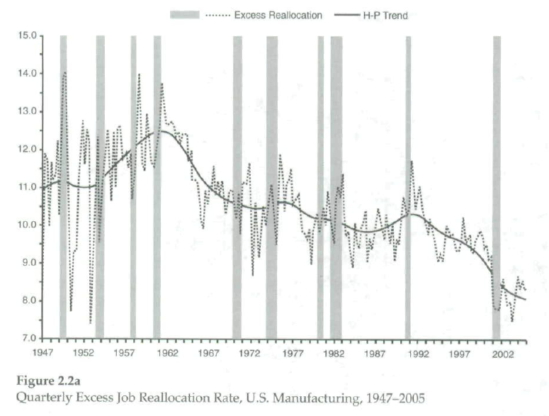
Davis, Haltiwanger, Jarmin, Miranda (2006)

Slide 11
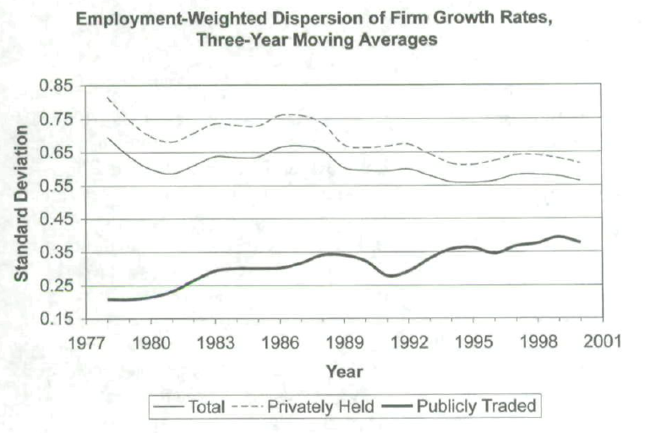
Davis, Haltiwanger, Jarmin, Miranda (2006)

Slide 12
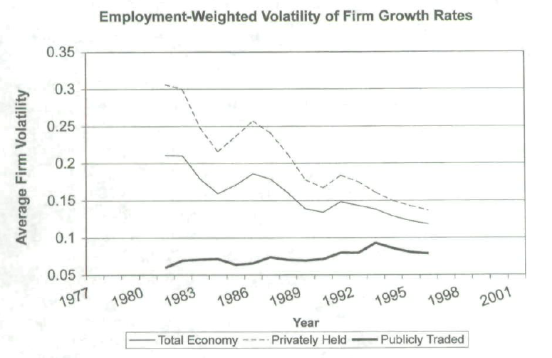
Davis, Haltiwanger, Jarmin, Miranda (2006)

Slide 13
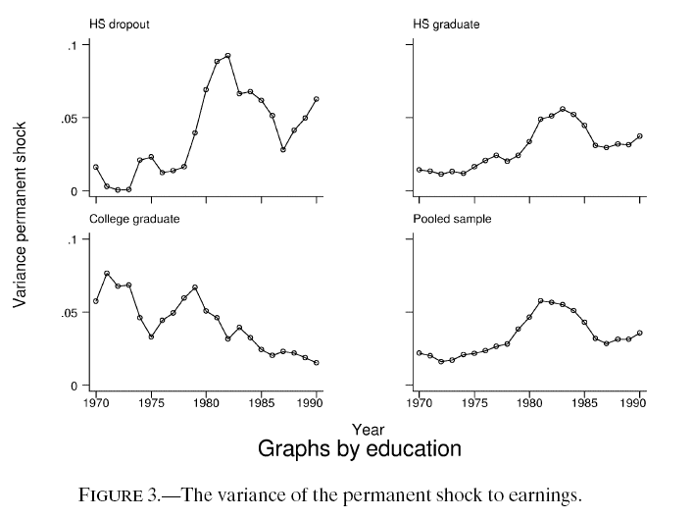
Meghir and Pistaferri (2004)

Slide 14
Meghir and Pistaferri (2004)
“The counter-cyclicality of income uncertainty has been advocated by those who propose a resolution of the equity premium puzzle based on the negative correlation between aggregate shocks and individual risk (Mankiw (1986)). We find mixed support for this.”
p. 10

Slide 15
Implied Volatility: Stocks

Slide 16
Realized Volatility: Stocks

Slide 17
Implied Volatility: Bonds

Slide 18
Realized Volatility: Bonds

Slide 19
Implied Volatility: Federal Funds Rate

Slide 20
Realized Volatility: Short-Term Rates

Slide 21
Realized Volatility: Oil Prices

Slide 22
Exogenous vs. Endogenous Uncertainty
Exogenous uncertainty:
Endogenous uncertainty:

Slide 23
Quantity vs. Price of Uncertainty/Risk
Bloom (2009): risk-neutral firms
This paper: firms evaluate investment using SDF
Risk premium = Quantity of risk × Price of risk
So the price of risk is as important as the quantity of risk in this paper.
Another reason to focus on financial market data

Slide 24
Summary of Comments & Suggestions
De-emphasize cross-sectional measures of dispersion
Emphasize GARCH, financial measures of uncertainty
Emphasize model
Confront issue of endogenous vs. exogenous uncertainty

Slide 25
Uncertainty Shocks
“Back in June 2008 I wrote a piece for VOXEU predicting a mild recession in 2009. Over the last few weeks the situation has become far worse, and I believe even these pessimistic predictions were too optimistic. I now believe Europe and the US will sink into a severe recession next year, with GDP contracting by 3% in 2009 and unemployment rising by about 3 million in both Europe and the US. This would be the worst recession since 1974/75.”
Nick Bloom, October 2008, VoxEU

