Slide 1
Presentation and Discussion of
Gagnon, Raskin, Remasche, and Sack,
“The Financial Market Effects of the Federal Reserve’s Large-Scale Asset Purchases”
Eric T. Swanson
Federal Reserve Bank of San Francisco
AEA Meetings, Denver
January 8, 2011
The views expressed in this presentation are the author’s and do not necessarily reflect the views of the manage-ment of the Federal Reserve Bank of San Francisco or any other individuals within the Federal Reserve System.

Slide 2
Gagnon et al.: Overview
Paper discusses 2008-2009 LSAPs in four parts:
Theoretical Motivation
Implementation Details
Event Study Analysis
Time Series Analysis

Slide 3
Gagnon et al: Theoretical Motivation
Tobin (1958): “Portfolio Balance” model
Modigliani and Sutch (1966): “Preferred Habitat” model
Idea:
Heterogeneous investors have different preferred habitats
Arbitrage is limited (risk aversion, capital constraints)
Decreasing supply of a security raises its price (reduces risk premium)
More recently:
Greenwood and Vayanos (2008), Vayanos and Vila (2009)

Slide 4
Gagnon et al.: Presentation Slides
Show selected Gagnon et al. presentation slides…

Slide 5
Gagnon et al: Four Comments (Caveats)
Event study analysis of QE1 is problematic: a lot going on; hard to isolate effects of announcements
Effects of Fed purchases during QE1 may not be representative of more normal times, QE2
Operation Twist was big, but did not have big effects
Think of Gagnon et al.’s estimates as an upper bound

Slide 6
Event Study Analysis of QE1 Is Problematic

Slide 7
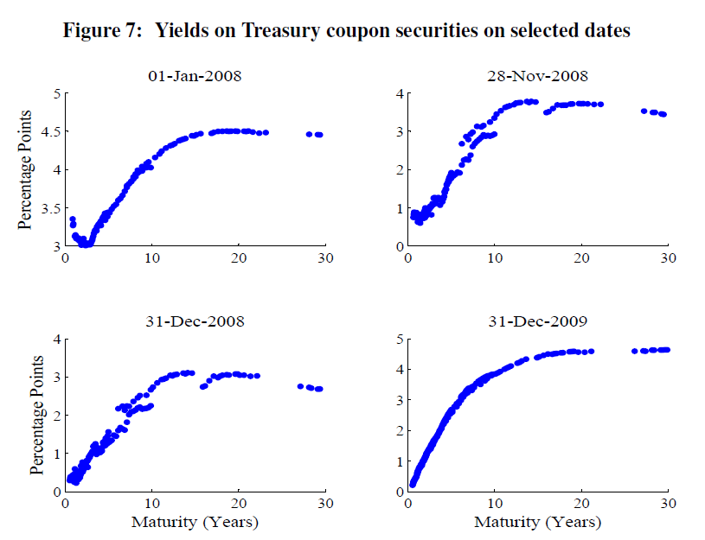
Markets in Fall 2008 Are Not Representative
source: Gurkaynak and Wright (2011)

Slide 8
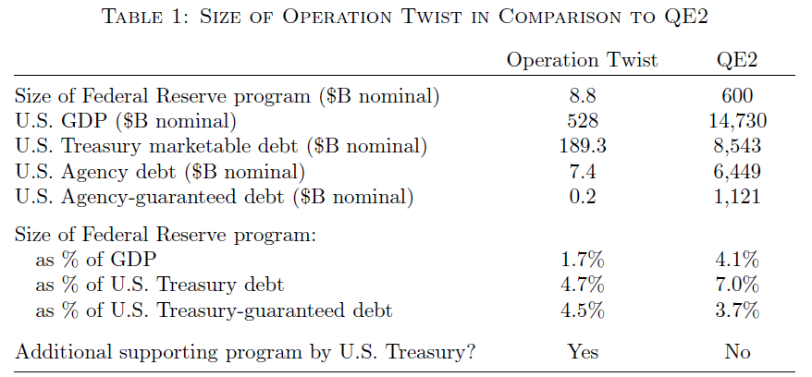
Operation Twist Was Big
source: Swanson (2011)

Slide 9
Operation Twist: Background
January 1961:
JFK just inaugurated
Recession (want to lower interest rates)
But European interest rates higher than in U.S., large gold outflows under Bretton Woods system
Solution:
Lower long-term interest rates but keep short-term rates unchanged
Fed would sell short-term Treasury bills and buy longer-term bonds
Treasury would issue more short-term bills and fewer long-term bonds.

Slide 10
Operation Twist vs. QE2
Operation Twist
QE2
Large gold outflows prevent Fed from lowering funds rate
Zero lower bound prevents Fed from lowering funds rate
Buy long-term Treasury securities
Buy long-term Treasury securities
Issue bank reserves (short-term Fed liabilities)
Sell/issue short-term Treasury bills

Slide 11
Operation Twist: Event Study Approach
Re-examine Operation Twist using modern event study
Modigliani and Sutch (1966,1967) used quarterly time series, concluded “effects most unlikely to exceed 10 to 20 bp”
Advantages of event study approach:
Other factors affecting macroeconomic outlook held constant
Standard errors are smaller
Avoids endogeneity problems
Advantages of Operation Twist period:
No financial crisis
Foreign official purchases were tiny

Slide 12
Operation Twist: Event Study Dates
source: Swanson (2011)

Slide 13
Operation Twist: Results
source: Swanson (2011)

Slide 14
Operation Twist: Comparison to the Literature
Predicted effect of QE2 on long-term yields
Study
Gagnon et al. (2010)
D’Amico-King (2010)
Hamilton-Wu (2010)
Greenwood-Vayanos (2008)
Krishnamurthy-
Vissing-Jorgensen (2007)
Warnock-Warnock (2009)
14 to 30 bp
100 bp
17 bp
10 to 16 bp
N/A (6 to 16 bp)
N/A (76 bp)

Slide 15
Conclusions
Operation Twist was remarkably similar to QE2
High-frequency event-study analysis finds Operation Twist decreased long-term Treasury yields by about 15bp
Consistent with lower end of range of estimates of Treasury supply effects in the literature
Note: 15bp decline in 10-yr Treasury yield is typical response to 100bp surprise cut in federal funds rate
For more details, see Swanson (2011):
“Let’s Twist Again: A High-Frequency Event-Study Analysis of Operation Twist and Its Implications for QE2”
http://www.ericswanson.org

