Slide 1
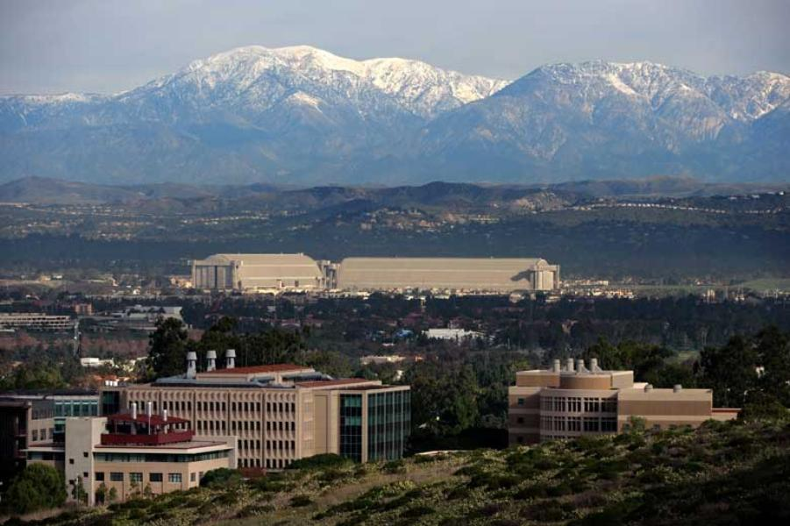
Discussion of Stavrakeva and Tang,
“The Dollar During the Great Recession:
US Monetary Policy Signaling and the Flight to Safety”
Eric T. Swanson
University of California, Irvine
CEBRA IFM Conference
Sveriges Riksbank (online)
October 1, 2020

Slide 2
Overview
Summary of Paper:
Empirical fact: puzzling exchange rate behavior from 2008:Q4 – 2012:Q2
Signaling (“Fed Information Effect”) model explains the empirical puzzle
Preview of My Comments:
Question the empirical fact:
Only present in low-frequency regressions
“Great Recession” sample is somewhat arbitrary
Provide an alternate explanation:
“Fed Response to News” channel (Bauer and Swanson, 2020)

Slide 3
Comment #1: Empirical Fact Only Present at Low Frequency
S-T regression specification is for quarterly exchange rate changes:
results:
puzzle

Slide 4
Comment #1: Empirical Fact Only Present at Low Frequency
High-frequency regression results from Swanson (2020):

Slide 5
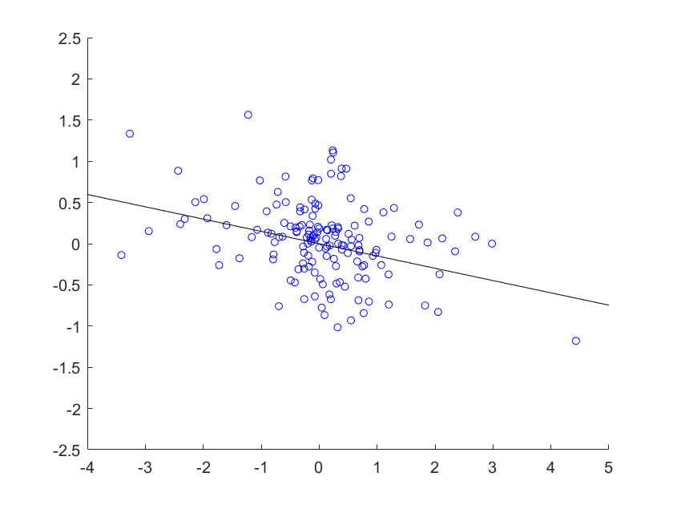
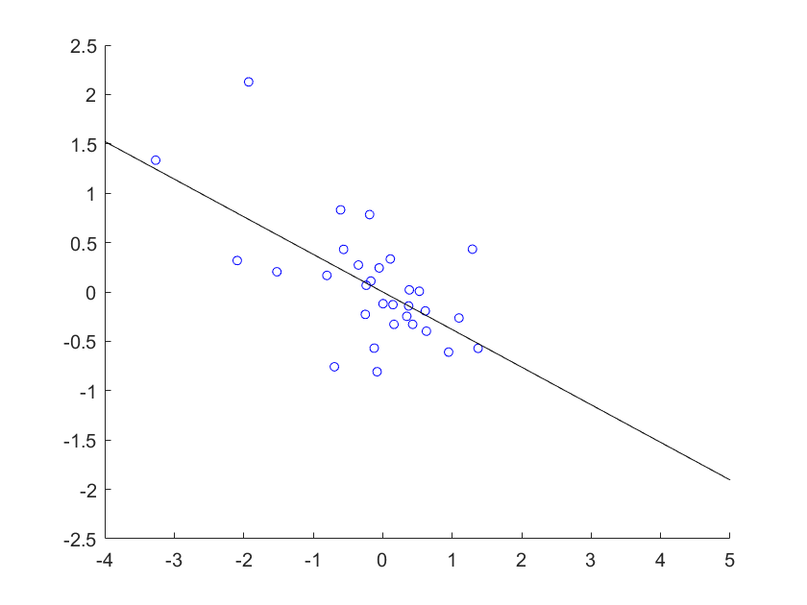
Comment #1: Empirical Fact Only Present at Low Frequency
High-frequency scatter plot for FOMC announcements, 2008Q4 – 2012Q2:
Effect of Forward Guidance on $/euro Exchange Rate
June 1991 – Sep. 2008
Oct. 2008 – June 2012

Slide 6
Comment #2: “Great Recession” Sample Is Somewhat Arbitrary
In Stavrakeva-Tang, “Great Recession” sample is 2008:Q4 – 2012:Q2
Chosen to maximize fit (e.g., Bai-Perron, 1998)
But:
NBER: Dec. 2007 – June 2009
ZLB period: Jan. 2009 – Nov. 2015
S-T sample choice is not necessarily wrong, but keep in mind:
the sample maximizes the empirical puzzle, by construction
the empirical puzzle does not exist in high-frequency data

Slide 7
Comment #3: Alternate Explanation for the Empirical Puzzle
Instead of a “Fed Information Effect”,
Bauer-Swanson (2020) present evidence of “Fed Response to News” channel

Slide 8
Comment #3: Alternate Explanation for the Empirical Puzzle
Fed sets interest rates according to policy rule:
If financial markets don’t know Fed’s policy rule f, then economic data will be correlated with interest rate surprises, even high-frequency surprises
High-frequency monetary policy surprises can be due to:
monetary policy shock ε
information about X
information about f

Slide 9
Comment #3: Alternate Explanation for the Empirical Puzzle
In fact, economic news predicts high-frequency monetary policy surprises:
source: Bauer-Swanson (2020), but see also Miranda-Agrippino (2017), Cieslak (2018), Miranda-Agrippino-Ricco (2020), Karnaukh (2019).

Slide 10
Comment #3: Alternate Explanation for the Empirical Puzzle
Economic news predicts high-frequency monetary policy surprises:
Then high-frequency IV approach in Stavrakeva-Tang is invalid:
instruments are correlated with economic news each quarter
economic news causes both the monetary policy surprise and exchange rate change

Slide 11
Comment #3: Alternate Explanation for the Empirical Puzzle
See Bauer-Swanson (2020) for extensive evidence against Fed Information Effect and in favor of Fed Response to News channel:
Including omitted economic news in standard Fed Information Effect regressions drives out the Fed Information Effect
Direct survey of Blue Chip forecasters contradicts Fed Information Effect
High-frequency stock market responses to FOMC announcements are strongly negative
Blue Chip and Fed Greenbook forecasts of economy are very similar
Extensive discussion and a model of Fed Response to News channel

Slide 12
Comment #3: Alternate Explanation for the Empirical Puzzle
Fed Response to News explanation:
A lot of economic news in 2008:Q4 – 2012:Q2
Fed and exchange rates both responded strongly to that news
Bad news caused Fed to ease, dollar to appreciate (and vice versa)

Slide 13
Comment #3: Alternate Explanation for the Empirical Puzzle
Fed Response to News explanation:
Economic news in U.S. has opposite effects on hedging vs. non-hedging currencies

Slide 14
Summary of My Comments
Question the empirical fact:
Only present in low-frequency regressions
“Great Recession” sample is somewhat arbitrary
Provide an alternate explanation:
“Fed response to news channel” (Bauer and Swanson, 2020)

