Slide 1
Psych 56L/ Ling 51:
Acquisition of Language
Lecture 5
Biological Bases of Language III
Notes:
1

Slide 2
Announcements
Be working on review questions for biological bases of language
Be working on HW1 (due: 1/24/13)
- Electronic submission due by the end of class (1:50pm) to receive full credit.
- Remember to include the name of everyone who worked on the assignment, and to submit only a single copy of the assignment per group.
Notes:
2

Slide 3

Language and Other Species
Notes:
3

Slide 4
Language and Other Species
Are we special among the animal species?
What are other species capable of?
Notes:
4

Slide 5
Communication Systems
Human language does enable communication, but it has several features that separate it from other animal communication systems:
reference: symbols stand for things (even abstract things) in the world
syntax: productive system for combining symbols to express new meanings
intentionality: speakers use language for the purpose of communicating with others
Notes:
5

Slide 6
Human Language vs. “Animal Language”
Is the difference between an animal communication system and human language just a matter of degree (a quantitative difference)?
or
Is there a sense in which human language is qualitatively different from the other communication systems?

Slide 7
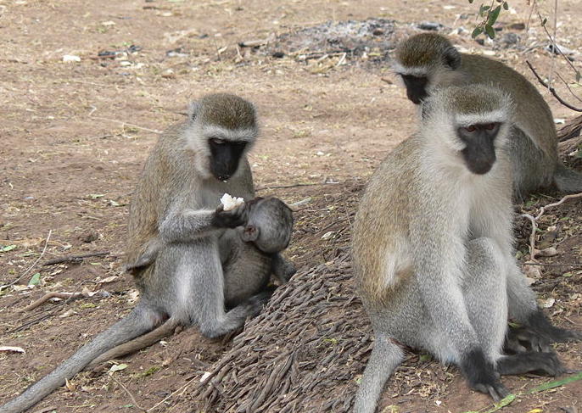
Primate Communication
Vervet monkeys
Seem to have intentionality – do this to inform other vervet monkeys.
Predator alarm calls:
“leopard” = run to the trees
“eagle” = look up, run into the bushes
“snake” = stand up on hind legs & look around
Notes:
7

Slide 8
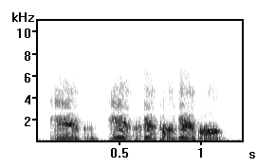
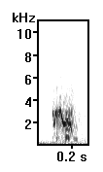

Primate Communication
Vervet monkeys
Male (KN)
Female (LO)

Slide 9
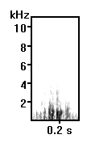
Primate Communication
Vervet monkeys
Female (BA)
Vervet ‘Eagle’ Alarm Call

Slide 10
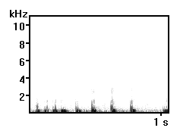

Primate Communication
Vervet monkeys
Male (KN)
Female (LB)
Vervet ‘Snake’ Alarm Call

Slide 11
Primate Communication
Vervet monkeys
However…no evidence for complex combinatorial system.
Unclear if system has reference – are these calls really symbols for “eagle”, “snake”, and “leopard”? Or are they more like “Head for the grass!” and “Look around your feet!” Or something else?

Slide 12
Primate Communication
Vervet monkeys
What they can’t say:
“What a large eagle up in the sky over there! We’d better take cover. C’mon!”
“I doubt there are any leopards around here. The field looks pretty clear.”
“Did you see that whopping big snake yesterday? It was so scary!”
Notes:
12

Slide 13
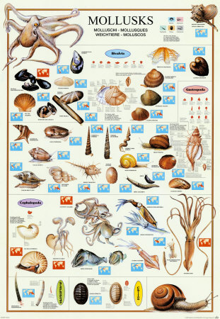
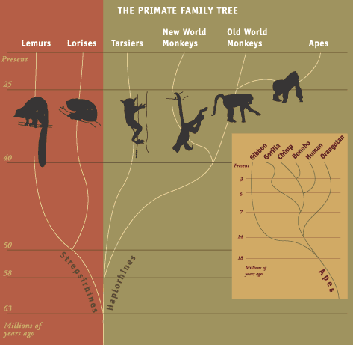
Mollusks vs. Primates
Notes:
13
http://www.sciencentral.com/articles/pop11.php3?video=quicktime&video_id=[stn2img:2024398:stn2img]&date10=02.13.06&article_id=218392737%20target=

Slide 14
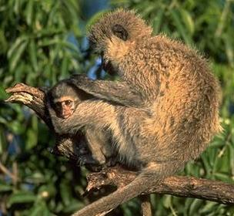
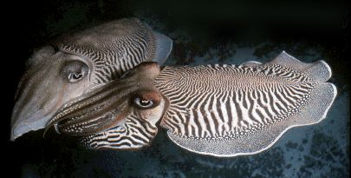
Mollusks vs. Primates
Primates likely have:
More complex bodies and brains
Better learning and problem solving skills
More complex social structures
More complex and flexible behavior
Longer lives
Notes:
14

Slide 15
After 450 million years…
Mollusks vs. Primates
Cephelopods:
15-35 distinct displays
Non-human primates:
15-35 distinct displays
Adapted from Liberman
http://www.thecephalopodpage.org/cephschool/WhyCephalopodsChangeColor.pdf
Notes:
15
http://www.thecephalopodpage.org/cephschool/WhyCephalopodsChangeColor.pdf
We think of ourselves as being the pinnacle of development, the most perfect of earth's creatures. As Alexander Pope put it in his Essay on Man,
Far as creation's ample range extends,
The scale of sensual, mental pow'rs ascends:
Mark how it mounts to man's imperial race,
From the green myriads in the peopled grass:
...
Remembrance and reflection how ally'd;
What thin partitions sense from thought divide?
And middle natures, how they long to join,
Yet never pass th' insuperable line!
Without this just gradation, could they be
Subjected, these to those, or all to thee?
...
Vast chain of being! which from God began,
Natures aethereal, human, angel, man,
Beast, bird, fish, insect, what no eye can see,
No glass can reach; from infinite to thee,
From thee to nothing. We tend to view the quirks and peculiarities of our species as The Right Thing to Do, and assume that if other species don't do the same, it's because they just haven't evolved to our level. Surely our most complex and perfected language must be what all other species aspire to "in just gradation," mounting a scale of communicative complexity from worms to insects to fish to birds to mammals to us.

Slide 16
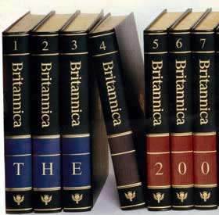
Not just mollusks and non-human primates
“For most relatively social adult fishes, birds and mammals, the range or repertoire size [of communicative displays] for different species varies from 15 to 35 displays.”
-Encyclopedia Britannica,
“Animal Communication”
Notes:
16

Slide 17


Human Vocabulary
Wordsmith Shakespeare
estimated to have 30,000 words
Average educated person: 15,000 words
http://www.rhymezone.com/g/shakespeare/coinages/
http://plato.stanford.edu/entries/types-tokens/

Slide 18
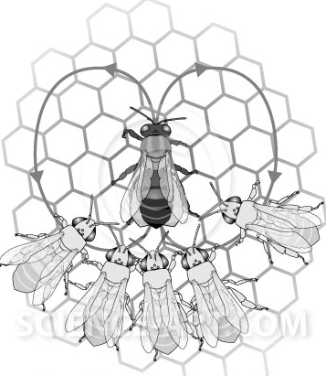
Bee Communication
Honey Bees
Dance to communicate the location of food (nectar)
Can indicate: nearby vs. far, direction, richness of the food source (dance harder for the good stuff)
Though bees can create novel messages, they’re always about the location of food.
Notes:
18

Slide 19
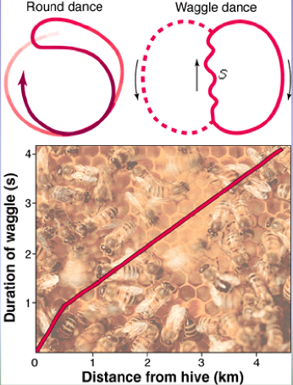
Bee Communication
Under 50m away
The angle from the sun indicates direction of food source. The duration of the waggle part of the dance signifies the distance. Approximately 1 second of dance = 1 km distance.
Over 50m away:
encodes distance & direction - is encoding of 2D space (a bee’s “mental map”)
http://www.youtube.com/watch?v=-7ijI-g4jHg
‘deciphered’ by Karl von Frisch, 1919 & onward
Notes:
19

Slide 20
Bee Communication
Has reference? Maybe – indicating properties of nectar. (But that’s all they ever communicate about with this method – no new symbols are created.)
Has syntax? Not really – but has rudimentary combinatorial properties (what direction, how far, how much).
Has intentionality? Definitely – waggling for other bees.

Slide 21
Bee Communication
Honey Bees
What bees can’t communicate:
“Have you seen the flowers in the next field over? They totally rock. I’ve never seen such brilliant colors.”
“I thought the hive was really crowded yesterday.”
Notes:
21

Slide 22
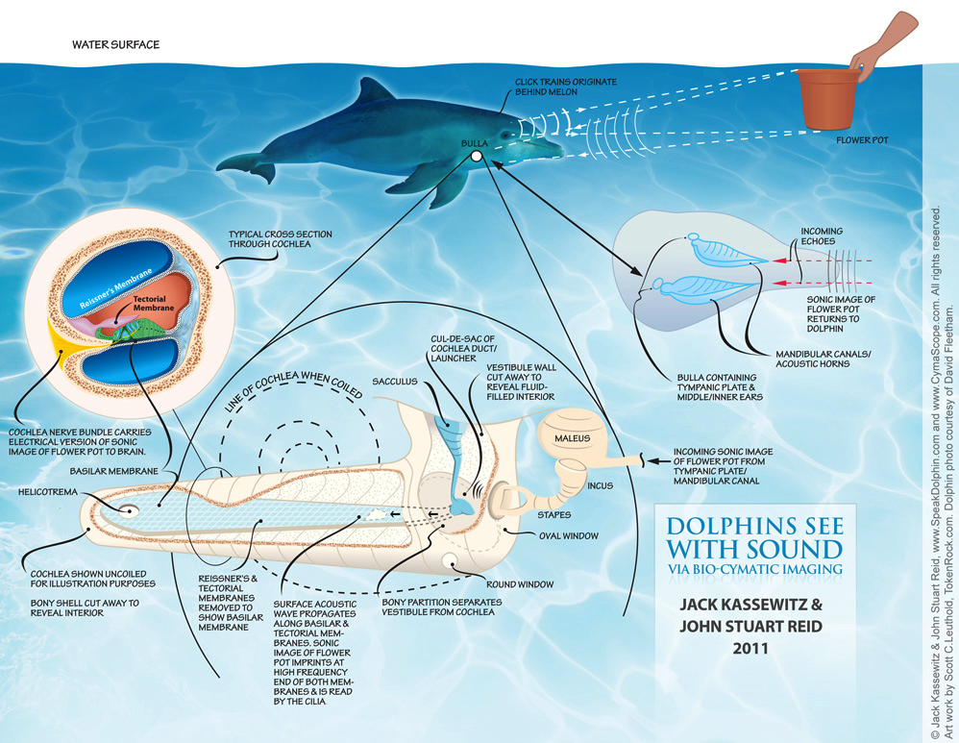
Dolphin Communication
Dolphins
Kassewitz & Stuart Reid (2011): Dolphins use
“Sono-Pictorial Exo-holographic Language”, (SPEL)
Evidence that dolphins can communicate about novel objects in their environment via the patterns that echolocation makes when pinging off the objects.
Certainly intentional, and likely referential. Unclear if syntax is present.

Slide 23
Dolphin Communication
Dolphins
Unclear if they have a complex combinatorial system (syntax)
Can a dolphin communicate this?
“I wish there were some more tasty fish around.”
“Those humans are soooo annoying sometimes.”

Slide 24
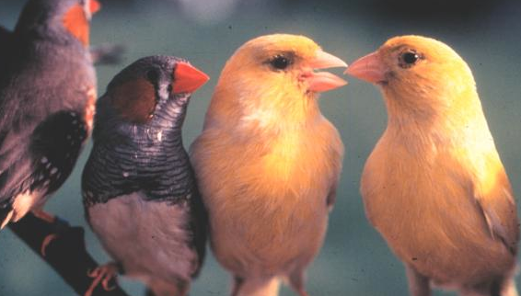
Bird Communication
Songbirds
Males use songs to attract and acquire mates (fairly clear intentionality). In many species, the development of the song requires exposure to adult birds who model the song.
Notes:
24

Slide 25

Bird Communication
Songbirds
Note: even though there is a learned part and a genetic part, we still classify birdsong as an instinct.
Notes:
25

Slide 26
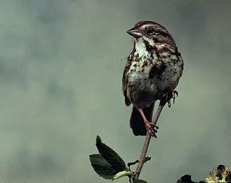
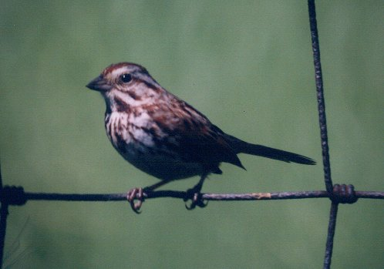
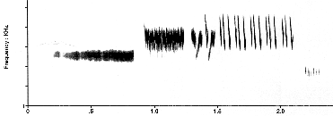
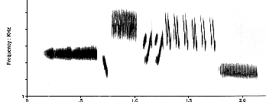
Bird Communication
Sparrow Song
song call
student
Song is highly structured (combinatorial system) - notes, syllables, phrases
teacher
Notes:
26

Slide 27
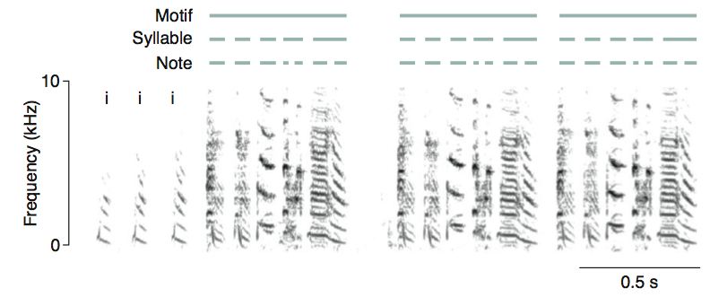
Bird Communication: Hierarchical Structure
Zebra Finch Song
“Sound spectrogram of a typical zebra finch song depicting a hierarchical structure. Songs often start with ‘introductory notes’ (denoted by ‘i’) that are followed by one or more ‘motifs’, which are repeated sequences of syllables. A ‘syllable’ is an uninterrupted sound, which consists of one or more coherent time-frequency traces, which are called ‘notes’. A continuous rendition of several motifs is referred to as a ‘song bout’.” – Berwick et al. 2012

Slide 28
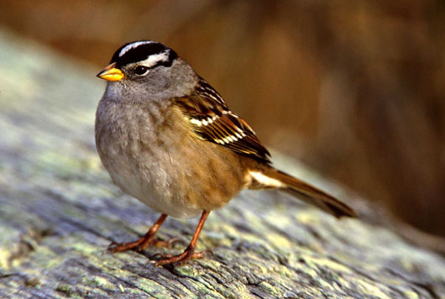
Birdsong
Songs are learned
  Regional dialects
Learning, however, is innately guided (Marler, 1990)
  Many species of sparrows prefer to learn the songs of their own species
  And if they are only exposed to other species’ songs, they follow species-specific structure
  Learning is subjected to a sensitive period (must be learned within a time period)

Slide 29
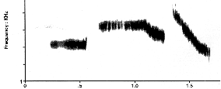
White-crown sparrow song
White-crown sparrow #1 in isolation
White-crown sparrow #2 w/ tutor
White-crown sparrow’s tutor

Slide 30
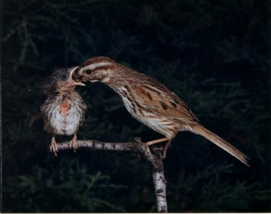
Bird Communication
Variation in Song
Bird 1
Bird 2
Notes:
30

Slide 31
Bird Communication vs Human Language
There are several similarities between language acquisition in humans and song acquisition in songbirds. Both human language and birdsong:
(1) have early stages prior to the appearance of the adult form (babbling vs. subsong)
(2) require the babies to be able to hear their own productions
(3) have sensitive periods (between 7 and 60 days old for birds)
(4) are lateralized in the left hemisphere
Notes:
31

Slide 32
Bird Communication vs Human Language
However, there are also some crucial differences (see Berwick et al. 2012 for a more thorough discussion of this):
Birdsong seems to lack flexible semantics. (Like the bee dance, birdsong is only ever about one thing. No novel meanings.)
Birdsong seems to lack individual words. (Is a particular note sequence a symbol for something? What does it refer to? It’s unclear.)

Slide 33
Bird Communication vs Human Language
However, there are also some crucial differences (see Berwick et al. 2012 for a more thorough discussion of this):
(3) The complexity of the combinatorial system seems less complex in birdsong. While human language has phonemes that make syllables that make words that make phrases that make sentences, birdsong seems to stop at the “word” level (~motif).

Slide 34
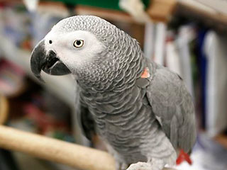
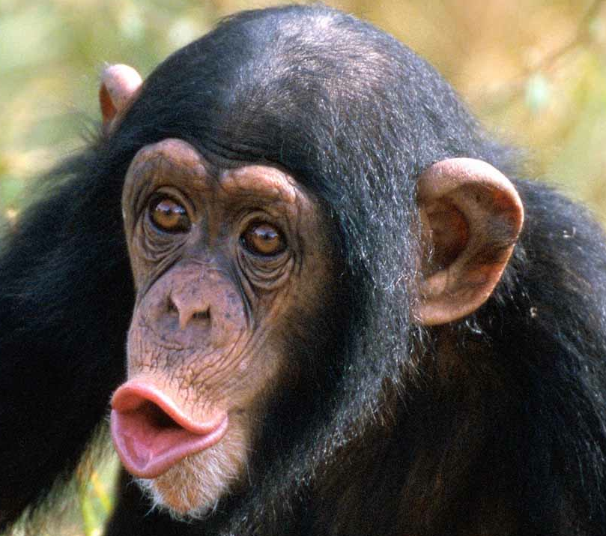

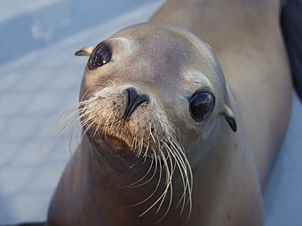
Learning Human Language
Just because other animals’ communication systems aren’t as complex as human language, does that mean that they’re incapable of learning human language (reference, syntax, intentional communication)?
Notes:
34

Slide 35
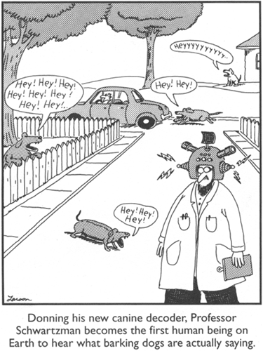
Non-Primates

Slide 36
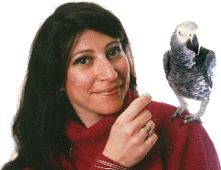
Alex the Parrot
Grey parrot, born 1976, died 2007
Trained by Dr Irene Pepperberg (U. Arizona) since 1977
Impressive ability to speak/understand
…for a parrot
http://www.youtube.com/watch?v=7yGOgs_UlEc
Notes:
36

Slide 37
Alex’s language
Speech sounded remarkably accurate
…produced very differently from humans
Knew names of about 150 objects plus some fixed expressions
Answered simple questions about objects (e.g. about size, color, material)
Required immense amounts of training
Notes:
37

Slide 38
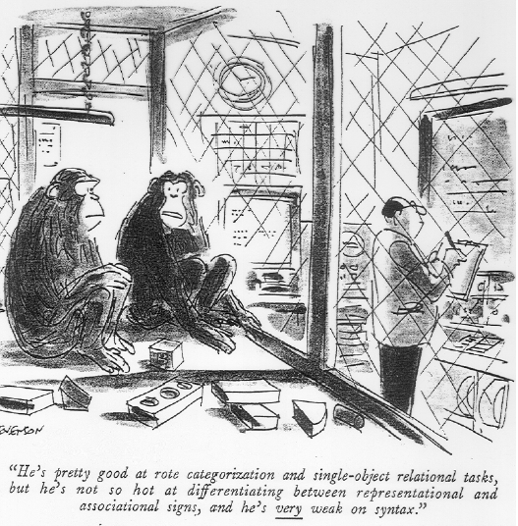
Non-human primates
“He’s pretty good at rote categorization and single-object relational tasks, but he’s not so hot at differentiating between representational and associational signs, and he’s very weak on syntax.”

Slide 39
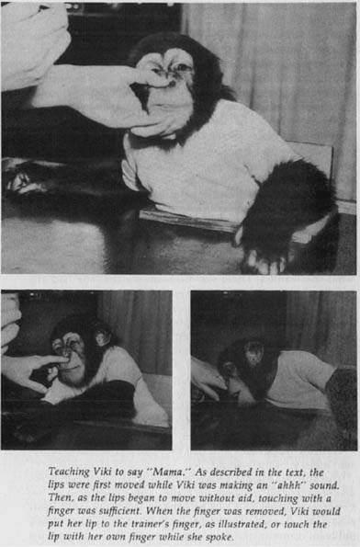
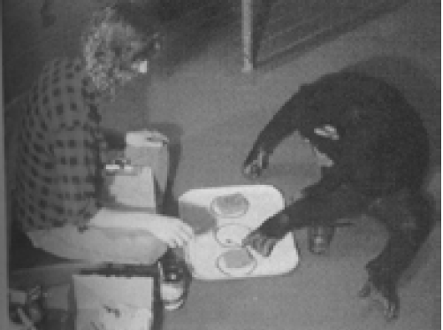
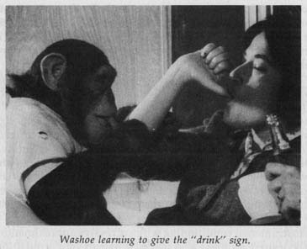
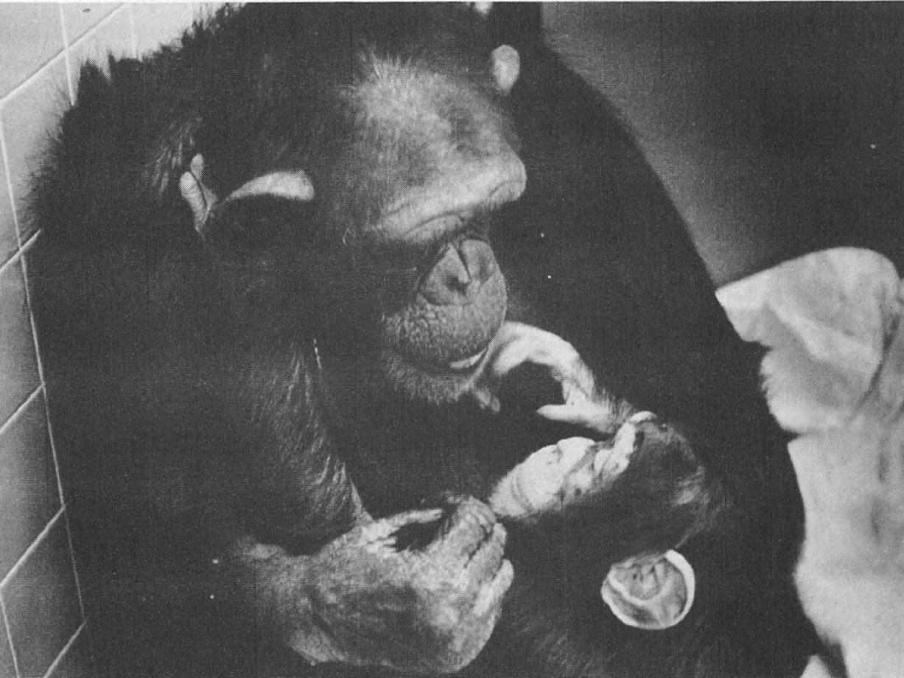
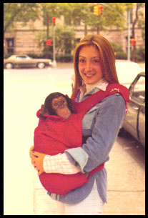
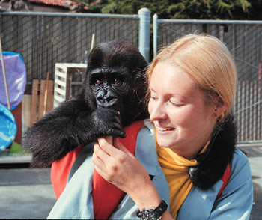
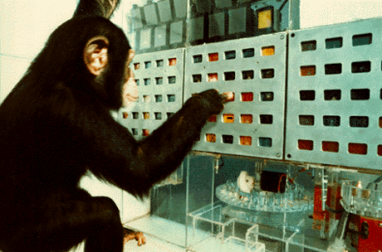
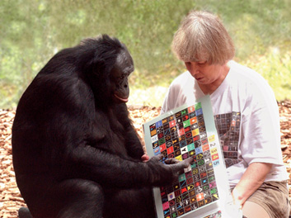
Non-human primates
sarah & co.
washoe
washoe & louslis
vicki
Koko
nim chimsky
lana & co.
kanzi & co.

Slide 40
Teaching chimpanzees
Teaching chimpanzees to speak didn’t work out very well
1930s: Gua, raised in a human home and treated like human infant along with the couple’s son
- motor skills surpassed child’s, but never learned to speak (while the child did)
1940s and 50s: Viki, raised in a human home and actively taught to produce words
- by 6, Viki could say “mama”, “papa”, “cup”, and “up”
Problem: Chimpanzees have a vocal tract that makes speech production essentially impossible.
Notes:
40

Slide 41
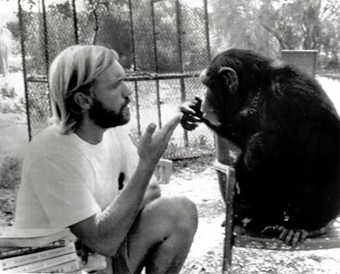
Teaching chimpanzees
Teaching chimps to sign using ASL
1960s: Washoe, lived in trailer in backyard, people always communicated via ASL, taught by molding hands into the appropriate signs
June 1965: born
1-yr-old: Begins training
2-yrs-old: 13 signs
3-yrs-old: 34 signs
4-yrs-old: 85 signs
5-yrs-old: 132 signs
27-yrs-old: 240 signs
Findings (though controversial)
New extensions
  e.g., “dirty”, “red”
New word combination & syntax
  e.g., “water bird”, “baby in my drink.”
Transmitted 50 signs to Louslis (adopted son).
Notes:
41

Slide 42
Teaching chimpanzees
Teaching chimps to sign using ASL
1979: Nim Chimpsky, raised in private home, taught signs by having hands molded into them
- learned 100 signs and produced some combinations
But combinations produced are very different from those of a human child - very repetitive, no additional complexity:
2-sign 3-sign 4-sign
“eat drink” “eat me Nim” “eat drink eat drink”
“tickle me” “me Nim eat” “play me Nim play”
Notes:
42

Slide 43
Teaching chimpanzees
Teaching chimps to sign using ASL
1979: Nim Chimpsky, raised in private home, taught signs by having hands molded into them
- learned 100 signs and produced some combinations
A quantitative analysis of combinatorial ability (called productivity) from Yang (2012) also demonstrates that Nim’s productions are not compatible with a combinatorial system. Instead, they are much more likely to be imitations of whole chunks from the surrounding input. This is corroborated by reports of how Nim’s sign combinations originated: All of them were imitations of his teachers - no novel combinations, unlike human children.

Slide 44
Teaching chimpanzees
Teaching chimps to sign using ASL
Nim’s longest utterance: “give orange me give eat orange me eat orange give me eat orange give me you”
Notes:
44

Slide 45
Teaching chimpanzees
Teaching chimps to sign using ASL
No symbolic reference:
“For Nim, meaning seemed to have no role outside of the specific association between a form and its referent that had been explicitly taught to him….for Nim, signs did not refer; he did not have words - signs, or names - for things.” - Laura Petitto, one of Nim’s teachers, 1988

Slide 46
Conversations with Koko
Moderator: Koko are you going to have a baby in the future?
Koko: Pink.
Dr. Patterson: We’ve had earlier discussion about colors today.
Koko: Listen! Koko loves eat.
….
Moderator: What are the names of your kittens? (and dogs?)
Koko: foot
Dr. Patterson: Foot isn’t the name of your kitty.
Moderator: Koko, what’s the name of your cat?
Koko: no
....
Moderator: Do you like to chat with other people?
Koko: fine nipple
Dr. Patterson: Nipple rhymes with people, she doesn’t sign people per se, she was trying to do a “sounds like …”

Slide 47
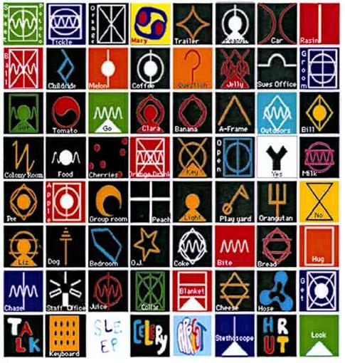
Lana & friends
The Lana Project (or LANguage Analog) established in 1971.
Yerkish: Artificial language
LEXIGRAMS
(1) http://www.greatapetrust.org/science/history-of-ape-language/interactive-lexigram/
(2) http://www.greatapetrust.org/science/history-of-ape-language/
(3) http://www.greatapetrust.org/science/history-of-ape-language/use-of-human-languages-by-captive-great-apes/#videoGalleryTab

Slide 48
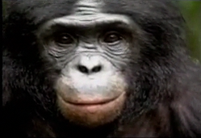
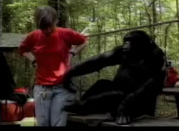
Teaching bonobos
http://video.ted.com/talks/podcast/SusanSavageRumbaugh_2004.mp4
Total length = 17:25, look at 2:32 - 7:32 especially

Slide 49
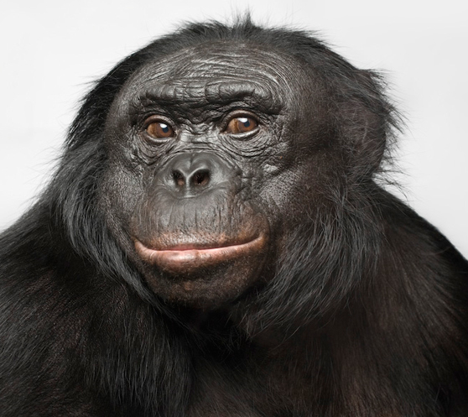
Teaching bonobos
Bonobos (pygmy chimpanzees) vocalize in communication more frequently than common chimps do.
1981: adult bonobo Matata instructed with an artificial language and utterly failed
However, her infant bonobo Kanzi - who wasn’t explicitly instructed in anything, but accompanied his mother when she was instructed - learned the artificial language and was also able to understand some spoken English (presumably because he was within the critical/sensitive period).
http://www.youtube.com/watch?v=wRM7vTrIIis (Lexigrams)
http://www.youtube.com/watch?v=LxmbjLoUnhk (Spoken Language)
http://www.youtube.com/watch?v=2Dhc2zePJFE (Novel Sentences)
Notes:
49

Slide 50
Teaching bonobos
Did Kanzi have reference? Unclear.
“strawberry” = “I want to go to the place where strawberries are found”, “I want a strawberry to eat”, “There’s a picture of strawberries”, …
Kanzi’s spoken English: comparable to a 2-yr-old child’s performance (but a 2-yr-old’s syntactic knowledge is fairly limited)
Also, Kanzi was 8 years old when he was tested, and was unlikely to improve his performance any further with age….unlike human children.
Notes:
50

Slide 51
Some interim conclusions about animal communication
Small vocabularies
Little evidence of grammar
Little evidence of productive or innovative language
Maybe some evidence of displaced reference (referring to something that’s not there right now)
Maybe some transmission of language to next generation

Slide 52

Some Linguists’ Concluding Remarks
I do not believe that there has ever been an example anywhere of a nonhuman expressing an opinion, or asking a question. Not ever,” says Geoffrey Pullum, a linguist at the University of California at Santa Cruz. “It would be wonderful if animals could say things about the world, as opposed to just signaling a direct emotional state or need. But they just don’t.”
Source: http://www.smithsonianmagazine.com/issues/2006/november/speakingbonobo.php

Slide 53
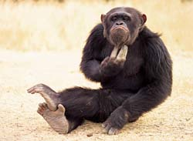
So what’s the problem?
Not a lack of intelligence - chimpanzees are highly intelligent.
One answer: language is an expression of a domain-specific mental faculty that humans have and other primates do not (nativist: generativist).
Specific abilities: syntax & referential semantics
Another answer: language must be learned through social interaction with others, and chimpanzees’ ability to learn from others is limited - they can’t seem to collaborate
Notes:
53

Slide 54
A more detailed look at the nativist idea
Hauser, Chomsky, & Fitch 2002:
Faculty of Language – Broad (FLB): biological capacity for acquiring language that humans have and other animals don’t. However, much of the biological capacity is assumed to derive from shared origins with animal communication.
Ex: Parts of the human conceptual system such as causal, spatial, and social reasoning are shared with other primates (Buttelman et al. 2007)
Difference between humans and animals is assumed to be more about “quantity” – humans have more power to drive these abilities than other animals, but the fundamental ability is basically the same.

Slide 55
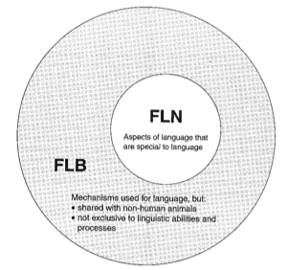
A more detailed look at the nativist idea
Hauser, Chomsky, & Fitch 2002:
Faculty of Language – Narrow (FLN): A subset of FLB abilities that only humans have. Biological underpinnings not shared with other animals. A difference of “quality” not just “quantity”.
Pinker & Jackendoff (2005): properties of speech perception, speech production, words (as referential), grammar, complex conceptual understanding that requires words (ex: week, 10 feet from the blue wall, half past five next Tuesday)

Slide 56
Recap: Animal Communication
While animal communication systems may share some properties of human language, none currently seem to be as complex as human language.
When other animals try to learn human language, they are much slower and do not achieve a level of competency that a human child does.
This suggests that there is something special about human language. Some ideas about why suggest that there are aspects that are unique to human biology which make this possible.

Slide 57
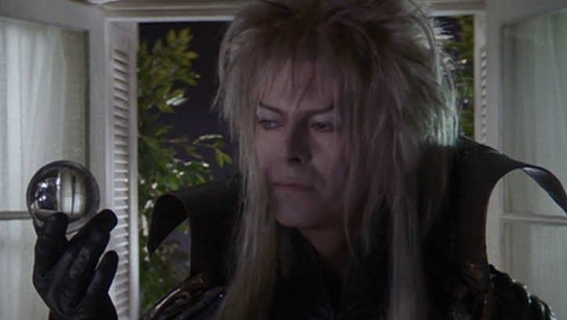
Questions?
Remember: HW1 is due Thursday, and you should be able to do all of it now.
You should also be able to do all of the review questions for biological bases of language.
Notes:
57

