Slide 1
Psych 56L/ Ling 51: Acquisition of Language
Lecture 4
Biological Bases of Language II
Notes:
1

Slide 2
Announcements
Be working on HW1 (due 1/24/13)
Be working on bio bases review questions - remember that collaboration is strongly encouraged
Check out the reference material on the webpage
Notes:
2

Slide 3
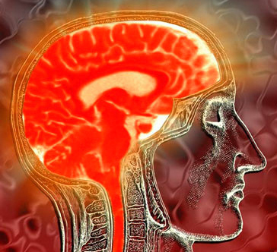
Anatomy & Language
Notes:
3

Slide 4
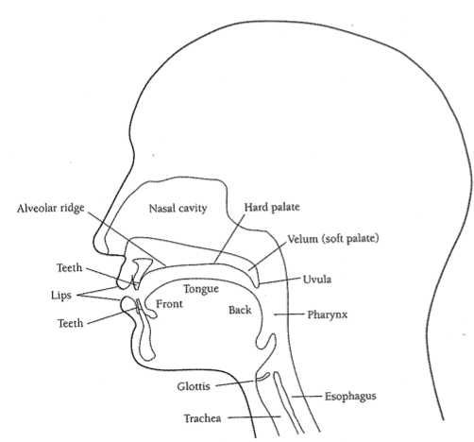
The Human Vocal Tract: A Finely Honed Instrument
Speech is produced when air from the lungs exits the larynx and is filtered by the vocal tract above the larynx: glottis, pharynx, uvula, velum, hard palate, tongue, nasal cavity, alveolar ridge, teeth, lips.
Notes:
4

Slide 5
Human Speech Apparatus: Pros and Cons
Larynx: most speech-specific feature of the human vocal tract.
Compared to other mammals, human larynx is very low.
The good: Low larynx helps produce a wider variety of speech sounds.
The bad: Humans are more likely to get food caught in the trachea and choke.
Lower mouth shape: accommodate the lower larynx
The good: Help support lower larynx.
The bad: Lead to overcrowded teeth and impacted wisdom teeth.
Notes:
5

Slide 6
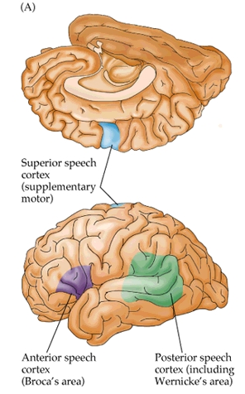
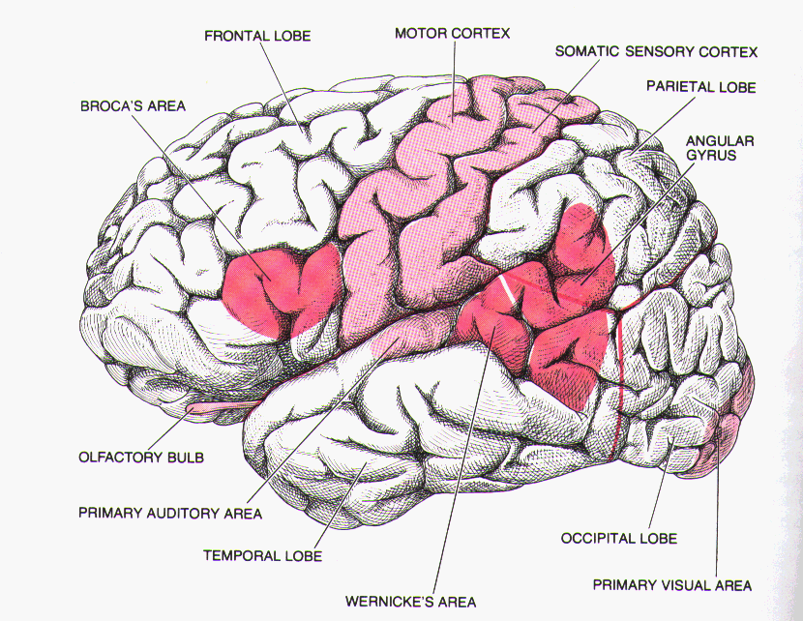
Brain areas associated with language

Slide 7
Functional Architecture
Functional architecture: how the brain is organized to do what it does (that is, how it is organized to accomplish some function)
Neurolinguistics: study of the brain with relation to language functioning. One big question: is there a separate chunk of brain (or dedicated brain activity = a functional “organ”) specifically for language?
Notes:
7

Slide 8
A brain without language: Insights during a stroke
http://www.ted.com/talks/jill_bolte_taylor_s_powerful_stroke_of_insight.html
(about 10:30 through 13:22 of 18:41 minute video)

Slide 9
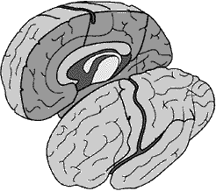
Methods of Neurolinguistic Investigation
Lesion studies: correlate missing bits of brain (lesions) with missing bits of psychological functioning.
One very interesting kind of missing brain bit: split or damaged corpus callosum, found in split brain patients
Notes:
9

Slide 10
Methods of Neurolinguistic Investigation
Contralateral connections in the 1860s: investigators apply electric currents to brains of anesthetized animals and made an interesting discovery.
Note on connections:
Contralateral: across
Ipsalateral: same side
Left Brain
Right Brain
Left Body
Right Body
Notes:
10

Slide 11
Hemispheres & Visual Field
Left Visual Field
Right Visual Field
Left Brain
Right Brain
corpus callosum

Slide 12
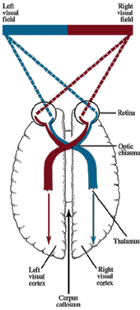
Information Flow:
LVF → RH → LH
RVF → LH → RH

Slide 13
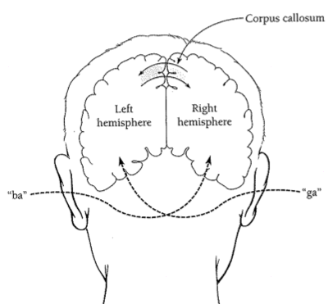
Methods of Neurolinguistic Investigation
Dichotic listening tasks: use the fact that contralateral connections from the ears to the brain are stronger than ipsalateral connections. Experimenters present two tasks at the same time, one to each ear, and ask subjects which one is perceived.
If subjects say the left ear’s stimulus, then the right side of the brain processes that signal. If subjects say the right ear’s stimulus, then the left side of the brain processes that signal.

Slide 14
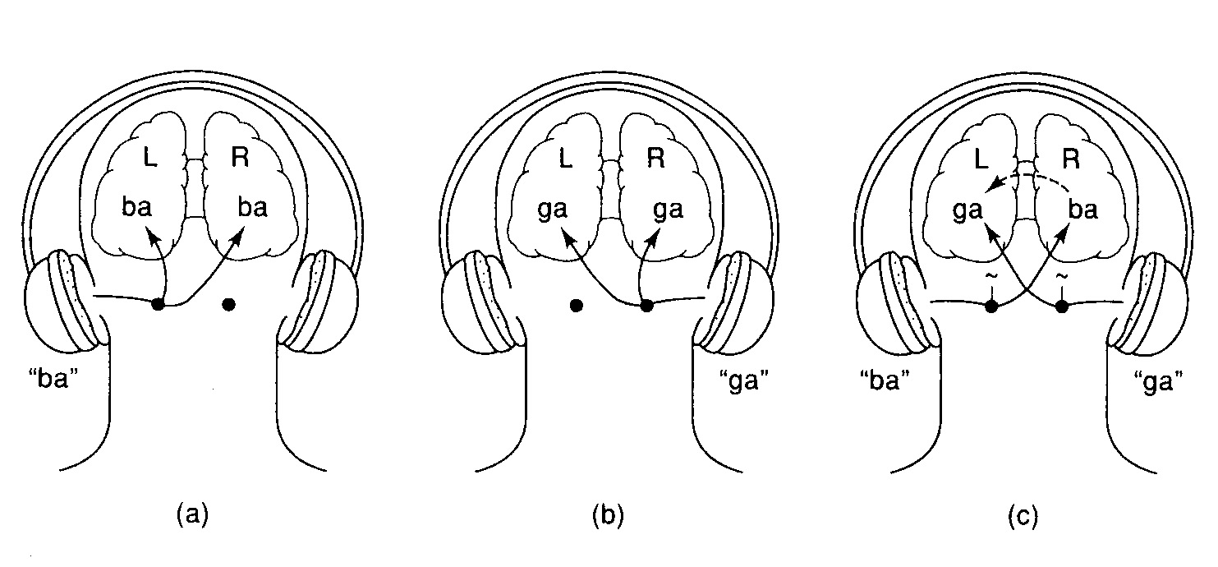
Dichotic Listening

Slide 15
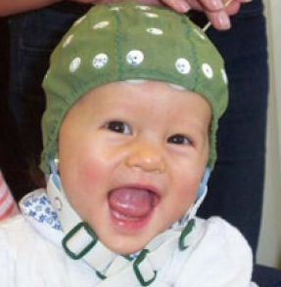
Methods of Neurolinguistic Investigation
ERPs: Event-related brain potentials, gauged via electrode caps. The location of ERPs associated with different mental activities is taken as a clue to the area of the brain responsible for those activities.
Good: non-invasive, relatively undemanding on the subject, provide precise timing on brain events
Bad: poor information on exact location of ERP since just monitoring the scalp
Notes:
15

Slide 16
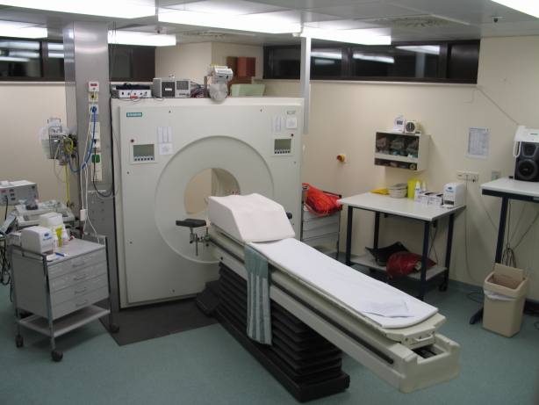
Methods of Neurolinguistic Investigation
Brain-imaging techniques: gauge what part of the brain is active as subjects perform certain tasks
PET scans: Positron emission topography scans - subjects inhale low-level radioactive gas or injected with glucose tagged with radioactive substance
- experimenters can see which parts of the brain are using more glucose (requiring the most energy)
http://www.youtube.com/watch?v=5KXIDUo18aA
[Language Processing in the Brain: 6:26 long]
Notes:
16

Slide 17
Methods of Neurolinguistic Investigation
Brain-imaging techniques: gauge what part of the brain is active as subjects perform certain tasks
fMRI scans: functional magnetic resonance imaging
- subjects have to be very still inside MRI machine, which is expensive to operate
- experimenters can see which parts of the brain are getting more blood flow or consuming more oxygen

Slide 18
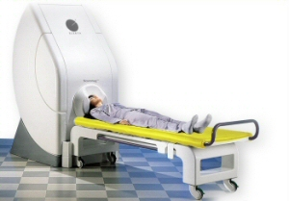
Methods of Neurolinguistic Investigation
Brain-imaging techniques: gauge what part of the brain is active as subjects perform certain tasks
MEG: Magnetoencephalography
- subjects have to be very still
- experimenters can see which parts of the brain are active
Video of word recognition in brain (10 sec long):
http://www.mrc-cbu.cam.ac.uk/facilities/meg/
Notes:
18

Slide 19
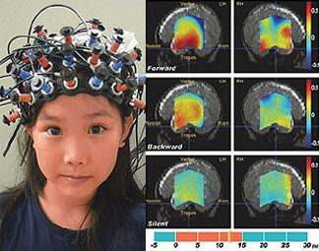
Methods of Neurolinguistic Investigation
Brain-imaging techniques: gauge what part of the brain is active as subjects perform certain tasks
Optical Topography: Near-infrared spectroscopy (NIRS)
- transmission of light through the tissues of the brain is affected by hemoglobin concentration changes, which can be detected
Notes:
19

Slide 20
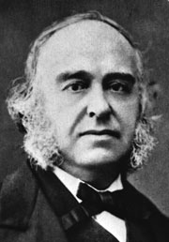
Where is language located? Left hemisphere evidence
From brain injury and aphasia (when language is severely impaired):
Paul Broca’s lesion studies
- “Tan”, who had left hemisphere lesion and loss of language abilities
Functional asymmetry: damage to the left hemisphere seems to cause language problems (whether it is spoken or signed) while damage to the right hemisphere seems to cause non-linguistic visual-spatial information processing problems.
Notes:
20

Slide 21
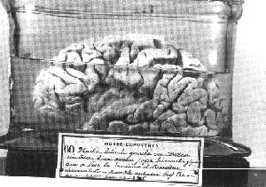
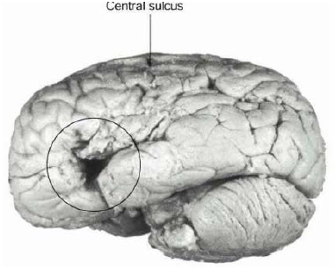
Broca’s Aphasia
Frontal Lobe
Parietal Lobe
Occipital Lobe

Slide 22
Broca’s Aphasia
Patients have trouble producing speech, mostly content words (nouns and verbs) with few grammatical morphemes
“Yes… ah… Monday… er… Dad and Peter H… [his own name], and Dad…. er… hospital… and… ah… Wednesday… Wednesday, nine o’clock…”
Video of sample speech from a Broca’s aphasic:
http://www.youtube.com/watch?v=f2IiMEbMnPM
However, there are also issues with understanding more complex grammatical forms.
http://www.learner.org/vod/vod_window.html?pid=1574 [7:40 long]
(especially 2:43-6:16)
Notes:
22

Slide 23
Broca’s Aphasia
Broca’s aphasics & comprehension:
Relatively good comprehension of some sentences:
Can understand sentences like these:
The dog bit the woman.
The apple that the boy is eating is red.
…but not these (because their meaning can’t be inferred from
the meaning of the nouns and verbs alone):
The car is pushed by the truck.
The girl whom the boy is pushing is tall.

Slide 24
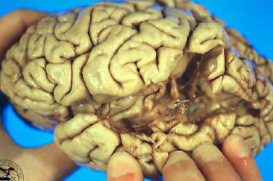
Wernicke’s Aphasia
Patients with posterior lesions in the left hemisphere
Speech is fluent
But comprehension is impaired
Frontal Lobe
Occipital Lobe

Slide 25
Wernicke’s Aphasia
Patients have speech that is “syntactically full but semantically empty”
“I feel very well. My hearing, writing been doing well. Things that I couldn’t hear from. In other words, I used to be able to work cigarettes I didn’t know how…”
Videos of sample speech from Wernicke’s aphasics:
http://www.youtube.com/watch?v=B-LD5jzXpLE
http://www.youtube.com/watch?v=aVhYN7NTIKU
Comprehension is very low.
Also, see http://www.learner.org/vod/vod_window.html?pid=1574 from about 6:20 through 7:40.
Notes:
25

Slide 26
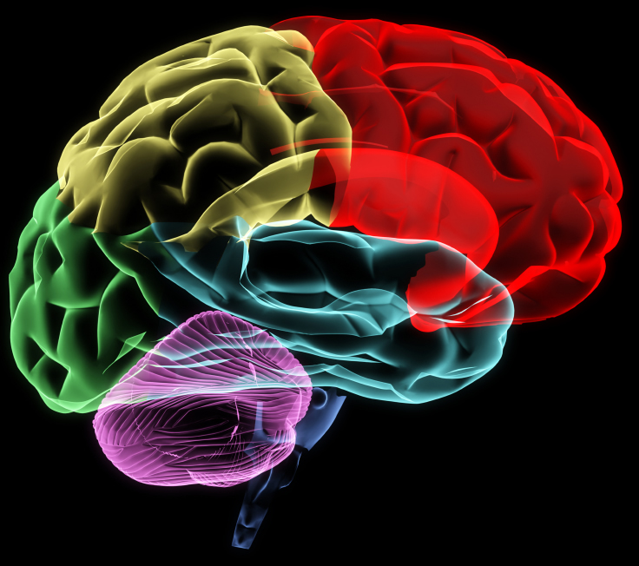
Where is language located?

Slide 27
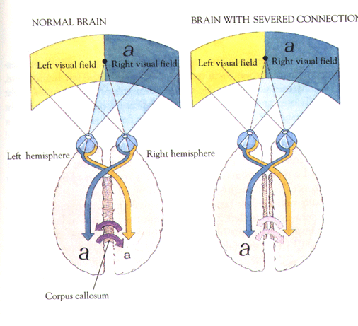
Where is language located? Left hemisphere evidence
From split-brain patients (with severed corpus callosum - no communication between hemispheres)
Notes:
27

Slide 28
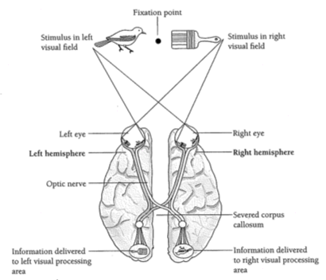
Where is language located? Left hemisphere evidence
From split-brain patients (with severed corpus callosum - no communication between hemispheres)
Can’t say what they saw on the left side, but can draw with their left hand.

Slide 29
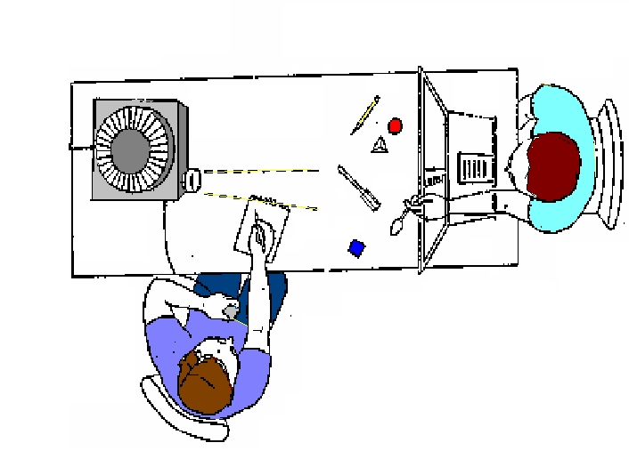
Testing Split Brain Patients
General Testing Setup

Slide 30
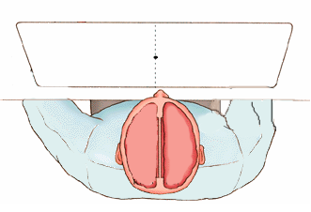
Testing Split Brain Patients
Name that object (picture in RVF)
Patient says: “Spoon!”

Slide 31
Testing Split Brain Patients
Name that object (picture in LVF)
Patient: (says nothing)
Researcher: “Did you see anything?”
Patient: “Nope.”

Slide 32
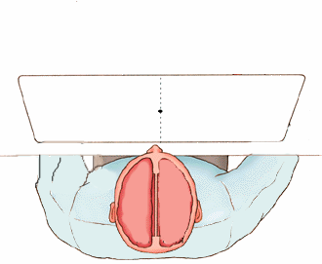
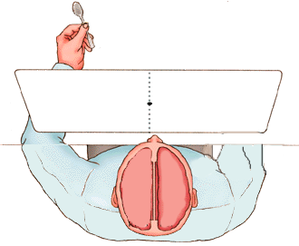
Testing Split Brain Patients
Pick up the object displayed (picture in RVF)
Right Hand: Pulls out spoon
Left Hand does nothing

Slide 33
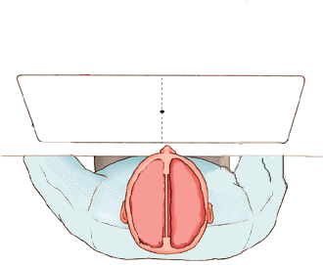
Testing Split Brain Patients
Pick up the object displayed (picture in LVF)
Left Hand: Pulls out spoon!
Right hand does nothing

Slide 34
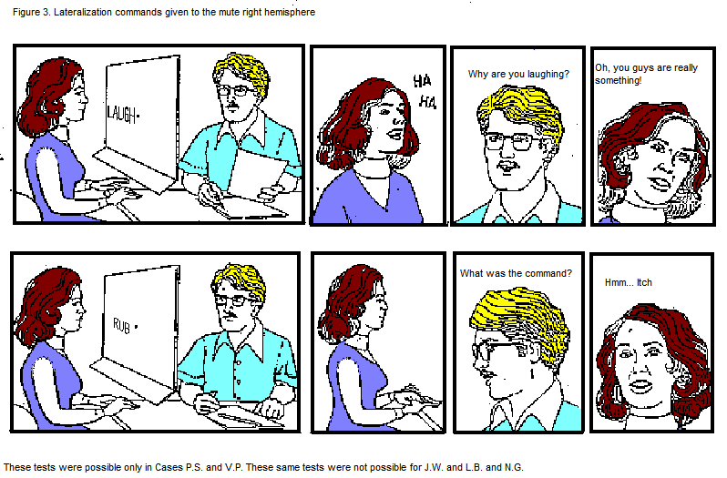
Left Hemisphere rationalizing behavior of Right Hemisphere

Slide 35
Typical Split Brain Patient
Left Brain:
Normal language use
No easily detectable deficits.
Right Brain:
Some rudimentary word recognition.

Slide 36
Extremely useful walkthrough of a split-brain study
http://ebooks.bfwpub.com/psychinquiry/shell.php?activity=simulate_splitbrain

Slide 37
Where is language located? Left hemisphere evidence
From normal adults: dichotic-listening experiments
Normal adults have a right-ear advantage
ba
ga
Notes:
37

Slide 38
Evidence for Left Hemisphere Lateralization from American Sign Language
Deaf Signers with Left Hemisphere Damage:
Language Deficit. Aphasic.
Deaf Signers with Right Hemisphere Damage:
Visuo-Spatial Deficits.
No easily detectable language deficits.
Left Hemisphere implicated in language
Poizner, Klima, & Bellugi (1987)

Slide 39
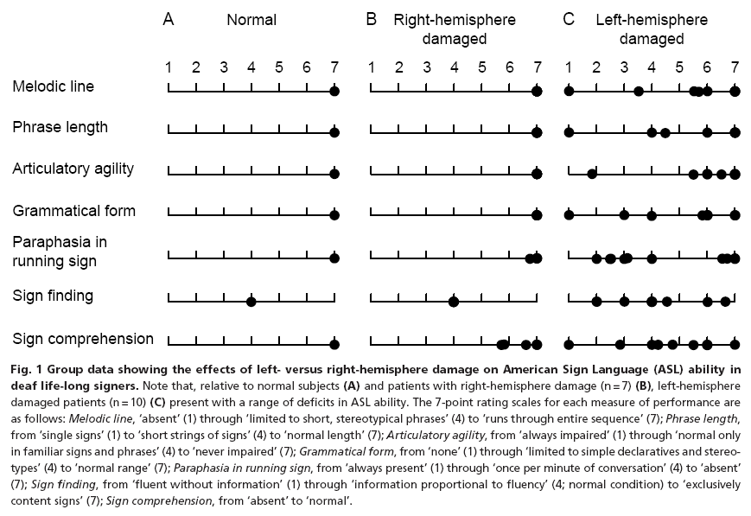
Hickok et al. 1998: ASL lateralization evidence
Left hemisphere damage leads to language damage while right hemisphere damage does not

Slide 40
Why the left hemisphere?
Left hemisphere may process information more analytically.
Trained musicians process music in the left hemisphere. Normal (untrained) people process it on the right.
Left hemisphere may be better at executing well-practiced routines, while right is better at responding to novel stimuli.
Language, for adults, is a well-practiced routine.
Notes:
40

Slide 41
Where is language located? Not-just-left hemisphere evidence
Sometimes, aphasia doesn’t result when there is left hemisphere damage.
Sometimes, aphasia does result when there is right hemisphere damage.
In some people (usually left-handed people), language is controlled by the right hemisphere.
Notes:
41

Slide 42
Where is language located? Not-just-left hemisphere evidence
Right hemisphere contributions to language: tone contour, emotional tone, jokes, sarcasm, figurative language interpretation, following indirect requests
(much of this falls under pragmatics)
Evidence: right hemisphere lesion patients
Right hemisphere activated by semantic processing,
while left hemisphere activated primarily by syntactic processing
Evidence: ERP studies
Evidence: late language learners who aren’t as proficient with syntax, and have language located primarily in right hemisphere
Notes:
42

Slide 43
How does a left hemisphere specialization for language develop?
Equipotentiality hypothesis: left and right hemispheres have equal potential at birth
Prediction: dichotic listening and brain injury in children show less specialization for language than adults
Invariance hypothesis: left hemisphere specialization available at birth
Prediction: dichotic listening and brain injury data from children should look like the corresponding data from adults
Notes:
43

Slide 44
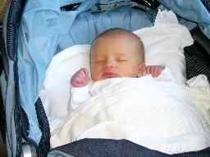
How does a left hemisphere specialization for language develop?
fMRI studies: newborns and 3-month-old infants show greater left-hemisphere than right-hemisphere activation in response to speech stimuli (as do adults)
- But also greater left-hemisphere activity in response to non-speech sounds, suggesting general bias to process sounds in left hemisphere (older children [10-month-olds] and adults process non-speech sounds with right hemisphere)
Notes:
44

Slide 45
How does a left hemisphere specialization for language develop?
Summary from experimental studies:
Language processing appears to be specialized to the left hemisphere as early as researchers can test it.
But the infant brain is not the same as the adult brain - specialization/lateralization continues to increase as the brain matures.
Notes:
45

Slide 46
Recap
Researchers interested in the functional architecture of the brain with respect to language are interested in how the brain is organized to accomplish the function of language.
Broca’s and Wernicke’s aphasics, as well as split brain patients, indicate that certain areas of the brain seem to be integral for processing and producing language.
Many aspects of language seem to be lateralized in the left hemisphere on many people (such as syntax), though some language processing may be done in the right hemisphere (such as semantics/lexical meaning).

Slide 47
Questions?
You should be able to do up through question 6 on HW1 and up through question 24 on the bio bases review questions.

