Slide 1
Psych 56L/ Ling 51:
Acquisition of Language
Lecture 2
Introduction Continued
Notes:
1

Slide 2
Announcements
Review questions for introductory material available on website
Homework 1 available (be working on it): due 1/24/13
Remember to look at the reference material in addition to downloading the lecture notes & listening to the available podcasts
Notes:
2

Slide 3
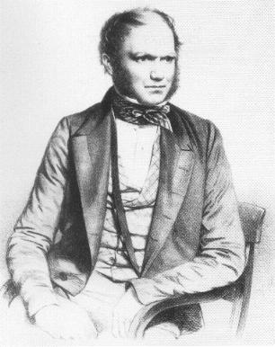
Investigating normal language development
Diary studies: keeping diaries of children’s development. Charles Darwin did this with his son (Darwin, 1877), who seemed to follow the progression we now expect.
Other diary studies: Clara & Wilhelm Stern’s 1907 Die Kindersprache and Werner Leopold’s (1939-1949) four volume account of his daughter’s acquisition of English & German.
Modern diary studies: Braunwald 1976; Bowerman 1985, 1990; Dromi 1987; A. Gopnik & Meltzoff 1987; L. Bloom, 1993; Naigles, Vear, & Hoff 2002
Notes:
3

Slide 4

A very modern diary study
http://www.ted.com/talks/deb_roy_the_birth_of_a_word.html
Beginning through about 4:15 (full video is about 17 minutes total)

Slide 5
The question
“It is obvious that children have some quality of mind that explains why they learn to talk but kittens, for example, do not” - Hoff, p.254
Not obvious what this quality is.
Idea 1: Children have specialized (domain-specific) knowledge about how language works.
Idea 2: Children’s domain-general cognitive processes allow them to acquire language while a kitten’s do not.

Slide 6
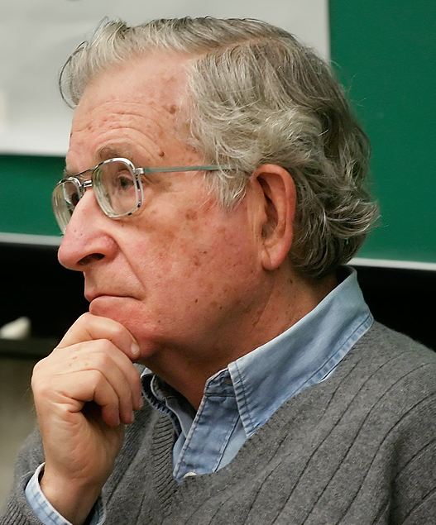
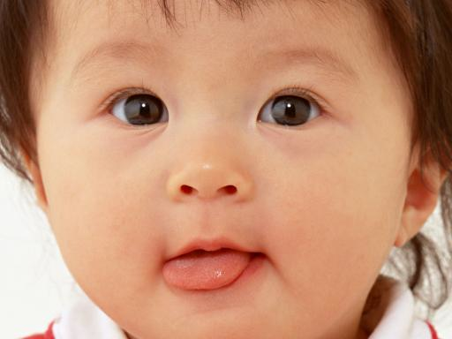
Chomskyan Revolution
Chomsky 1957: Syntactic Structures
Innovation: What speakers do is not as interesting as the mental grammar that underlies what speakers do
So, if adults have a mental grammar that explains what they do when they talk, children must have a mental grammar that explains what children do when they talk.
New formation of language development: What are children’s grammars like and how do they eventually achieve adult grammars?
Notes:
6

Slide 7
Some Current Approaches
Language as a complex cognitive system that maps sounds to meaning
One idea for the mechanism behind this process: Language Acquisition Device
Information from the environment
Language Acquisition
Language Acquisition Device
(unconscious process inside child’s mind, used only for learning language)
Notes:
7

Slide 8
Some Current Approaches
Language as a complex cognitive system that maps sounds to meaning
One idea for the mechanism behind this process: Language Acquisition Device
Linguistic approach
Premise: LAD contains some domain-specific knowledge about the structure of language (this is often called Universal Grammar).
Focus: description of children’s prior (innate) linguistic knowledge and how that knowledge interacts with the data from the native language to produce knowledge of the native language
Knowledge specifically about human language
Notes:
8

Slide 9
Some Current Approaches
Language as a complex cognitive system that maps sounds to meaning
One idea for the mechanism behind this process: Language Acquisition Device
LAD + information from the environment
Basic premise: The language acquisition device provides a little bit of knowledge about how human languages work to get the child started. This allows the child to use her language input more effectively – to notice certain things more easily and to entertain only certain hypotheses about how language works.

Slide 10
Innate Linguistic Knowledge?
Why do children need this kind of head start?
Proposal: Input is too impoverished for children to converge on the right language rules without it. This is sometimes called the Poverty of the Stimulus.
So, children need something else besides just the data in the input to help them decide against the wrong rules.

Slide 11
Some Current Approaches
Language as a complex cognitive system that maps sounds to meaning
Another idea for the mechanism behind this process: general learning abilities
Domain-general cognitive approach
Premise: Language acquisition is no different from any other kind of knowledge acquisition; children can solve this problem in the same way that they solve other problems (such as perception, for example)
Focus: description of domain-general learning capacities that serve language development, and the sources of input those capacities use
Useful for all kinds of learning (ex: grouping things together into larger units)
Notes:
11

Slide 12
Some Current Approaches
Language as a complex cognitive system that maps sounds to meaning
Another idea for the mechanism behind this process: general learning abilities
Domain-general cognitive approach
Basic premise: Abilities that are useful for other kinds of input besides language input are used to learn language. There is no knowledge or ability that is unique to language learning.

Slide 13
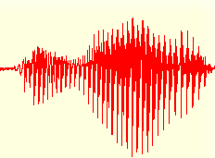
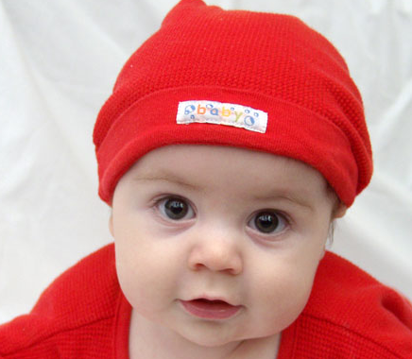

Domain-general response to
Poverty of the Stimulus
Maybe children don’t need domain-specific knowledge to learn language. Maybe they just use the data available to them more cleverly than some researchers think they do.
Example:
Saffran, Aslin, & Newport (1996): 8-month-olds can (unconsciously) track probabilities between syllables in order to identify words in fluent speech in an artificial language
Sample audio input
http://whyfiles.org/058language/images/baby_stream.aiff

Slide 14
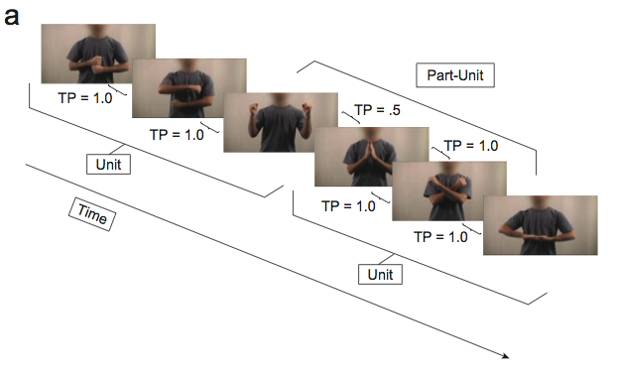
Domain-general response to
Poverty of the Stimulus
Maybe children don’t need domain-specific knowledge to learn language. Maybe they just use the data available to them more cleverly than some researchers think they do.
Example:
Roseberry, Richie, Hirsh-Pasek, Golinkoff, & Shipley (2012): 8-month-old infants are able to (unconsciously) track probabilities between dynamic events, such as a series of hand motions.

Slide 15
Domain-general response to
Poverty of the Stimulus
Maybe children don’t need domain-specific knowledge to learn language. Maybe they just use the data available to them more cleverly than some researchers think they do.
Example:
Denison, Reed, & Xu (2011): 6-month-old infants are able to create probabilistic expectations about their environment, based on their observations of their environment. For example, after seeing that a box is mostly filled with yellow balls, they are surprised when someone pulls four pink balls in a row out of the box.

Slide 16
Domain-general response to
Poverty of the Stimulus
Maybe children don’t need domain-specific knowledge to learn language. Maybe they just use the data available to them more cleverly than some researchers think they do.
Example:
Kidd, Piantadosi, & Aslin (2012): 7- to 8-month-old infants have a tendency to learn only from data whose informational complexity is neither too high nor too low (the “Goldilocks Effect”).

Slide 17
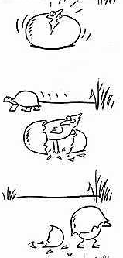
Nature vs. Nurture
Notes:
17

Slide 18
The debate in a nutshell
Is the development of language in children the result of humans’ innate endowment (like upright posture & bipedal locomotion)? Or is it the result of circumstances in which children are nurtured (like table manners and formal math, which depend on particular experiences)?
Empiricism: all knowledge and reason come from experience
Nativism: mind has some pre-existing structure it imposes to interpret experience
Notes:
18

Slide 19
Nativism: Why believe it?
Children acquire language rapidly
Children acquire language with very little conscious effort
Children acquire language without explicit instruction for most of it
Nativism: mind has some pre-existing structure it imposes to interpret experience
Notes:
19

Slide 20
Nativism: Why believe it?
“Language learning is not really something that the child does; it is something that happens to a child placed in an appropriate environment, much as the child’s body grows and matures in a predetermined way when provided with appropriate nutrition and environmental stimulation.” - Chomsky, 1973
Nativism: mind has some pre-existing structure it imposes to interpret experience
Notes:
20

Slide 21
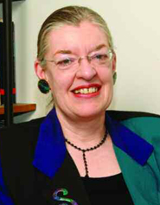
Interactionist/Constructionist View
“We on the other side think that learning language is a long slog, which requires from the child a lot of work. And the child is working as hard as he can, fifteen, sixteen hours a day. We think it requires a relationship with an adult, and a whole set of cognitive abilities.” - Snow, 1993
Interactionist/constructionist: language is constructed by the child from experience, and the input is crucial - but there may still be some innate knowledge contributing
Notes:
21

Slide 22
Back to nativism: the nature of nature
There are different ways for something to be innate:
Knowledge itself is innate
Procedures for learning are innate (knowledge is the result from these procedures)
Notes:
22

Slide 23
Back to nativism: the nature of nature
There are different ways for something to be innate:
Knowledge itself is innate: children have inborn knowledge of the general form of language (domain-specific knowledge)
Procedures for learning are innate (knowledge is the result from these procedures)
Notes:
23

Slide 24

Why do we think knowledge could be innate?
Common properties of human languages: all languages of the world share structural properties. This could be due to innate biases about how languages are structured.
Evolution has equipped the human mind with other useful knowledge (ex: world is 3D, even though retinas process only 2D) - why not prior knowledge about language?
Notes:
24

Slide 25
Back to nativism: the nature of nature
There are different ways for something to be innate:
Knowledge itself is innate: children have inborn knowledge of the general form of language (domain-specific capacities)
Procedures for learning are innate (knowledge is the result from these procedures): children have domain-general capacities that all contribute to language acquisition, such as symbolic representation, memory, chunking input into smaller parts, and probabilistic analysis.
Notes:
25

Slide 26
Why do we think some learning procedures are innate?
Babies as statistical learners
Statistical learning: keeping track of the relative frequency of two things (ex: how often they occur together)
Evidence that infants (6-month-olds, 8-month-olds) are capable of statistical learning and probabilistic reasoning abililities:
Saffran et al. 1996, Denison et al. 2011, Roseberry et al. 2012
Notes:
26

Slide 27
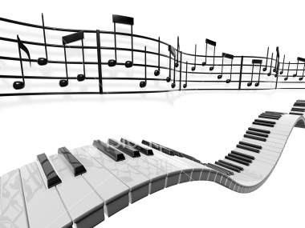
Why do we think some learning procedures are innate?
Babies as statistical learners
Statistical learning is domain-general.
Saffran, Johnson, Aslin, & Newport (1999): babies can track the probabilities between tones (not just between language stimuli like syllables)
Denison et al. (2011): Infants can create probabilistic expectations about their environment (such as the color of balls in boxes), not just about language.
Roseberry et al. (2012): Infants can track probabilities between dynamic events.
Notes:
27

Slide 28
Back to nativism: the nature of nature
There are different ways for language acquisition to work:
language
One domain-specific module
General cognitive processes applied to language input (which can also apply to other kinds of input)
language
perception
spatial location
Notes:
28

Slide 29
Back to nativism: the nature of nature
There are different ways for language acquisition to work:
Currently this debate between domain-specific and domain-general is going on for many areas of cognition, not just for language acquisition.
Notes:
29

Slide 30
Quick Summary of Some Major Current Theories of Language Development
Generativist
Constructionist
Notes:
30

Slide 31
Quick Summary of Some Major Current Theories of Language Development
Generativist: Universal Grammar, which contains biases for language structure, is innate. Language experience triggers prior knowledge, which is domain-specific.
Constructionist
language
One domain-specific module
Notes:
31

Slide 32
Quick Summary of Some Major Current Theories of Language Development
Generativist
Constructionist: language is constructed by the child using general cognitive learning procedures applied to language input. These are domain-general abilities used for language learning.
language
perception
spatial location
Notes:
32

Slide 33
An important division
Domain-specific
Learned
Innate
Domain-general

Slide 34
An important division
Domain-specific
Generativist
Learned
Innate
Constructionist
Domain-general

Slide 35
An important division
Domain-specific
Generativist
Learned
Innate
Empiricist
Nativist
Constructionist
Domain-general

Slide 36
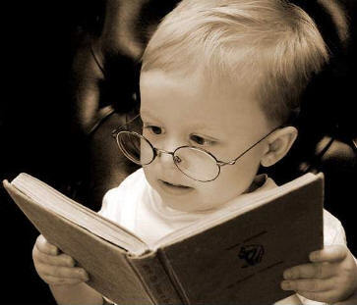
Research Methods
Notes:
36

Slide 37




Research Methods
Important: do cross-linguistic and cross-cultural research. Even if language is universal, there are individual differences in language development and there may be more than one route to acquisition success. Also, there may be influence from different cultures on the language learning environment for children.
Notes:
37

Slide 38
Research Methods
Analyzing samples of spontaneous speech from children:
Video/audio recordings of spontaneous speech samples
Used to find out the nature of language children produce. Ideally, sample is representative of everything child says - but hard to do in practice. (Deb Roy’s work is a notable exception.)
Because of this, it is hard to make claims that children don’t use/know a particular structure based on its absence in spontaneous speech samples. It could be that they simply didn’t say that structure when they were being recorded.
Notes:
38

Slide 39
Research Methods
Analyzing samples of spontaneous speech from children:
Video/audio recordings of spontaneous speech samples
Difficulty: Have to transcribe recorded speech. May take between 5 and 20 hours to faithfully transcribe 1 hour of child speech.
Why?
Conversational speech does not often use complete sentences.
Child pronunciation is often not adult-like - and the non-adult-like parts are usually what researchers are interested in.
Notes:
39

Slide 40
Research Methods
Getting standardized assessments of children’s performance
Use coding systems like Mean Length of Utterance (MLU), which correlates with measures of children’s grammatical and phonological development. This is done by tracking the average number of meaning-bearing units (morphemes) in the child’s speech.
Ex: “He likes me” = 4 morphemes (“he”, “like”, “-s”, “me”)
Use estimates that caregivers provide of children’s performance, such as the MacArthur-Bates Communicative Development Inventories (CDIs): 8-16 months, 16-30 months, 30-36 months. These include checklists of words, gestures, and word combinations children use or comprehend.
Use examiner-administered tests like the Peabody Picture Vocabulary Test, which assesses vocabulary comprehension.
Notes:
40

Slide 41
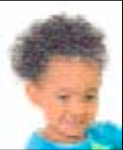
Research Methods
Computational Modeling (Digital Children)
Create a computer program that takes the data children hear as input and see if it can learn the same knowledge children do from that input. Usually, the program will implement some learning theory’s assumptions about how learning works (ex: what learning strategies children might use), and therefore test that theory empirically.
Ex: Learning to identify words in fluent speech (word segmentation) [Swingley 2005, Gambell & Yang 2006, Pearl, Goldwater, & Steyvers 2011, Phillips & Pearl 2012]
Ex: Learning referential meaning, such as what one refers to in “Look at the purple goblin - and there’s another one behind Jareth, too.” [Foraker et al. 2009, Pearl & Lidz 2009, Pearl & Mis 2011]
Notes:
41

Slide 42
Recap
Some current approaches to how language acquisition works include the generativist approach and the constructionist approach. Both believe in innate knowledge, though only the generativist approach believes that knowledge is domain-specific.
There are different methods for investigating questions in language acquisition, most of which involve using child-directed input and child-produced output. One research method gaining prominence in the field is computational modeling, which tends to look at specific implementations of how the process of language acquisition could work.

Slide 43

Questions?
You should now be able to answer all of the review questions for the introductory material, and the first 3 questions of HW1.
Notes:
43

