Slide 1
Psych 56L/ Ling 51:
Acquisition of Language
Lecture 17
Language in Special Populations
Notes:
1

Slide 2
Announcements
Review questions available for language development in special populations
Review session in class on 3/14/13 for final
Final: 3/22/13, 10:30am-12:30pm, in the normal classroom
OR the computer lab in SBSG G241
Please fill out course evaluations
Remember that extra credit is available!
Notes:
2

Slide 3
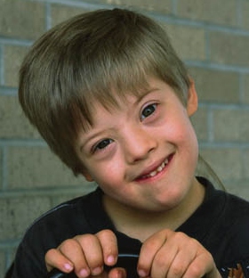
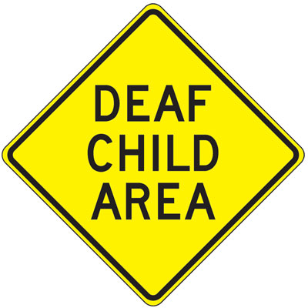

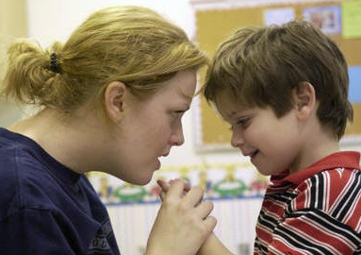
Special Populations
Notes:
3

Slide 4
Why special populations?
Not everyone is a typically developing child.
We can explore how different human abilities contribute to the human language acquisition process.
Does language develop differently if there’s no auditory input (deaf children)?
What about if there’s no visual input (blind children)?
What if general intelligence is lower (mentally retarded children)?
What if social abilities are lagging (autistic children)?
What about if only language abilities are lagging (specific language impairment children)?
Notes:
4

Slide 5
Deaf Children
Notes:
5

Slide 6
Sign language
Remember: Sign languages are just as complex as spoken languages - it’s just that they’re expressed with manual gestures and facial expressions, rather than spoken words.
Signed vs. spoken languages:
http://www.youtube.com/watch?v=p_AAttEQj88
(~6 minutes)
(0:37 - 4:12)
Using sign language to identify what the core properties of any language system are
(4:12 - end)
Language processing in brains of deaf people (left hemisphere specialization)

Slide 7
The situation
Deaf individuals aren’t all the same
Deaf parents vs. Hearing parents
  Deaf-of-deaf children are exposed to a full language immediately
  Deaf-of-hearing children are exposed to “non-native” signers: they receive inconsistent and incomplete input
Parents of deaf children also have to make a choice in how to teach their children

Slide 8
Manual / Oral / Total traditions
Manual tradition
  Teach sign language exclusively (at least at first)
  Gives linguistic input from day 1
Oral tradition
  Force deaf children to learn spoken language
  Delayed linguistic input, but potentially better communication with non-signers
Total communication
  Expose deaf children both to manual & oral language

Slide 9
Progression of
Sign Language Acquisition
Children pass through the same stages as in spoken language acquisition, in the same order: manual babbling to single-sign productions, to multisign combinations, followed by morphological development and more complex syntax.
Children make the same kind of mistakes as in spoken language acquisition, such as overregularization errors in morphology (“goed”), ignoring parental corrections of form, pronoun reversal errors (confusing what “I” and “you” mean) - despite these being signified by pointing gestures.
Notes:
9

Slide 10




Oral Language Development
Deaf children are only exposed to lip movements
- This is really hard!
Mouth “Elephant shoes” vs. “I love you.”
vs. “olive juice” vs. “island view”
Notes:
10

Slide 11
Oral Language Development
Phonological development: Deaf children differ during the babble stage from hearing children in both the quality and quantity of sound production. However, some orally trained children develop enough phonological awareness to identify rhymes from lip-reading.
Lexical development: oral vocabulary is delayed and proceeds more slowly.
Syntactic development: delayed, and endpoint of development falls far short of normal language competence.
John goes to fishing. Him wanted go. Who TV watched?
Who a boy gave you a ball? Tom has pushing the wagon.
Notes:
11

Slide 12
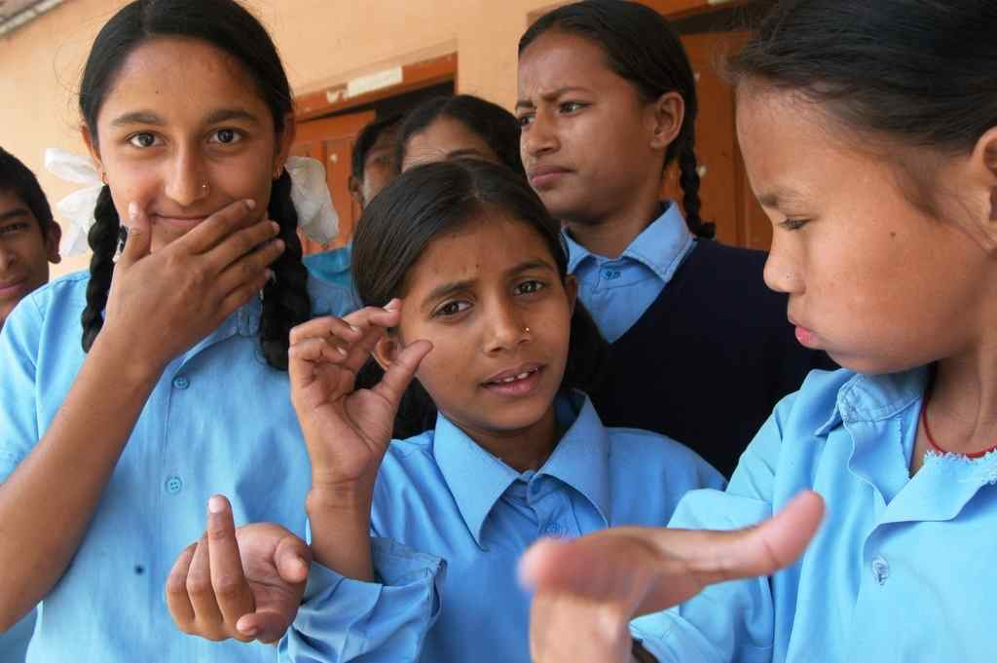
Deaf Children: Interim Recap
Deaf children exposed to sign language learn language the same as normal-hearing children
- There’s no inherent deficit in language ability for deaf children
Deaf children exposed to spoken language learn much slower and never catch up to their normal-hearing peers!
- Deficit in spoken language, NOT in language generally
Notes:
12

Slide 13
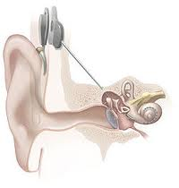
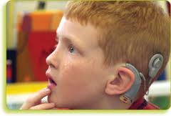
Cochlear Implants
Cochlear Implants (CI): Allow certain deaf individuals to hear
  CIs are controversial: treat deafness as a disease which can be “cured”
How do they work?
  Replaces the cochlea
  Takes air pressure and turns it into neural signals

Slide 14

Cochlear Implants:
Sample speech
8-channel vocoded sentence
Normal sentence

Slide 15
Cochlear Implants
Why are cochlear implants interesting?
  Explore how oral language develops after a lack of linguistic exposure
How do these children do with spoken language?
  Wide variability, some catch up to normal-hearing peers, some are unable to use their implants
  Deficits appear to be due to auditory capabilities

Slide 16
Deaf children: Bigger picture recap
Implication 1: Language is a property of the human brain, not a property predicated on the mouth and ears.
Implication 2: Since deaf children make the same mistakes in learning as hearing children - despite sign languages being more naturally iconic – this suggests that acquiring a formal grammatical system is a separate cognitive enterprise from learning how to communicate. If it wasn’t, sign languages should be easier to pick up than spoken languages.
Notes:
16

Slide 17
Deaf children: Bigger picture recap
Implication 3: While cochlear implants allow some deaf children to hear spoken language, there is wide variability in the ability to pick up the spoken language. However, this is a deficit in the spoken modality, rather than a language deficit - these children still have native-level proficiency in their signed languages.

Slide 18
Blind Children
Notes:
18

Slide 19
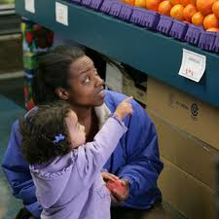
Why blind children?
Blind children hear and talk, but lack visual cues to language:
Ex 1: achieving joint attention through pointing and eye gaze isn’t possible.
Notes:
19

Slide 20
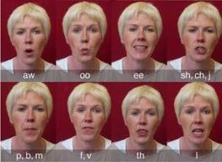
Why blind children?
Blind children hear and talk, but lack visual cues to language:
Ex 2: visual information about lip configurations for producing sounds isn’t available.

Slide 21
Linguistic Development of Blind Children
Phonological development: Blind children make more errors than sighted children with sounds that involve visible articulatory movements (/b/, /m/, /f/).
Lexicon development: Blind children have fewer words for things that can be seen, but not touched (like flag, moon). They have more words for things associated with auditory change.
Syntactic development: Same as that of sighted children.
- Some differences due to mother’s input (fewer questions, more commands), which leads to late auxiliary verb (“has”, “is”) acquisition
Notes:
21

Slide 22
Insight into first language acquisition
One perspective: language development builds on nonverbal communication, and on accessing the meanings of sentences from the observable nonlinguistic context.
But blind children can’t do either of these - yet they still acquire language the same way (and at the same time) as sighted children do.
Implication: Nonverbal cues are helpful, but not necessary. Syntactic information in the language itself can be just as useful. (Remember how useful syntactic bootstrapping was for lexical acquisition.)
Notes:
22

Slide 23
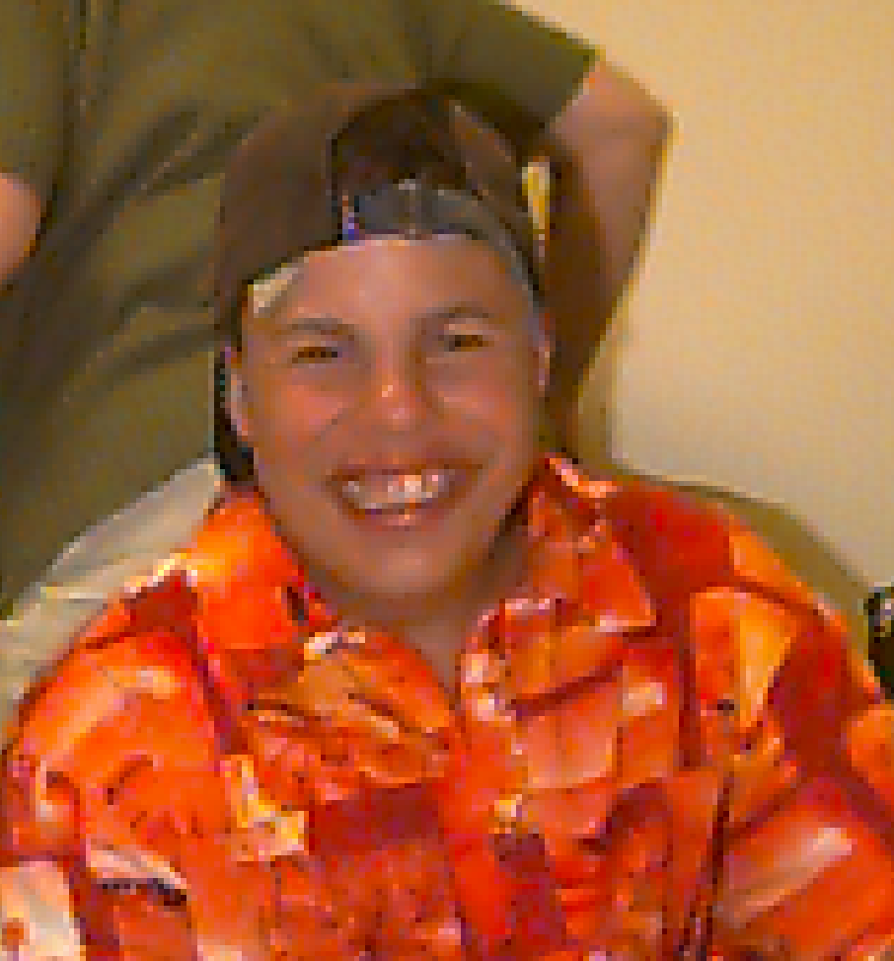
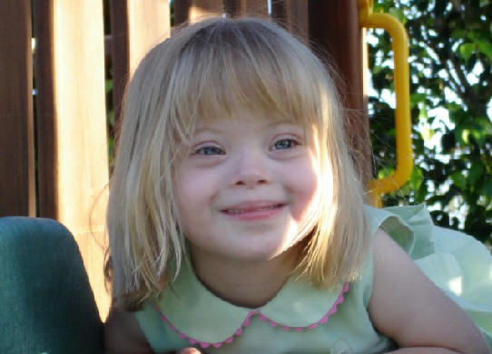

Mentally Retarded Children
Notes:
23

Slide 24
A Heterogeneous Group
Mental retardation = “significantly subaverage general intellectual functioning…that is accompanied by significant limitations in adaptive functioning”
This lets us test how general intelligence aids language acquisition.
Research import:
If language is the result of general cognitive abilities, mentally retarded individuals should have poor language.
If language is a specialized ability, it may be fine even if general intelligence is poor.
Notes:
24

Slide 25
Down Syndrome
Due to a chromosomal abnormality, and accounts for about one third of the moderately to severely mentally retarded population.
While some Down syndrome individuals achieve typical adult-linguistic competence, most do not. Language tends to be more impaired than other cognitive functions. Grammar is particularly impaired.
However, communicative development and pragmatic development are strong. Down syndrome babies vocalize more and engage in mutual eye contact more. School-age children are particularly interested in social interaction and less interested in objects.
Notes:
25

Slide 26
Down Syndrome Implications
Some language development (ex: grammar) is impaired.
One conclusion: Therefore language development requires general cognitive abilities. (Any other ways to interpret this if you’re a nativist? Hint: Could a specific brain part be impaired too?)
Some language development (ex: communicative/social aspects) is not as impaired.
Therefore, “language” is not a single cognitive ability. Some aspects can be impaired while others are spared.
Also consider that “intelligence” is not a single ability. Down Syndrome may affect some aspects of intelligence but not others.
Notes:
26

Slide 27
Williams Syndrome
Low general IQ (40-70), poor math, poor visuospatial reconstruction abilities
Good language, often good with music, highly social
Often used to make the argument for the dissociability of language and cognition.
Notes:
27

Slide 28


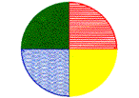




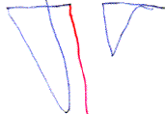
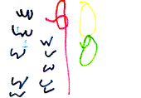
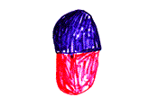

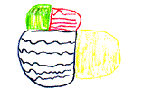
Williams Syndrome: Copying Simple Pictures
Model
WS
Age 11
WS
Age 11
Control
Age 6
Notes:
28

Slide 29
Williams Syndrome: “Describe An Elephant”
“And what an elephant is, it is one of the animals. And what the elephant does, it lives in the jungle. It can also live in the zoo. And what it has, it has long gray ears, fan ears, ears that can blow in the wind. It has a long trunk that can pick up grass, or pick up hay…If they’re in a bad mood it can be terrible…If the elephant gets mad it could stomp; it could charge, like a bull can charge. They have long big tusks. They can damage a car…it could be dangerous. When they’re in a pinch, when they’re in a bad mood it can be terrible. You don’t want an elephant as a pet. You want a cat or a dog or a bird…”
Notes:
29

Slide 30
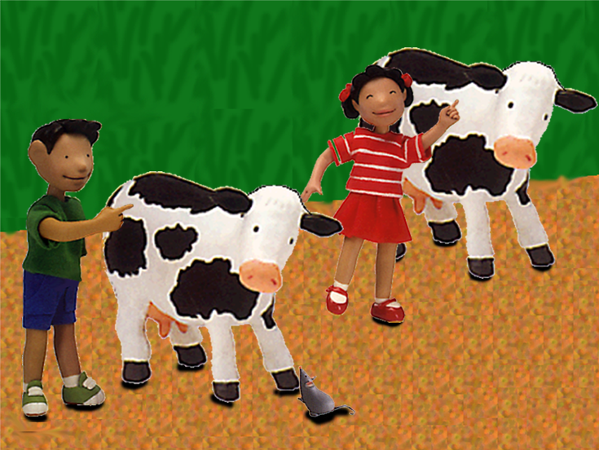
Describing Complex Pictures
“Max is looking at the cow who um the boy’s pointing to.”
(WS age 12;10)
(Zukowski 2008)
Notes:
30

Slide 31
Williams Syndrome: Conclusive?
While their language skills are quite impressive in comparison to other cognitive abilities, they still lag behind those of typically developing children of the same chronological age.
Williams syndrome children also show clear deficits on standardized tests of morphosyntactic knowledge. In addition, while they may make grammatical errors similar to typically developing children (ex: contracting wanna when they shouldn’t: *Who do you wanna win the race?), they don’t seem to recover from them the way that typically developing children do (Zukowski & Larsen 2012).
They also seem to produce more than they comprehend (like Wernicke’s aphasia patients). Often they can’t answer questions about the stories they just told.
Notes:
31

Slide 32
Williams Syndrome: Neurological Underpinnings
Williams syndrome brain is hypersensitive to processing faces and voices, and more of the brain is devoted to learning language.
So why does this lead to poorer performance in the end?
Karmiloff-Smith et al. (1997) says: Learning device is only driven to find patterns and extract rules (like grammar) when the space available is insufficient to memorize everything (similar to the “Less is More” idea of Newport (1990)). So, Williams syndrome children have a lot of memorization space…and subsequently not enough (unconscious) motivation to find patterns and make a more compact system of representation.
Notes:
32

Slide 33
Williams Syndrome: Implications
Excellent lexical development, phonological memory
+
Poor performance on some aspects of grammar (and finding pattern regularities)
=
Williams syndrome children may acquire language differently than typically developing children. Process is not the same (or at least gets stuck), and so end result (language system) may not be not the same. Therefore, this may not be as decisive about the separation of typical language development from general intelligence.
Notes:
33

Slide 34
Autistic Children
Notes:
34

Slide 35
Characteristics of Autism
Always: impaired language and communication
Includes: impaired social development, delayed and deviant language, insistence on sameness, and onset before age 30 months
Variability: Distinction between lower- and higher-functioning individuals; linked to nonverbal cognitive abilities
Notes:
35

Slide 36
Language in Lower-Functioning Autistics
Lower-functioning = ~80% of autistic individuals, scoring in mentally retarded range on nonverbal tests of development
~50% either do not speak at all or have echolalic speech, which is the meaningless repetition of a word or word group previously produced by another speaker
Some mixed success in teaching lower-functioning individuals when speech is combined with manual signs.
Notes:
36

Slide 37
Language in Higher-Functioning Autistics
Language success varies widely among higher-functioning autistics. In general, development is delayed and deviant in at least some respects.
Odd prosody: speech sounds mechanical (problems expressing emotional affect); possibly resulting from lack of attention to how others sound and/or a lack of interest in sounding like others
Gaps in semantics: autistic children do not use words that refer to mental states, such as believe, guess, idea, etc.; however, generally show similar understanding of other word meanings when compared with non-autistic children
Notes:
37

Slide 38
Language in Higher-Functioning Autistics
Language success varies widely among higher-functioning autistics. In general, development is delayed and deviant in at least some respects.
Gaps in syntax: autistic children use a narrower range of constructions, generally do not ask questions; however, development generally follows a similar course to that of non-autistic children
Severe communicative competence impairment: infants show little interest in people and no preference for their mother’s speech, rarely produce pointing gestures, joint attention skills markedly deficient, make pronoun reversal errors
Notes:
38

Slide 39
Autism: Implications
Impaired social abilities = impaired language, but crucially not the basic core of semantics and syntax
Idea: There is a dissociation between language acquisition ability and social/communicative abilities
Idea: Basic deficit is lack of theory of mind, and understanding people’s minds is a prerequisite to true communicative behavior.
However…lots of overlap with specific language impairment children, so underlying deficit may not be so simple as that. Lack of theory of mind could be result, not cause.
Notes:
39

Slide 40
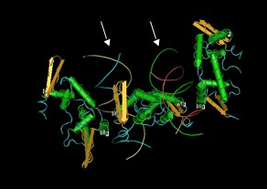
Specific Language Impairment
Notes:
40

Slide 41
Characteristics of
Specific Language Impairment (SLI)
Speech from a 16-year old with SLI:
He want play that violin.
Can I play with violin?
Then he went home and tell mother - his mother - tell what he doing that day.
Then about noontime those guy went in and eat and warm up.
Notes:
41

Slide 42
Characteristics of
Specific Language Impairment (SLI)
In the absence of any clear sensory or cognitive disorder, language development is impaired.
FoxP2 gene on chromosome 7: impairment affecting jaw and tongue movement, speech, and grammar (tense, number).
Generally, these children show late onset of talking as well. Vocabulary development is typically delayed, but the greatest deficits are in morphology and syntax.
However, SLI children produce different kinds of grammatical errors than typically developing children – they may be learning differently than typical children
Notes:
42

Slide 43
Characteristics of
Specific Language Impairment (SLI)
Impaired phonological memory: SLI children are generally worse than typically developing children at repeating a meaningless sequence of sounds. (Remember, that was useful for predicting size of vocabulary in typically developing children.)
Nonlinguistic cognition impairment: worse at symbolic functioning, mental imagery, hierarchical planning, hypothesis testing, reasoning, drawing inferences from stories. Maybe SLI isn’t so specific to language? (Though perhaps these are the result of a language deficit in some cases - without the ability to use language for cognitive-offloading, performance on these other tasks suffers.)
Notes:
43

Slide 44
Accounting for
Specific Language Impairment (SLI)
Idea 1: SLI children have an impairment in the language acquisition device (generativist viewpoint). Specifically, their innate knowledge about language is missing a piece.
Ex: Unimpaired children hear walk, walked, jump, jumped, and build a rule for forming the past tense (+ed). Children with SLI never use those regularities to build a rule. They just memorize the different forms. (This is similar to one idea about how Williams syndrome children develop, with the difference being that Williams syndrome children have better associative memories for acoustic stimuli.) Crucial difference: even when they lack the memory capacity for all the grammatical forms, something keeps them from learning the rule.
Notes:
44

Slide 45
Accounting for
Specific Language Impairment (SLI)
Idea 2: SLI children’s phonological memory impairment means that they don’t pick up on phonological information that is less salient, like unstressed grammatical morphology (Leonard 1989).
Ex: walk~walking, may be difficult for SLI children to retain in memory, and so they are delayed in picking up this information.
Note: doesn’t necessarily account for all the differences between SLI and typically developing children.
Prediction: Should depend on the language - languages with more of this kind of less salient morphology should have more SLI kids. So far, sometimes yes, sometimes no.
Notes:
45

Slide 46
Accounting for
Specific Language Impairment (SLI)
Idea 3: SLI children can’t process rapidly processed stimuli, like speech, as well as typically developing children.
Ex: They can’t process rapidly presented musical tones as well (Tallal 1978, Tallal et al. 1985), in addition to not being able to distinguish acoustic signals like dabiba vs. dabuba (Leonard et al. 1992).
This ties in with the impaired phonological memory story, since children with a processing deficit will definitely have more trouble with less salient phonological cues like most grammatical morphology.
Notes:
46

Slide 47
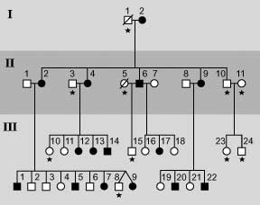
Genetic Factors in
Specific Language Impairment (SLI)
There seems to be a familial concentration of specific language impairment. In the KE family, it turned out to be a single dominant gene at work (the FOXP2 gene).
Notes:
47

Slide 48
SLI: Implications
Since language development seems to depend on many different underlying abilities, language impairment will likely have a number of different underlying causes.
It also may be that SLI simply represents the low end of the spectrum of language acquisition (Leonard 1987, 1991). SLI children show the same variability seen in typically developing children: some are weak in syntax but strong in pragmatics, some have the opposite pattern, and some are weak in both. Potential underlying problem: ability to extract regularities is significantly below average, which leads to many problems in language development (and elsewhere).
Notes:
48

Slide 49
Recap: Special Populations
Special populations let us test what matters and what doesn’t matter for language acquisition:
  Auditory cues: Only crucial for acquiring spoken language (deaf children)
  Visual cues: Not crucial for acquiring language (blind children)
  Social cues: Only crucial for pragmatics, maybe theory of mind (Down Syndrome, autistic children)
  General intelligence: Potentially important for language acquisition, but not straightforward (Down Syndrome, Williams Syndrome)
  Genetic factors? (SLI children)

Slide 50


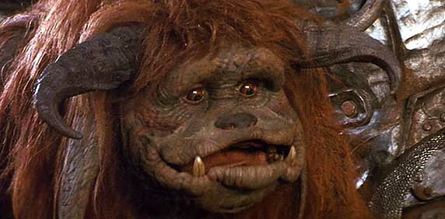


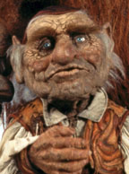
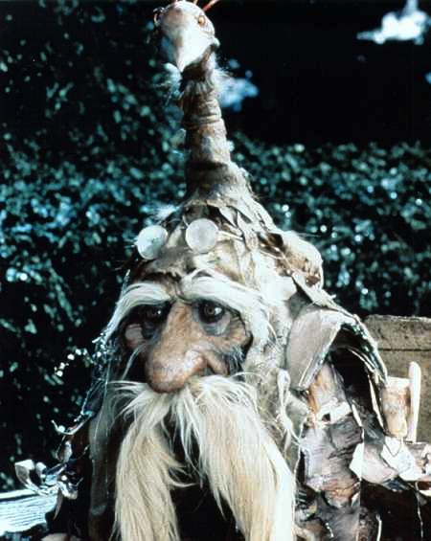
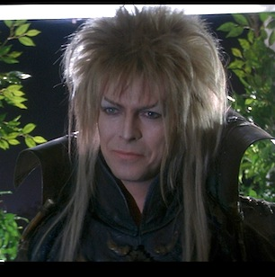
Questions?
Don’t forget:
Final Exam Review – 3/14/13, in class
Final Exam – 3/22/13, in classroom RH 101 or SBSG G241, 10:30am-12:30pm
Notes:
50

