Slide 1
Psych 56L/ Ling 51:
Acquisition of Language
Lecture 12
Development of Morphology & Syntax I
Notes:
1

Slide 2
Announcements
HW2 due today by 1:50pm
Review questions for morphology and syntax available
HW3 available (begin working on it): due 3/12/13
Notes:
2

Slide 3

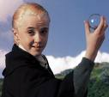
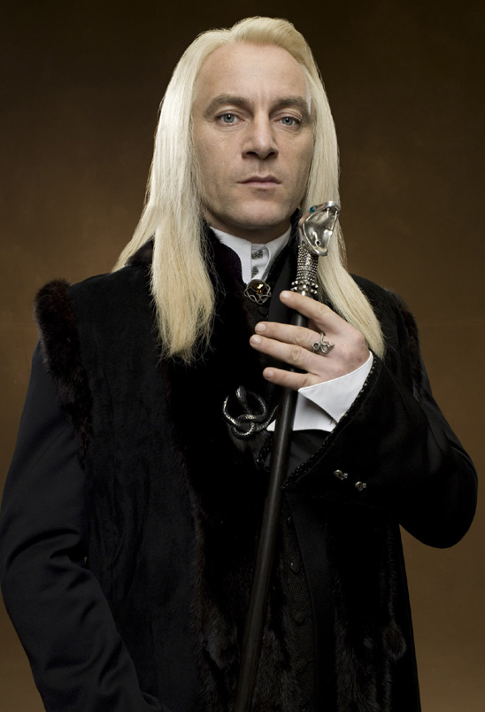
Adult knowledge:
The target state for morphology
Notes:
3

Slide 4
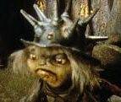
Words and word parts
The smallest unit manipulated by the rules of syntax is not a single word. Instead there are units smaller than words that play a role, called morphemes.
One goblin.
Two goblins. goblins = goblin + s =
+ plural
Morpheme = smallest unit of meaning
Notes:
4

Slide 5
Words and word parts
The smallest unit manipulated by the rules of syntax is not a single word. Instead there are units smaller than words that play a role, called morphemes.
One goblin.
Two goblins. goblins = goblin + s =
+ plural
Bound morpheme = morpheme that can’t stand on its own - it must be attached to something
Notes:
5

Slide 6
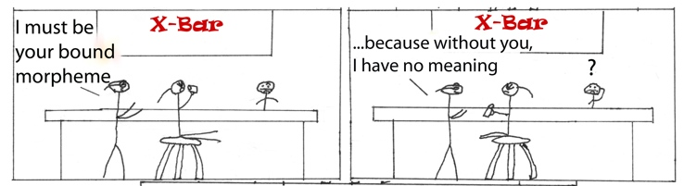
Words and word parts
The smallest unit manipulated by the rules of syntax is not a single word. Instead there are units smaller than words that play a role, called morphemes.
One goblin.
Two goblins. goblins = goblin + s =
+ plural

Slide 7
Words and word parts
The smallest unit manipulated by the rules of syntax is not a single word. Instead there are units smaller than words that play a role, called morphemes.
One goblin.
Two goblins. goblins = goblin + s =
+ plural
Free morpheme = morpheme that can stand on its own - it does not need to be attached to another morpheme
Notes:
7

Slide 8
Types of Morphology
Inflectional morphology: adds grammatical information, but does not change the word’s category (nouns stay nouns, verbs stay verbs, etc.)
Notes:
8

Slide 9
Types of Morphology
Inflectional morphology: adds grammatical information, but does not change the word’s category (nouns stay nouns, verbs stay verbs, etc.)
One goblin.
Two goblins. goblins = goblin + s =
+ plural
Notes:
9

Slide 10
Types of Morphology
Inflectional morphology: adds grammatical information, but does not change the word’s category (nouns stay nouns, verbs stay verbs, etc.)
One goblin.
Two goblins. goblins = goblin + s =
+ plural
+ present
tense
He scowls. scowls = scowl + s =
Notes:
10

Slide 11
Types of Morphology
Inflectional morphology: adds grammatical information, but does not change the word’s category (nouns stay nouns, verbs stay verbs, etc.)
One goblin.
Two goblins. goblins = goblin + s =
+ plural
+ present
tense
He scowls. scowls = scowl + s =
He’s scowling. scowling = scowl + ing =
+ continuing action
Notes:
11

Slide 12
Types of Morphology
Derivational morphology: forms a new word, potentially changing the word’s category (nouns become adjectives, verbs become nouns, etc.)
Notes:
12

Slide 13
Types of Morphology
Derivational morphology: forms a new word, potentially changing the word’s category (nouns become adjectives, verbs become nouns, etc.)
goblin
goblinish goblinish = goblin + ish =
+ similar to
Notes:
13

Slide 14
Types of Morphology
Derivational morphology: forms a new word, potentially changing the word’s category (nouns become adjectives, verbs become nouns, etc.)
goblin
goblinish goblinish = goblin + ish =
+ similar to
scowl
scowler scowler = scowl + er =
+ one who does that action
Notes:
14

Slide 15
Crosslinguistic Comparison
English does not have a rich morphological system, compared to other languages. Instead, English mostly relies on word order to indicate who did what to whom.
Languages like Hungarian, however, rely more on morphology.
“The boy gave a book to the girl.”
A fiú könyvet adott a lánynak.
The boy a book+ACC gave the girl+DAT
Notes:
15

Slide 16
Crosslinguistic Comparison
English does not have a rich morphological system, compared to other languages. Instead, English mostly relies on word order to indicate who did what to whom.
Languages like Hungarian, however, rely more on morphology.
“The boy gave a book to the girl.”
A fiú könyvet adott a lánynak.
The boy a book+ACC gave the girl+DAT
Inflectional morphology: ACC = accusative case = direct object (thing given)
Notes:
16

Slide 17
Crosslinguistic Comparison
English does not have a rich morphological system, compared to other languages. Instead, English mostly relies on word order to indicate who did what to whom.
Languages like Hungarian, however, rely more on morphology.
“The boy gave a book to the girl.”
A fiú könyvet adott a lánynak.
The boy a book+ACC gave the girl+DAT
Inflectional morphology: DAT = dative case = indirect object (recipient of giving)
Notes:
17

Slide 18
Morphology Recap
Morphology refers to how words are put together to convey meaning.
The smallest units of meaning are morphemes, which can be smaller than a whole word.
Some morphology can change the category of a word (derivational), while other morphology does not (inflectional).
Languages vary on how rich their system of morphology is. Children must learn how their language puts words together, and what types of meaning can be conveyed via morphology.
Notes:
18

Slide 19
Adult knowledge:
The target state for syntax
Notes:
19

Slide 20


Creativity of Human Language
Ability to combine signs with simple meanings to create
(1) Utterances with complex meanings
(2) Novel expressions
(3) Infinitely many
Sentences never heard before...
  “Some tulips are starting to samba on
  the chessboard.”
Sentences of prodigious length...
  “Hoggle said that he thought that the odiferous leader of the goblins had it in mind to tell the unfortunate princess that the cries that she made during her kidnapping from the nearby kingdom that the goblins themselves thought was a general waste of countryside ...”
Notes:
20

Slide 21
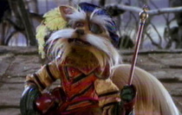
An Account That Won’t Work
“You just string words together in an order that makes sense”
In other words...
“Syntax is determined by Meaning”
(The way words are put together is determined solely by what they mean)
Notes:
21

Slide 22
Syntax is More than Meaning
Nonsense sentences with clear syntax
Colorless green ideas sleep furiously. (Chomsky)
A verb crumpled the ocean.
I gave the question a goblin-shimmying egg.
…which are incomprehensible when the syntax is nonsense
*Furiously sleep ideas green colorless.
Ocean the crumpled verb a.
*The question I an egg goblin-shimmying gave.
Notes:
22

Slide 23
Syntax is More than Meaning
Famous nonsense sentences with clear syntax
‘Twas brillig and the slithy toves
Did gyre and gimble in the wabe;
All mimsy were the borogroves,
And the mome raths outgrabe
Beware the Jabberwock, my son!
The jaws that bite, the claws that catch!
Beware the Jubjub bird, and shun
The frumious Bandersnatch!”
- Lewis Carroll, Jabberwocky
Notes:
23

Slide 24
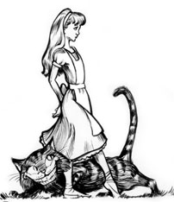
Syntax is More than Meaning
'It seems very pretty,' she said when she had finished it, 'but it's RATHER hard to understand!' (You see she didn't like to confess, even to herself, that she couldn't make it out at all.) 'Somehow it seems to fill my head with ideas -- only I don't exactly know what they are! However, SOMEBODY killed SOMETHING: that's clear, at any rate -- '
Notes:
24

Slide 25
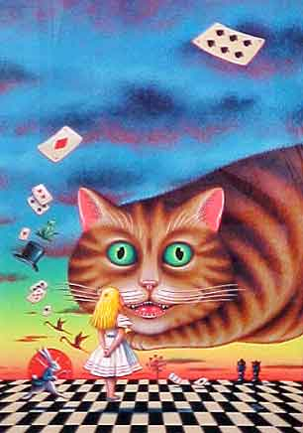
Syntax is More than Meaning
And these same nonsense sentences with nonsense syntax are incomprehensible…
‘Toves slithy the and brillig ‘twas
wabe the in gimble and gyre did...
Notes:
25

Slide 26
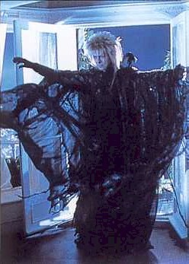
Syntax is More than Meaning
Ungrammatical sentences that make perfect sense
Jareth put the cape on.
Jareth put on the cape.
Jareth put it on.
*Jareth put on it.
Notes:
26

Slide 27
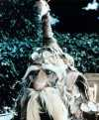
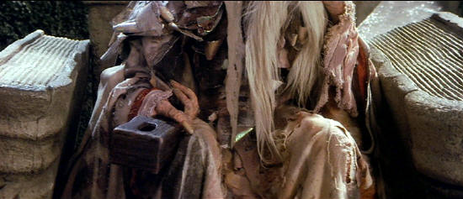
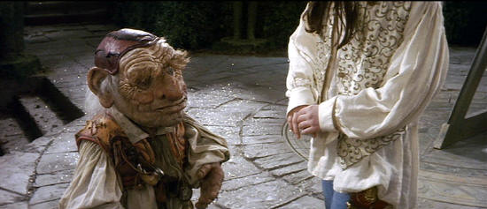
Syntax is More than Meaning
Ungrammatical sentences that make perfect sense
Sarah gave a ring to the Wiseman.
Sarah gave him a ring.
Sarah donated a ring to the Wiseman.
*Sarah donated him a ring.
Notes:
27

Slide 28
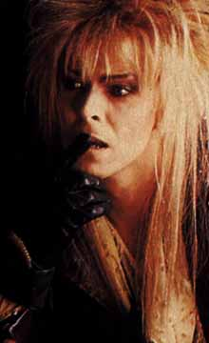
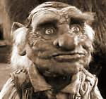
Syntax is More than Meaning
Ungrammatical sentences that make perfect sense
Jareth made Hoggle leave.
Jareth let Hoggle leave.
Jareth saw Hoggle leave.
*Jareth wanted Hoggle leave.
*Jareth made Hoggle to leave.
*Jareth let Hoggle to leave.
*Jareth saw Hoggle to leave.
Jareth wanted Hoggle to leave.
Notes:
28

Slide 29
Syntax is More than Meaning
Cross-language Variation
If syntax was entirely determined by meaning, then we should not expect to find syntactic differences between languages of the world….but we do see variation.
English: Sarah sees that book.
Korean: Sarah ku chayk poata.
    Sarah that book see
Notes:
29

Slide 30
Syntax is More than Meaning
Cross-language Variation
If syntax was entirely determined by meaning, then we should not expect to find syntactic differences between languages of the world….but we do see variation.
English:
Baso put the money in the cupboard.
Selayarese (spoken in Indonesia):
Lataroi doe injo ri lamari injo i Baso.
put money the in cupboard the Baso
Notes:
30

Slide 31
So…what does determine how you string words together?
Answer: Syntax!
(That is, our knowledge of the possible forms of sentences in our language.)
“Syntax is determined by Meaning”
(The way words are put together is determined solely by what they mean)
Notes:
31

Slide 32
A Template
A sentence often consists of a Noun Phrase followed by a Verb Phrase
S --> NP VP
Phrase Structure Rule
Phrase Structure Tree
S
NP
VP
Notes:
32

Slide 33
A Template
Noun Phrase
Verb Phrase
Hoggle
slept
The chicken
tricked the guards
Seven goblins
left
Sarah
said that Ludo thought that pixies were nasty
A feeling
kicked the bucket
The strangest story that you ever did hear
got drunk on dwarf wine
Notes:
33

Slide 34
A Template
Noun Phrase
Verb Phrase
Hoggle
slept
The chicken
tricked the guards
Seven goblins
left
Sarah
said that Ludo thought that pixies were nasty
A feeling
kicked the bucket
The strangest story that you ever did hear
got drunk on dwarf wine
6 Sentences
Notes:
34

Slide 35
A Template
Noun Phrase
Verb Phrase
Hoggle
slept
The chicken
tricked the guards
Seven goblins
left
Sarah
said that Ludo thought that pixies were nasty
A feeling
kicked the bucket
The strangest story that you ever did hear
got drunk on dwarf wine
36 Sentences
Notes:
35

Slide 36
A Template
Noun Phrase
Verb Phrase
NP --> Det N
VP --> V NP
VP
NP
V
NP
Det
N
VP --> V
NP --> N
NP
VP
N
V
Notes:
36

Slide 37
A Tiny Little Grammar
5 Rules
S --> NP VP
NP --> Det N
NP --> N
VP --> V NP
VP --> V
9 Words
Det: the, four, some
N: goblins, crystals, peaches
V: understood, ate, approached
468 Sentences
Notes:
37

Slide 38
A Tiny Little Grammar
5 Rules
S --> NP VP
NP --> Det N
NP --> N
VP --> V NP
VP --> V
30 Words
Det: the, four, some
+ 7 more
N: goblins, crystals, peaches + 7 more
V: understood, ate, approached + 7 more
122,100 Sentences
Notes:
38

Slide 39
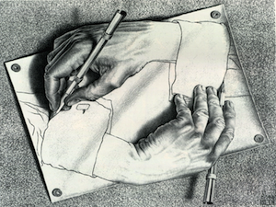
Embedded Sentences
Additional VP Rule
Hoggle thought Sarah ate the peach.
VP → V S
Recursion = a phrase of one kind inside a phrase of the same kind (a sentence is a kind of phrase, so a sentence-inside-a-sentence fits this definition)
Combine with S --> NP VP, to get recursion:
S --> NP VP --> NP V S
Can be used to create a sentence-inside-a-sentence
= example of recursion
Notes:
39

Slide 40
Embedded Sentences
Additional VP Rule
Hoggle thought Sarah ate the peach.
VP → V S
Recursion = a phrase of one kind inside a phrase of the same kind (a sentence is a kind of phrase, so a sentence-inside-a-sentence fits this definition)
Can be used to create a sentence-inside-a-sentence
= example of recursion
We can also see this property in English noun phrases
NP → NP’s Noun
Sarah’s friend is a dwarf.
Sarah’s friend’s uncle is a dwarf.
Sarah’s friend’s uncle’s neighbor is a dwarf.

Slide 41
Embedded Sentences
Additional VP Rule
Hoggle thought Sarah ate the peach.
VP → V S
Ludo said Hoggle thought Sarah ate the peach.
The fairy claimed Ludo said Hoggle thought Sarah ate the peach.
The Wiseman’s birdhat hoped the fairy claimed Ludo said Hoggle thought Sarah ate the peach.
Can be used to create a sentence-inside-a-sentence
= example of recursion
Infinitely many sentences can be generated!

Slide 42
Complementizer
Complementizer (Comp): words like THAT, IF, and WHETHER that allow one sentence to be the subject or object of another sentence
Hoggle realized that Sarah ate the peach.
Whether Sarah ate the peach didn’t matter.
S’ → Comp S
VP → V S’
S → S’ VP
Notes:
42

Slide 43
Complementizer
Complementizer (Comp): words like THAT, IF, and WHETHER that allow one sentence to be the subject or object of another sentence
Hoggle realized that Sarah ate the peach.
Whether Sarah ate the peach didn’t matter.
S’ → Comp S
VP → V S’
S → S’ VP
Example of Recursion 1:
S expands to include S’
S’ expands to include S
S → S’ VP → Comp S VP

Slide 44
Complementizer
Complementizer (Comp): words like THAT, IF, and WHETHER that allow one sentence to be the subject or object of another sentence
Hoggle realized that Sarah ate the peach.
Whether Sarah ate the peach didn’t matter.
S’ → Comp S
VP → V S’
S → S’ VP
Example of Recursion 2:
S expands to include VP
VP expands to include S’
S’ expands to include S
S → S’ VP → S’ V S’ → S’ V Comp S

Slide 45
A Slightly Bigger Grammar
9 Rules
S --> NP VP
S --> S’ VP
NP --> Det N
NP --> N
VP --> V NP
VP --> V
VP --> V S
VP --> V S’
S’ --> Comp S
Sentences it can generate:
Hoggle likes jewels.
Notes:
45

Slide 46
A Slightly Bigger Grammar
9 Rules
S --> NP VP
S --> S’ VP
NP --> Det N
NP --> N
VP --> V NP
VP --> V
VP --> V S
VP --> V S’
S’ --> Comp S
Sentences it can generate:
Hoggle likes jewels.
S --> NP VP
Notes:
46

Slide 47
A Slightly Bigger Grammar
9 Rules
S --> NP VP
S --> S’ VP
NP --> Det N
NP --> N
VP --> V NP
VP --> V
VP --> V S
VP --> V S’
S’ --> Comp S
Sentences it can generate:
Hoggle likes jewels.
S --> NP VP
NP --> N
VP --> V NP
Notes:
47

Slide 48
A Slightly Bigger Grammar
9 Rules
S --> NP VP
S --> S’ VP
NP --> Det N
NP --> N
VP --> V NP
VP --> V
VP --> V S
VP --> V S’
S’ --> Comp S
Sentences it can generate:
Hoggle likes jewels.
S --> NP VP
NP --> N
VP --> V NP
N
V NP
Hoggle
likes jewels.
Notes:
48

Slide 49
A Slightly Bigger Grammar
9 Rules
S --> NP VP
S --> S’ VP
NP --> Det N
NP --> N
VP --> V NP
VP --> V
VP --> V S
VP --> V S’
S’ --> Comp S
Sentences it can generate:
Hoggle likes jewels.
S
NP
VP
N
V
NP
Hoggle
likes jewels.
Notes:
49

Slide 50
A Slightly Bigger Grammar
9 Rules
S --> NP VP
S --> S’ VP
NP --> Det N
NP --> N
VP --> V NP
VP --> V
VP --> V S
VP --> V S’
S’ --> Comp S
Sentences it can generate:
Sarah thought that she solved the Labyrinth.
Notes:
50

Slide 51
A Slightly Bigger Grammar
9 Rules
S --> NP VP
S --> S’ VP
NP --> Det N
NP --> N
VP --> V NP
VP --> V
VP --> V S
VP --> V S’
S’ --> Comp S
Sentences it can generate:
Sarah thought that she solved the Labyrinth.
S --> NP VP
Notes:
51

Slide 52
A Slightly Bigger Grammar
9 Rules
S --> NP VP
S --> S’ VP
NP --> Det N
NP --> N
VP --> V NP
VP --> V
VP --> V S
VP --> V S’
S’ --> Comp S
Sentences it can generate:
Sarah thought that she solved the Labyrinth.
S --> NP VP
NP --> N
VP --> V S’
Notes:
52

Slide 53
A Slightly Bigger Grammar
9 Rules
S --> NP VP
S --> S’ VP
NP --> Det N
NP --> N
VP --> V NP
VP --> V
VP --> V S
VP --> V S’
S’ --> Comp S
Sentences it can generate:
Sarah thought that she solved the Labyrinth.
S --> NP VP
NP --> N
VP --> V S’
N
V S’
Sarah
thought
S’ --> Comp S
Notes:
53

Slide 54
A Slightly Bigger Grammar
9 Rules
S --> NP VP
S --> S’ VP
NP --> Det N
NP --> N
VP --> V NP
VP --> V
VP --> V S
VP --> V S’
S’ --> Comp S
Sentences it can generate:
Sarah thought that she solved the Labyrinth.
S --> NP VP
NP --> N
VP --> V S’
N
V S’
Sarah
thought
Comp S
Notes:
54

Slide 55
A Slightly Bigger Grammar
9 Rules
S --> NP VP
S --> S’ VP
NP --> Det N
NP --> N
VP --> V NP
VP --> V
VP --> V S
VP --> V S’
S’ --> Comp S
Sentences it can generate:
Sarah thought that she solved the Labyrinth.
S --> NP VP
NP --> N
VP --> V S’
N
V S’
Sarah
thought
Comp S
that
Notes:
55

Slide 56
A Slightly Bigger Grammar
9 Rules
S --> NP VP
S --> S’ VP
NP --> Det N
NP --> N
VP --> V NP
VP --> V
VP --> V S
VP --> V S’
S’ --> Comp S
Sentences it can generate:
Sarah thought that she solved the Labyrinth.
S --> NP VP
NP --> N
VP --> V S’
N
V S’
Sarah
thought
that S
Notes:
56

Slide 57
A Slightly Bigger Grammar
9 Rules
S --> NP VP
S --> S’ VP
NP --> Det N
NP --> N
VP --> V NP
VP --> V
VP --> V S
VP --> V S’
S’ --> Comp S
Sentences it can generate:
Sarah thought that she solved the Labyrinth.
S --> NP VP
NP --> N
VP --> V S’
N
V S’
Sarah
thought
that
S --> NP VP
Notes:
57

Slide 58
A Slightly Bigger Grammar
9 Rules
S --> NP VP
S --> S’ VP
NP --> Det N
NP --> N
VP --> V NP
VP --> V
VP --> V S
VP --> V S’
S’ --> Comp S
Sentences it can generate:
Sarah thought that she solved the Labyrinth.
S --> NP VP
NP --> N
VP --> V S’
N
V S’
Sarah
thought
that
NP VP
Notes:
58

Slide 59
A Slightly Bigger Grammar
9 Rules
S --> NP VP
S --> S’ VP
NP --> Det N
NP --> N
VP --> V NP
VP --> V
VP --> V S
VP --> V S’
S’ --> Comp S
Sentences it can generate:
Sarah thought that she solved the Labyrinth.
S --> NP VP
NP --> N
VP --> V S’
N
V S’
Sarah
thought
that
NP VP
NP --> N
VP --> V NP
Notes:
59

Slide 60
A Slightly Bigger Grammar
9 Rules
S --> NP VP
S --> S’ VP
NP --> Det N
NP --> N
VP --> V NP
VP --> V
VP --> V S
VP --> V S’
S’ --> Comp S
Sentences it can generate:
Sarah thought that she solved the Labyrinth.
S --> NP VP
NP --> N
VP --> V S’
N
V S’
Sarah
thought
that
NP VP
NP --> N
VP --> V NP
N
V NP
she
solved
Notes:
60

Slide 61
A Slightly Bigger Grammar
9 Rules
S --> NP VP
S --> S’ VP
NP --> Det N
NP --> N
VP --> V NP
VP --> V
VP --> V S
VP --> V S’
S’ --> Comp S
Sentences it can generate:
Sarah thought that she solved the Labyrinth.
S --> NP VP
NP --> N
VP --> V S’
N
V S’
Sarah
thought
that
NP VP
NP --> N
VP --> V NP
N
V NP
she
solved
NP --> Det N
Notes:
61

Slide 62
A Slightly Bigger Grammar
9 Rules
S --> NP VP
S --> S’ VP
NP --> Det N
NP --> N
VP --> V NP
VP --> V
VP --> V S
VP --> V S’
S’ --> Comp S
Sentences it can generate:
Sarah thought that she solved the Labyrinth.
S --> NP VP
NP --> N
VP --> V S’
N
V S’
Sarah
thought
that
NP VP
NP --> N
VP --> V NP
N
V NP
she
solved
Det N
the Labyrinth
Notes:
62

Slide 63
A Slightly Bigger Grammar
9 Rules
S --> NP VP
S --> S’ VP
NP --> Det N
NP --> N
VP --> V NP
VP --> V
VP --> V S
VP --> V S’
S’ --> Comp S
Sentences it can generate:
Sarah thought that she solved the Labyrinth.
S
NP
VP
S’
N
V
Comp
Sarah
thought
that
S
NP
VP
N
V
NP
she
solved
Det
N
the Labyrinth
Notes:
63

Slide 64
Figuring out structure: bottom-up
9 Rules
S --> NP VP
S --> S’ VP
NP --> Det N
NP --> N
VP --> V NP
VP --> V
VP --> V S
VP --> V S’
S’ --> Comp S
Sarah thought that Hoggle was a cheat.

Slide 65
Figuring out structure: bottom-up
9 Rules
S --> NP VP
S --> S’ VP
NP --> Det N
NP --> N
VP --> V NP
VP --> V
VP --> V S
VP --> V S’
S’ --> Comp S
N
V
Comp
N
V
Det
N
Sarah thought that Hoggle was a cheat.

Slide 66
Figuring out structure: bottom-up
9 Rules
S --> NP VP
S --> S’ VP
NP --> Det N
NP --> N
VP --> V NP
VP --> V
VP --> V S
VP --> V S’
S’ --> Comp S
NP
N
V
Comp
N
V
Det
N
Sarah thought that Hoggle was a cheat.

Slide 67
Figuring out structure: bottom-up
9 Rules
S --> NP VP
S --> S’ VP
NP --> Det N
NP --> N
VP --> V NP
VP --> V
VP --> V S
VP --> V S’
S’ --> Comp S
VP
NP
N
V
Comp
N
V
Det
N
Sarah thought that Hoggle was a cheat.

Slide 68
Figuring out structure: bottom-up
9 Rules
S --> NP VP
S --> S’ VP
NP --> Det N
NP --> N
VP --> V NP
VP --> V
VP --> V S
VP --> V S’
S’ --> Comp S
VP
NP
NP
N
V
Comp
N
V
Det
N
Sarah thought that Hoggle was a cheat.

Slide 69
Figuring out structure: bottom-up
9 Rules
S --> NP VP
S --> S’ VP
NP --> Det N
NP --> N
VP --> V NP
VP --> V
VP --> V S
VP --> V S’
S’ --> Comp S
S
VP
NP
NP
N
V
Comp
N
V
Det
N
Sarah thought that Hoggle was a cheat.

Slide 70
Figuring out structure: bottom-up
9 Rules
S --> NP VP
S --> S’ VP
NP --> Det N
NP --> N
VP --> V NP
VP --> V
VP --> V S
VP --> V S’
S’ --> Comp S
S’
S
VP
NP
NP
N
V
Comp
N
V
Det
N
Sarah thought that Hoggle was a cheat.

Slide 71
Figuring out structure: bottom-up
9 Rules
S --> NP VP
S --> S’ VP
NP --> Det N
NP --> N
VP --> V NP
VP --> V
VP --> V S
VP --> V S’
S’ --> Comp S
VP
S’
S
VP
NP
NP
N
V
Comp
N
V
Det
N
Sarah thought that Hoggle was a cheat.

Slide 72
Figuring out structure: bottom-up
9 Rules
S --> NP VP
S --> S’ VP
NP --> Det N
NP --> N
VP --> V NP
VP --> V
VP --> V S
VP --> V S’
S’ --> Comp S
NP
VP
S’
S
VP
NP
NP
N
V
Comp
N
V
Det
N
Sarah thought that Hoggle was a cheat.

Slide 73
Figuring out structure: bottom-up
9 Rules
S --> NP VP
S --> S’ VP
NP --> Det N
NP --> N
VP --> V NP
VP --> V
VP --> V S
VP --> V S’
S’ --> Comp S
S
NP
VP
S’
S
VP
NP
NP
N
V
Comp
N
V
Det
N
Sarah thought that Hoggle was a cheat.

Slide 74
Figuring out structure: bottom-up
9 Rules
S --> NP VP
S --> S’ VP
NP --> Det N
NP --> N
VP --> V NP
VP --> V
VP --> V S
VP --> V S’
S’ --> Comp S
That Hoggle lied surprised Sarah.

Slide 75
Figuring out structure: bottom-up
9 Rules
S --> NP VP
S --> S’ VP
NP --> Det N
NP --> N
VP --> V NP
VP --> V
VP --> V S
VP --> V S’
S’ --> Comp S
Comp
N
V
V
N
That Hoggle lied surprised Sarah.

Slide 76
Figuring out structure: bottom-up
9 Rules
S --> NP VP
S --> S’ VP
NP --> Det N
NP --> N
VP --> V NP
VP --> V
VP --> V S
VP --> V S’
S’ --> Comp S
NP
Comp
N
V
V
N
That Hoggle lied surprised Sarah.

Slide 77
Figuring out structure: bottom-up
9 Rules
S --> NP VP
S --> S’ VP
NP --> Det N
NP --> N
VP --> V NP
VP --> V
VP --> V S
VP --> V S’
S’ --> Comp S
VP
NP
Comp
N
V
V
N
That Hoggle lied surprised Sarah.

Slide 78
Figuring out structure: bottom-up
9 Rules
S --> NP VP
S --> S’ VP
NP --> Det N
NP --> N
VP --> V NP
VP --> V
VP --> V S
VP --> V S’
S’ --> Comp S
VP
VP
NP
Comp
N
V
V
N
That Hoggle lied surprised Sarah.

Slide 79
Figuring out structure: bottom-up
9 Rules
S --> NP VP
S --> S’ VP
NP --> Det N
NP --> N
VP --> V NP
VP --> V
VP --> V S
VP --> V S’
S’ --> Comp S
VP
NP
VP
NP
Comp
N
V
V
N
That Hoggle lied surprised Sarah.

Slide 80
Figuring out structure: bottom-up
9 Rules
S --> NP VP
S --> S’ VP
NP --> Det N
NP --> N
VP --> V NP
VP --> V
VP --> V S
VP --> V S’
S’ --> Comp S
S
VP
NP
VP
NP
Comp
N
V
V
N
That Hoggle lied surprised Sarah.

Slide 81
Figuring out structure: bottom-up
9 Rules
S --> NP VP
S --> S’ VP
NP --> Det N
NP --> N
VP --> V NP
VP --> V
VP --> V S
VP --> V S’
S’ --> Comp S
S’
S
VP
NP
VP
NP
Comp
N
V
V
N
That Hoggle lied surprised Sarah.

Slide 82
Figuring out structure: bottom-up
9 Rules
S --> NP VP
S --> S’ VP
NP --> Det N
NP --> N
VP --> V NP
VP --> V
VP --> V S
VP --> V S’
S’ --> Comp S
S
S’
S
VP
NP
VP
NP
Comp
N
V
V
N
That Hoggle lied surprised Sarah.

Slide 83
Syntax Recap
The structure of language (syntax) involves more than simply the meaning of the words. It involves rules about how the words themselves are allowed to go together.
It isn’t enough to know the list of possible sentences in the language. Because adults can generate novel sentences and sentences of infinite length, adults need to know a rule system that can generate sentences.
Adults know (unconsciously) a system of rules for generating the word orders they use. A fairly small set of rules can generate a fairly large set of sentences.
Notes:
83

Slide 84
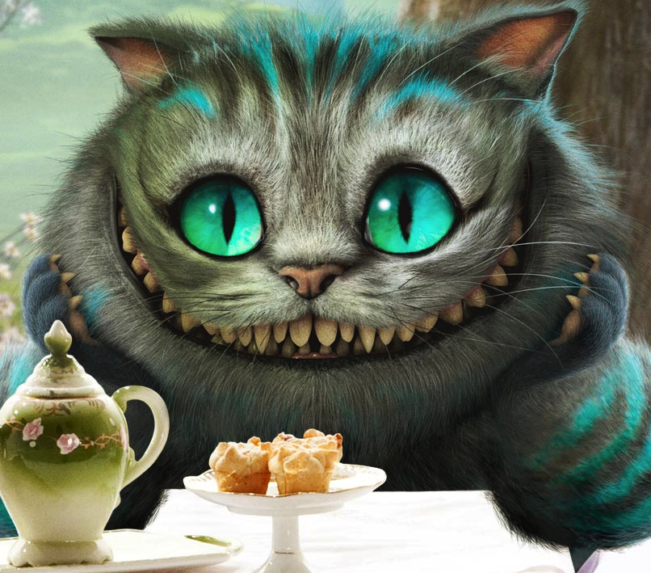
Questions?
You should be able to answer up through question 4 on the review questions, and up through question 3 on HW3.
Notes:
84

