Slide 1
Psych 156A/ Ling 150: Acquisition of Language II
5/3/2012
Midterm Review

Slide 2
Marr’s 3 Levels
Any problem can be decomposed into 3 levels:
Computational level
What’s the problem to be solved?
Algorithmic level
What (abstract) set of rules solves the problem?
Implementational level
How are those rules physically implemented?

Slide 3
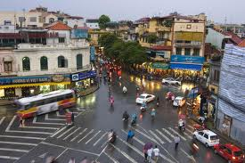
Computational Level
Abstract Problem:
How do we regulate traffic at an intersection?
Goal:
Direct lanes of traffic to avoid congestion/accidents

Slide 4
Algorithmic Level
What kind of rules can we use?
Let Lane go whenever X cars are waiting?
Let Lane go every X minutes?
Let 1 car at a time go through the intersection?
Make one direction always yield to the other?

Slide 5
Implementational Level
How do we physically implement the rule?
Set up a stop light
Set up a blinking stop light
Put up a stop sign
Have someone direct traffic
Put up nothing and have drivers implement the rules themselves!

Slide 6
Transitional Probability
TP(AB) = P(AB|A) = # of times you saw AB / # of times you saw A
ka/ko/si
ko/li/ja
ja/ko
li/je/vo
TP(ko/si) = # of times ko/si / # of times ko
TP(ja/vo) = # of times ja/vo / # of times ja

Slide 7
TP Minima
TP can be though of like a tide
Every time the TP is at “low tide” we put a boundary
0.7
0.65
0.55
0.5
0.45
0.4
0.35
0.3
0.3
0.2
0.15

Slide 8
Precision & Recall
I wonder how well I can segment this sentence today
Iwonder how well Ican seg ment this sen tencetoday

Slide 9
Precision & Recall
I wonder how well I can segment this sentence today
Iwonder how well Ican seg ment this sen tencetoday
Precision:
# of correct / # guessed
3 correct / 9 guessed

Slide 10
Precision & Recall
I wonder how well I can segment this sentence today
Iwonder how well Ican seg ment this sen tencetoday
Recall:
# of correct / # true words
3 correct / 10 true

Slide 11
Stress-based Segmentation
how WELL can a STRESS based LEARNER SEGment THIS?
If we assume Stress-INITIAL syllables:
How WELLcana STRESSbased LEARNER SEGment THIS?
Precision = 3/6 Recall = 3/9

Slide 12
Stress-based Segmentation
how WELL can a STRESS based LEARNER SEGment THIS?
If we assume Stress-FINAL syllables:
HowWELL canaSTRESS basedLEARNER SEG mentTHIS?
Precision = 0/5 Recall = 0/9

Slide 13
Bayesian Learning
All (statistical) learning is a form of INFERENCE
We have data…
But which hypothesis is true?
P(H|D) ?
P(H | D) = P(D | H) * P(H) / P(D)
posterior
likelihood
prior
prob. of data

Slide 14
Cross-Situational Learning
Use information across trials to identify a word/meaning mapping
Scene 1: “dugme” “lutka” “prozor”
Object 1 Object 2 Object 3
Scene 2: “lutka” “zid” “prozor”
Object 1 Object 3 Object 4

Slide 15
Cross-Situational Learning
Scene 1: “dugme” “lutka” “prozor”
Object 1 Object 2 Object 3
Scene 2: “lutka” “zid” “prozor”
Object 1 Object 3 Object 4
P(H|D) = P(D|H) * P(H) / P(D)
Posterior = likelihood * prior / prob. of data
P(lutka == 1) = ¼ Prior (let’s call this H1)
P(D | H1) = 1 Likelihood
P(D) = P(H1)*P(D|H1) + P(H2)*P(D|H2) + P(H3)*P(D|H3)…
P(H1 | D) = P(D | H1) * P(H1) / P(D)

Slide 16
Suspicious Coincedence
Three hypotheses:
Superordinate: “mammal”
Basic: “dog”
Subordinate: “beagle”
H1
H2
H3
Given a picture of a beagle:
P(data|H3) = 1/# of beagles
> P(data|H2) = 1/# of dogs
> P(data|H1) = 1/# of mammals

Slide 17
Contrastive Sounds
A pair of sounds are contrastive if:
Switching the sounds changes the MEANING
In English:
“food”: [f u d] ← Contrastive
“rude”: [r u d]
In German:
“street”: [s t R a s ə] ← Not contrastive
“street”: [s t r a s ə]

Slide 18
Learning Sounds
Maintenance & Loss Theory:
If you use a distinction in your language
Keep it
If you don’t use it
Ignore the distinction
Functional Reorganization:
Create a filter between acoustics and phonemes
If you hear a language sound
Impose filter to ignore non-native distinctions
If you hear a non-language sound
Don’t impose the filter

Slide 19
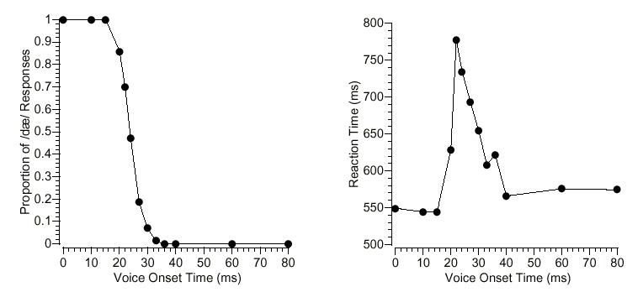
Sound Identification

Slide 20
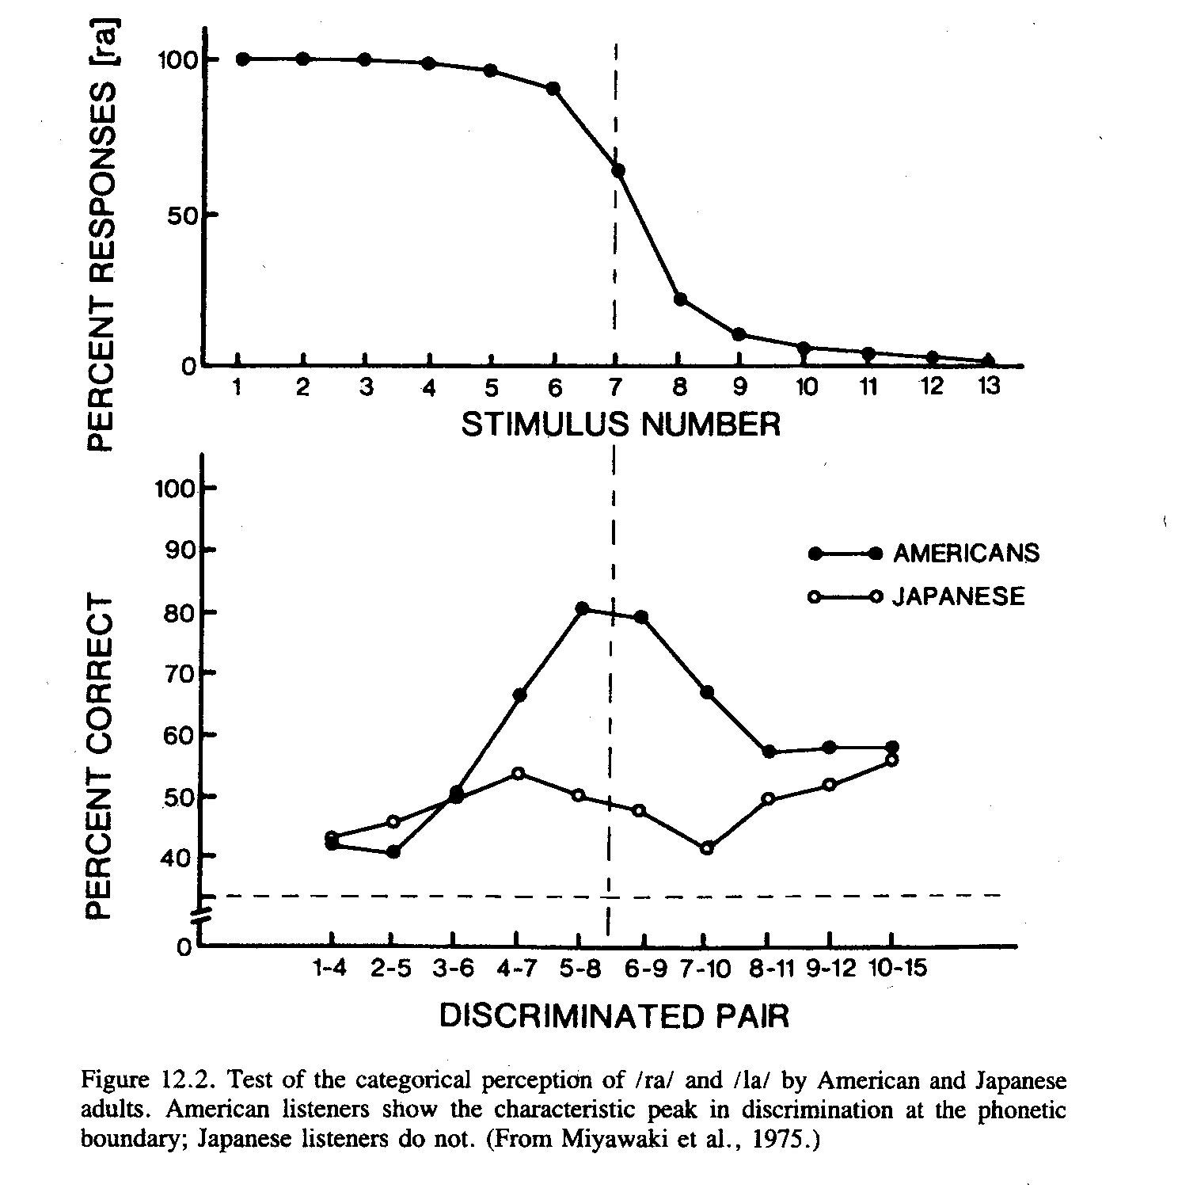
Sound Discrimination

