Slide 1
Psych 156A/ Ling 150: Acquisition of Language II
Lecture 6
Words in Fluent Speech I
Notes:
1

Slide 2
Announcements
HW1 due today by the end of class
HW2 now available (not due till after midterm)
Review questions on word segmentation now available
Midterm review: in class on 5/3/12
Midterm: during class on 5/8/12
Notes:
2

Slide 3
Computational Problem
Divide spoken speech into individual words
Notes:
3

Slide 4
Computational Problem
Divide spoken speech into individual words
to the castle beyond the goblin city
Notes:
4

Slide 5
Word Segmentation
“One task faced by all language learners is the segmentation of fluent speech into words. This process is particularly difficult because word boundaries in fluent speech are marked inconsistently by discrete acoustic events such as pauses…it is not clear what information is used by infants to discover word boundaries…there is no invariant cue to word boundaries present in all languages.”
- Saffran, Aslin, & Newport (1996)
Notes:
5

Slide 6
Pauses between words don’t really happen
Word boundaries are not necessarily evident in the acoustic waveform
whereareth
the s ilen ces bet weenword s
Notes:
6

Slide 7
Segmentation mistakes from children
Two dults
[Two adults]
I don’t want to go to your ami!
[I don’t want to go to Miami]
I am being have!
[I am behaving!] (in response to “Behave!”)
Oh say can you see by the donzerly light?
[Oh say can you see by the dawn’s early light?]
Notes:
7

Slide 8
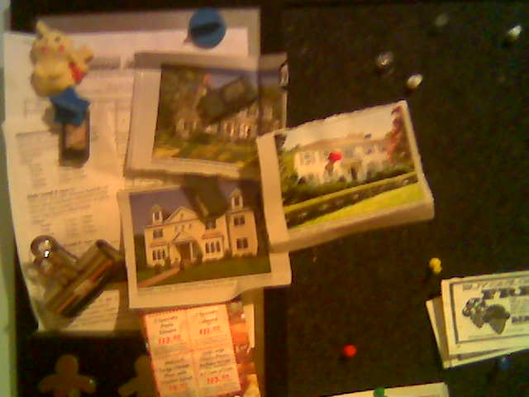
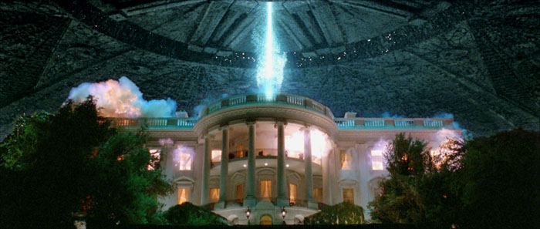
Top-down influence
th e w h i teh o u se i s u n d e ra tt a ck
The white house is under a tack.
The White House is under attack.
Notes:
8

Slide 9
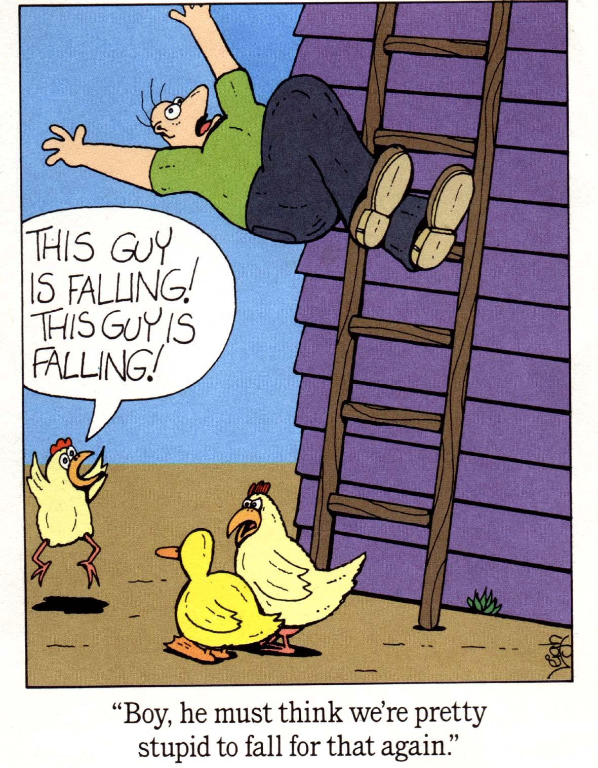
Top-down influence
The sky is falling!
or
This guy is falling!
Notes:
9

Slide 10
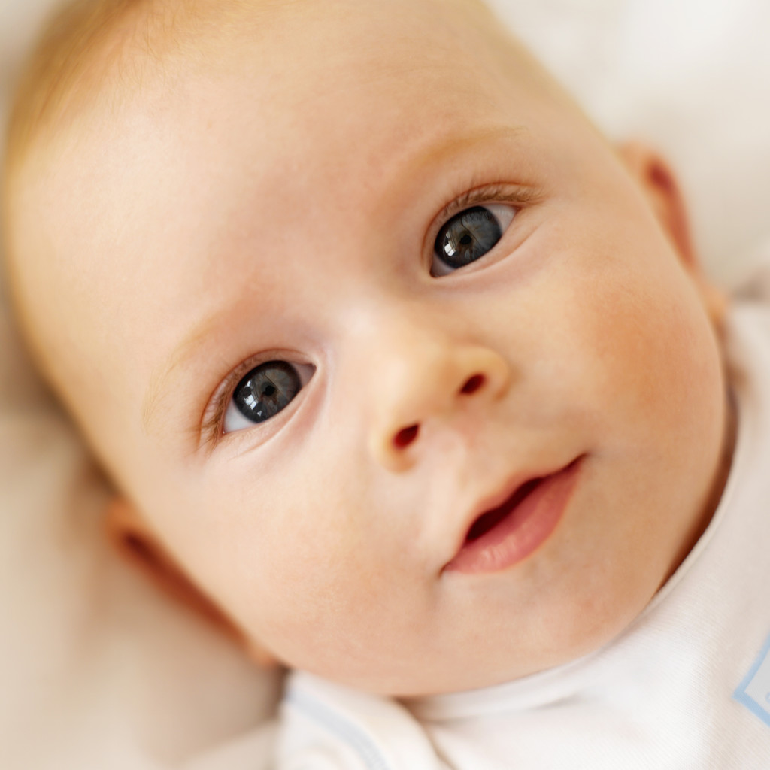
Adults can use top-down information (knowledge of words and the world) to help them with word segmentation.
What about infants who have none or few words in their vocabulary?
Notes:
10

Slide 11
Statistical Information Available
Maybe infants are sensitive to the statistical patterns contained in sequences of sounds.
“Over a corpus of speech there are measurable statistical regularities that distinguish recurring sound sequences that comprise words from the more accidental sound sequences that occur across word boundaries.” - Saffran, Aslin, & Newport (1996)
to the castle beyond the goblin city
Notes:
11

Slide 12
Statistical Information Available
Maybe infants are sensitive to the statistical patterns contained in sequences of sounds.
“Over a corpus of speech there are measurable statistical regularities that distinguish recurring sound sequences that comprise words from the more accidental sound sequences that occur across word boundaries.” - Saffran, Aslin, & Newport (1996)
Statistical regularity: ca + stle is a common sound sequence
to the castle beyond the goblin city
Notes:
12

Slide 13
Statistical Information Available
Maybe infants are sensitive to the statistical patterns contained in sequences of sounds.
“Over a corpus of speech there are measurable statistical regularities that distinguish recurring sound sequences that comprise words from the more accidental sound sequences that occur across word boundaries.” - Saffran, Aslin, & Newport (1996)
No regularity: stle + be is an accidental sound sequence
to the castle beyond the goblin city
word boundary
Notes:
13

Slide 14
Transitional Probability
“Within a language, the transitional probability from one sound to the next will generally be highest when the two sounds follow one another in a word, whereas transitional probabilities spanning a word boundary will be relatively low.” - Saffran, Aslin, & Newport (1996)
Transitional Probability = Conditional Probability
TrProb(AB) = Prob( B | A)
Transitional probability of sequence AB is the conditional probability of B, given that A has been encountered.
TrProb(“gob” ”lin”) = Prob(“lin” | “gob”)
Read as “the probability of ‘lin’, given that ‘gob’ has just been encountered”
Notes:
14

Slide 15
Transitional Probability
“Within a language, the transitional probability from one sound to the next will generally be highest when the two sounds follow one another in a word, whereas transitional probabilities spanning a word boundary will be relatively low.” - Saffran, Aslin, & Newport (1996)
Transitional Probability = Conditional Probability
TrProb(“gob” ”lin”) = Prob(“lin” | “gob”)
Example of how to calculate TrProb:
gob…
…ble, …bler, …bledygook, …let, …lin, …stopper
(6 options for what could follow “gob”)
TrProb(“gob” “lin”) = Prob(“lin” | “gob”) = 1/6
Notes:
15

Slide 16
Transitional Probability
“Within a language, the transitional probability from one sound to the next will generally be highest when the two sounds follow one another in a word, whereas transitional probabilities spanning a word boundary will be relatively low.” - Saffran, Aslin, & Newport (1996)
Idea: Prob(“stle” | ”ca”) = high
Why? “ca” is usually followed by “stle”
to the castle beyond the goblin city
Notes:
16

Slide 17
Transitional Probability
“Within a language, the transitional probability from one sound to the next will generally be highest when the two sounds follow one another in a word, whereas transitional probabilities spanning a word boundary will be relatively low.” - Saffran, Aslin, & Newport (1996)
Idea: Prob(“be” | ”stle”) = lower
Why? “stle” is not usually followed by “be”
to the castle beyond the goblin city
word boundary
Notes:
17

Slide 18
Transitional Probability
“Within a language, the transitional probability from one sound to the next will generally be highest when the two sounds follow one another in a word, whereas transitional probabilities spanning a word boundary will be relatively low.” - Saffran, Aslin, & Newport (1996)
Prob(“yond” | ”be”) = higher
Why? “be” is commonly followed by “yond”, among other options
to the castle beyond the goblin city
Notes:
18

Slide 19
Transitional Probability
“Within a language, the transitional probability from one sound to the next will generally be highest when the two sounds follow one another in a word, whereas transitional probabilities spanning a word boundary will be relatively low.” - Saffran, Aslin, & Newport (1996)
Prob(“be” | “stle”) < Prob(“stle” | “ca”)
Prob(“be” | “stle”) < Prob(“yond” | “be”)
to the castle beyond the goblin city
TrProb learner posits word boundary here,
at the minimum of the transitional probabilities
Important: doesn’t matter what the probability actually is, so long as it’s a minimum when compared to the probabilities surrounding it
Notes:
19

Slide 20
Transitional Probability Example
un
der
stand
my
po
si
tion
0.9
0.5
0.1
0.3
0.5
0.9
0.1 < 0.5
0.1 < 0.3
0.1 = Transitional probability minimum, compared with surrounding transitional probabilities (0.5, 0.3)
Word boundary is here
Notes:
20

Slide 21
Another Transitional Probability Example
un
der
stand
my
po
si
tion
0.9
0.8
0.7
0.9
0.5
0.9
0.7 < 0.8
0.7 < 0.9
0.7 = Transitional probability minimum, compared with surrounding transitional probabilities (0.8, 0.9)
Word boundary is here

Slide 22
8-month-old statistical learning
Saffran, Aslin, & Newport 1996
Familiarization-Preference Procedure (Jusczyk & Aslin 1995)
Habituation:
Infants exposed to auditory material that serves as potential learning experience
Test stimuli (tested immediately after familiarization):
(familiar) Items contained within auditory material
(novel) Items not contained within auditory material, but which are nonetheless highly similar to that material
Notes:
22

Slide 23
8-month-old statistical learning
Saffran, Aslin, & Newport 1996
Familiarization-Preference Procedure (Jusczyk & Aslin 1995)
Measure of infants’ response:
Infants control duration of each test trial by their sustained visual fixation on a blinking light.
Idea: If infants have extracted information (based on transitional probabilities), then they will have different looking times for the different test stimuli.
Notes:
23

Slide 24
Artificial Language
Saffran, Aslin, & Newport 1996
4 made-up words with 3 syllables each
Condition A:
tupiro, golabu, bidaku, padoti
Condition B:
dapiku, tilado, burobi, pagotu
Notes:
24

Slide 25
Artificial Language
Saffran, Aslin, & Newport 1996
Infants were familiarized with a sequence of these words generated by speech synthesizer for 2 minutes. Speaker’s voice was female and intonation was monotone. There were no acoustic indicators of word boundaries.
Sample monotone speech:
tu pi ro go la bu bi da ku pa do ti go la bu tu pi ro pa do ti…
http://whyfiles.org/058language/images/baby_stream.aiff
Notes:
25

Slide 26
Artificial Language
Saffran, Aslin, & Newport 1996
The only cues to word boundaries were the transitional probabilities between syllables.
Within words, transitional probability of syllables = 1.0
Across word boundaries, transitional probability of syllables = 0.33
tu pi ro go la bu bi da ku pa do ti go la bu tu pi ro pa do ti…
Notes:
26

Slide 27
Artificial Language
Saffran, Aslin, & Newport 1996
The only cues to word boundaries were the transitional probabilities between syllables.
Within words, transitional probability of syllables = 1.0
Across word boundaries, transitional probability of syllables = 0.33
tu pi ro go la bu bi da ku pa do ti go la bu tu pi ro pa do ti…
TrProb(“tu” “pi”) = 1.0
Notes:
27

Slide 28
Artificial Language
Saffran, Aslin, & Newport 1996
The only cues to word boundaries were the transitional probabilities between syllables.
Within words, transitional probability of syllables = 1.0
Across word boundaries, transitional probability of syllables = 0.33
tu pi ro go la bu bi da ku pa do ti go la bu tu pi ro pa do ti…
TrProb(“tu” “pi”) = 1.0 = TrProb(“go” “la”), TrProb(“pa” “do”)
Notes:
28

Slide 29
Artificial Language
Saffran, Aslin, & Newport 1996
The only cues to word boundaries were the transitional probabilities between syllables.
Within words, transitional probability of syllables = 1.0
Across word boundaries, transitional probability of syllables = 0.33
TrProb(“ro” “go”) < 1.0 (0.3333…)
tu pi ro go la bu bi da ku pa do ti go la bu tu pi ro pa do ti…
Notes:
29

Slide 30
Artificial Language
Saffran, Aslin, & Newport 1996
The only cues to word boundaries were the transitional probabilities between syllables.
Within words, transitional probability of syllables = 1.0
Across word boundaries, transitional probability of syllables = 0.33
TrProb(“ro” “go”), TrProb(“ro” “pa”) = 0.3333… <
1.0 = TrPrb(“pi” ro”), TrProb (“go” “la”), TrProb(“pa” “do”)
tu pi ro go la bu bi da ku pa do ti go la bu tu pi ro pa do ti…
word boundary
word boundary
Notes:
30

Slide 31
Testing Infant Sensitivity
Saffran, Aslin, & Newport 1996
Expt 1, test trial:
Each infant presented with repetitions of 1 of 4 words
2 were “real” words
(ex: tupiro, golabu)
2 were “fake” words whose syllables were jumbled up
(ex: ropitu, bulago)
tu pi ro go la bu bi da ku pa do ti go la bu tu pi ro pa do ti…
Notes:
31

Slide 32
Testing Infant Sensitivity
Saffran, Aslin, & Newport 1996
Expt 1, test trial:
Each infant presented with repetitions of 1 of 4 words
2 were “real” words
(ex: tupiro, golabu)
2 were “fake” words whose syllables were jumbled up
(ex: ropitu, bulago)
tu pi ro go la bu bi da ku pa do ti go la bu tu pi ro pa do ti…
Notes:
32

Slide 33
Testing Infant Sensitivity
Saffran, Aslin, & Newport 1996
Expt 1, results:
Infants listened longer to novel items (non-words)
(7.97 seconds for real words, 8.85 seconds for non-words)
Implication: Infants noticed the difference between real words and non-words from the artificial language after only 2 minutes of listening time!
Notes:
33

Slide 34
Testing Infant Sensitivity
Saffran, Aslin, & Newport 1996
Expt 1, results:
Infants listened longer to novel items (non-words)
(7.97 seconds for real words, 8.85 seconds for non-words)
Implication: Infants noticed the difference between real words and non-words from the artificial language after only 2 minutes of listening time!
But why?
Could be that they just noticed a familiar sequence of sounds (“tupiro” familiar while “ropitu” never appeared), and didn’t notice the differences in transitional probabilities.
Notes:
34

Slide 35
Testing Infant Sensitivity
Saffran, Aslin, & Newport 1996
Expt 2, test trial:
Each infant presented with repetitions of 1 of 4 words
2 were “real” words
(ex: tupiro, golabu)
2 were “part” words whose syllables came from two different words in order
(ex: pirogo, bubida)
tu pi ro go la bu bi da ku pa do ti go la bu tu pi ro pa do ti…
Notes:
35

Slide 36
Testing Infant Sensitivity
Saffran, Aslin, & Newport 1996
Expt 2, test trial:
Each infant presented with repetitions of 1 of 4 words
2 were “real” words
(ex: tupiro, golabu)
2 were “part” words whose syllables came from two different words in order
(ex: pirogo, bubida)
tu pi ro go la bu bi da ku pa do ti go la bu tu pi ro pa do ti…
Notes:
36

Slide 37
Testing Infant Sensitivity
Saffran, Aslin, & Newport 1996
Expt 2, test trial:
Each infant presented with repetitions of 1 of 4 words
2 were “real” words
(ex: tupiro, golabu)
2 were “part” words whose syllables came from two different words in order
(ex: pirogo, bubida)
tu pi ro go la bu bi da ku pa do ti go la bu tu pi ro pa do ti…
Notes:
37

Slide 38
Testing Infant Sensitivity
Saffran, Aslin, & Newport 1996
Expt 2, results:
Infants listened longer to novel items (part-words)
(6.77 seconds for real words, 7.60 seconds for part-words)
Implication: Infants noticed the difference between real words and part-words from the artificial language after only 2 minutes of listening time! They are sensitive to the transitional probability information.
Notes:
38

Slide 39
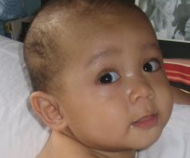
Recap: Saffran, Aslin, & Newport (1996)
Experimental evidence suggests that 8-month-old infants can track statistical information such as the transitional probability between syllables. This can help them solve the task of word segmentation.
Evidence comes from testing children in an artificial language paradigm, with very short exposure time.
Notes:
39

Slide 40
Other useful strategies
In additional to statistical information, infants appear to also use other cues to help them identify words in fluent speech.
Infants use the prosody (rhythm) of an utterance to help them identify likely boundaries for words (sequences that cross utterance or clause boundaries are less likely to be words). [Gout et al. 2004; Hirsh-Pasek et al. 1987; Jusczyk et al. 1992; Gerken et al. 1994; Nazzi et al. 2000; Seidl 2007]
clause boundary
“I went to the castle beyond the goblin city, which was very hard to get to. I saw the goblin king.”
utterance boundary

Slide 41
Other useful strategies
In additional to statistical information, infants appear to also use other cues to help them identify words in fluent speech.
Infants use the prosody (rhythm) of an utterance to help them identify likely boundaries for words (sequences that cross utterance or clause boundaries are less likely to be words). [Gout et al. 2004; Hirsh-Pasek et al. 1987; Jusczyk et al. 1992; Gerken et al. 1994; Nazzi et al. 2000; Seidl 2007]
{pause}
“I went to the castle beyond the goblin city, which was very hard to get to. I saw the goblin king.”
{pause}

Slide 42
Other useful strategies
In additional to statistical information, infants appear to also use other cues to help them identify words in fluent speech.
Infants use the prosody (rhythm) of an utterance to help them identify likely boundaries for words (sequences that cross utterance or clause boundaries are less likely to be words). [Gout et al. 2004; Hirsh-Pasek et al. 1987; Jusczyk et al. 1992; Gerken et al. 1994; Nazzi et al. 2000; Seidl 2007]
{pause}
“I went to the castle beyond the goblin city, which was very hard to get to. I saw the goblin king.”
Not crossing a clause or utterance boundary - more likely to be a word
{pause}

Slide 43
Other useful strategies
In additional to statistical information, infants appear to also use other cues to help them identify words in fluent speech.
Infants use the prosody (rhythm) of an utterance to help them identify likely boundaries for words (sequences that cross utterance or clause boundaries are less likely to be words). [Gout et al. 2004; Hirsh-Pasek et al. 1987; Jusczyk et al. 1992; Gerken et al. 1994; Nazzi et al. 2000; Seidl 2007]
{pause}
“I went to the castle beyond the goblin city, which was very hard to get to. I saw the goblin king.”
Crossing a clause boundary - less likely to be a word
{pause}

Slide 44
Other useful strategies
In additional to statistical information, infants appear to also use other cues to help them identify words in fluent speech.
Infants use the prosody (rhythm) of an utterance to help them identify likely boundaries for words (sequences that cross utterance or clause boundaries are less likely to be words). [Gout et al. 2004; Hirsh-Pasek et al. 1987; Jusczyk et al. 1992; Gerken et al. 1994; Nazzi et al. 2000; Seidl 2007]
{pause}
“I went to the castle beyond the goblin city, which was very hard to get to. I saw the goblin king.”
{pause}
Crossing an utterance boundary - less likely to be a word

Slide 45
Other useful strategies
In additional to statistical information, infants appear to also use other cues to help them identify words in fluent speech.
Infants distinguish between stressed and unstressed syllables, and they learn language-specific biases. English infants prefer words to begin with stress (Jusczyk et al. 1993, Jusczyk et al. 1999) while French infants prefer words to end with stress (Vihman et al. 1998).
{pause}
“I went to the castle beyond the goblin city, which was very hard to get to. I saw the goblin king.”
{pause}

Slide 46
Other useful strategies
In additional to statistical information, infants appear to also use other cues to help them identify words in fluent speech.
Infants distinguish between stressed and unstressed syllables, and they learn language-specific biases. English infants prefer words to begin with stress (Jusczyk et al. 1993, Jusczyk et al. 1999) while French infants prefer words to end with stress (Vihman et al. 1998).
{pause}
“I went to the castle beyond the goblin city, which was very hard to get to. I saw the goblin king.”
{pause}
Pretty good strategy for English…

Slide 47
Other useful strategies
In additional to statistical information, infants appear to also use other cues to help them identify words in fluent speech.
Infants distinguish between stressed and unstressed syllables, and they learn language-specific biases. English infants prefer words to begin with stress (Jusczyk et al. 1993, Jusczyk et al. 1999) while French infants prefer words to end with stress (Vihman et al. 1998).
{pause}
“I went to the castle beyond the goblin city, which was very hard to get to. I saw the goblin king.”
{pause}
…though it’s not perfect

Slide 48
Other useful strategies
In additional to statistical information, infants appear to also use other cues to help them identify words in fluent speech.
But how do infants learn these language-specific stress biases? Swingley (2005) suggests that they arise from the initial words infants extract by using statistical cues. This initial set of words is sometimes called a proto-lexicon.
went castle goblin city
very hard get saw
king
All words in this English proto-lexicon appear to begin with a stressed syllable.

Slide 49
Other useful strategies
In additional to statistical information, infants appear to also use other cues to help them identify words in fluent speech.
Some evidence that this is the right sequence of events:
Thiessen & Saffran (2003) found that 6-month-olds prefer to segment using statistical cues (like transitional probability), but 9-month-olds prefer to use lexical stress cues. This suggests that infants first rely on statistical cues, and use the proto-lexicon derived from these statistical cues to infer the appropriate lexical stress bias.

Slide 50
Recap: Other useful strategies
Besides statistical cues to word segmentation, infants are apparently sensitive to prosodic cues such as clause and utterance boundaries, and also lexical stress patterns.
It seems that some of the lexical stress cues infants use are language-specific, so these cues are probably not used initially. Instead, these cues may be derived from the proto-lexicons infants have after using statistical cues.

Slide 51
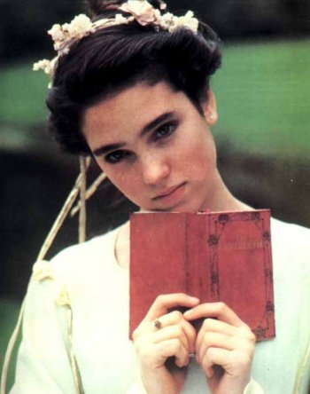
Questions?
You should be able to do up through question 3 on HW2 and up through question 6 on the word segmentation review questions.
Notes:
51

