Slide 1
Psych 156A/ Ling 150:
Acquisition of Language II
Lecture 3
Sounds
Notes:
1

Slide 2
Announcements
Be working on HW1 (due 4/19/12)
Review questions available for sounds & sounds of words
IPA sound conversion chart available
Notes:
2

Slide 3
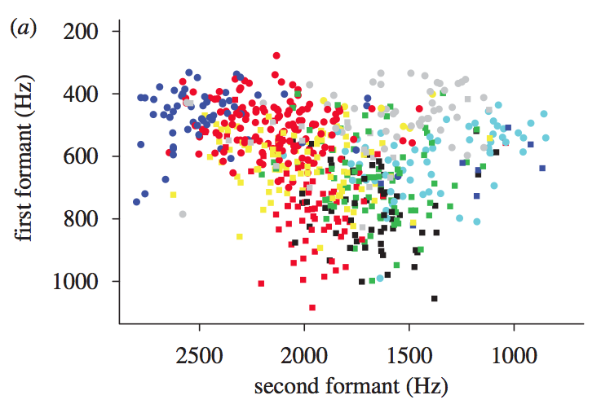
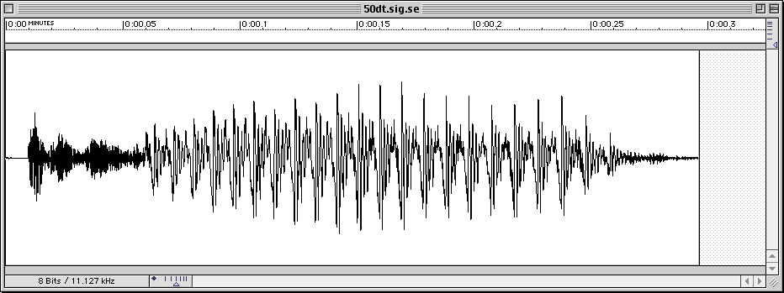
Learning Sounds
Notes:
3

Slide 4
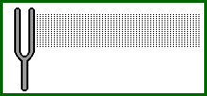
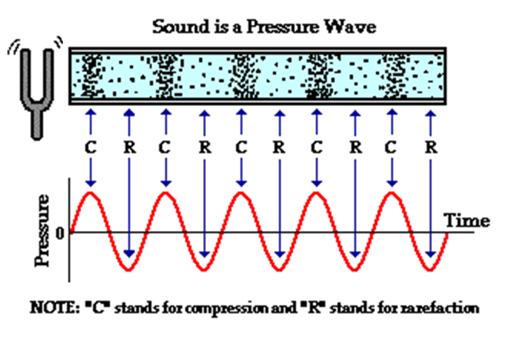
Sound Waves
A wave is a disturbance of a medium which transports energy through the medium without permanently transporting matter.
Notes:
4

Slide 5
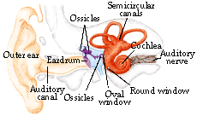
Listening
Hearing Frequency:
20 Hz and 20000 Hz
Speech:
200-8000 Hz
Most sensitive to
1000-3500 Hz
Phones (speech sounds): 300-3400 Hz
Notes:
5

Slide 6
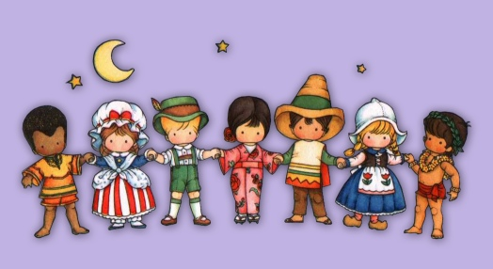
Sounds of Language (Speech Perception)
Learner’s job: Identify phonemes (contrastive sounds that signal a change in meaning)
big vs. pig
Phonemes are language-specific - r/l is a phonemic contrast in English but not in Japanese
Lisa = Risa for some of my Japanese friends
Kids of the world require knowledge of phonemes before they can figure out what different words are - and when different meanings are signaled by different words
Notes:
6

Slide 7
About Speech Perception
Important: Not all languages use the same contrastive sounds.
Languages draw from a common set of sounds (which can be represented by the International Phonetic Alphabet (IPA)), but only use a subset of that common set.
Child’s task: Figure out what sounds their native language uses contrastively.
Phonemic
meaningful sounds in the language: “contrastive sounds” or phonemic contrasts
Constructed
Acoustic
Innate
Notes:
7

Slide 8
Speech Perception: Computational Problem
Divide sounds into contrastive categories (phonemes)
Here, 23 acoustically-different sounds are clustered into 4 contrastive categories. Sounds within categories are perceived as being identical to each other.
x
x
x
x
x
x
x
x
x
C2
x
x
C1
x
x
x
x
x
x
x
x
x
x
x
x
x
x
x
x
x
x
x
x
x
C4
C3
x
x
x
x
x
x
x
x
x
x
x
x
x
x
Notes:
8

Slide 9
Speech Perception: Computational Problem
Note: Real life sounds are actually much harder because categories overlap.
Each color represents one vowel (that is, a sound perceived by native speakers as one vowel, like “oo” or “ee”)

Slide 10
Categorical Perception
Categorical perception occurs when a range of stimuli that differ continuously are perceived as belonging to only a few categories, with no degrees of difference within a given category.
Actual stimuli
Categorical Perception of stimuli
Notes:
10

Slide 11
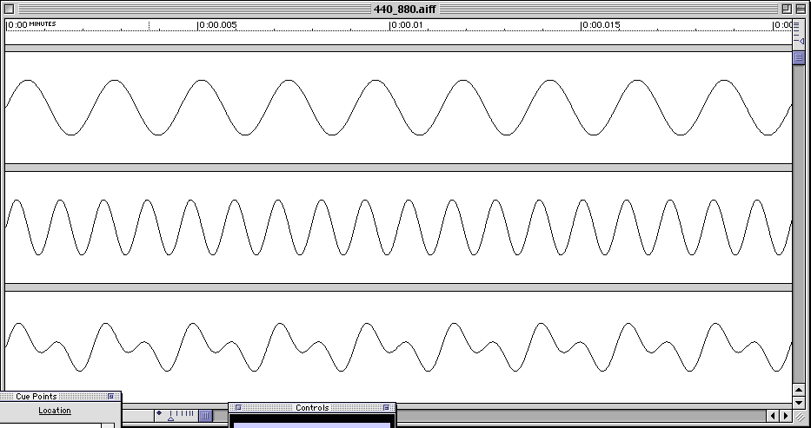

Acoustic-Level Information
Includes: timing and frequency
Tones: frequency (close-up)
Notes:
11

Slide 12
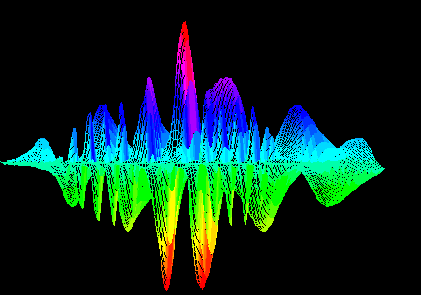
Acoustic-Level Information
Language sounds
Vowels combine acoustic energy at a number of different frequencies
Different vowels ([a] “ah”, [i] “ee”, [u] “oo” etc.) contain acoustic energy at different frequencies
Listeners must (unconsciously) perform a ‘frequency analysis’ of vowels in order to identify them
(Fourier Analysis)
Notes:
12

Slide 13
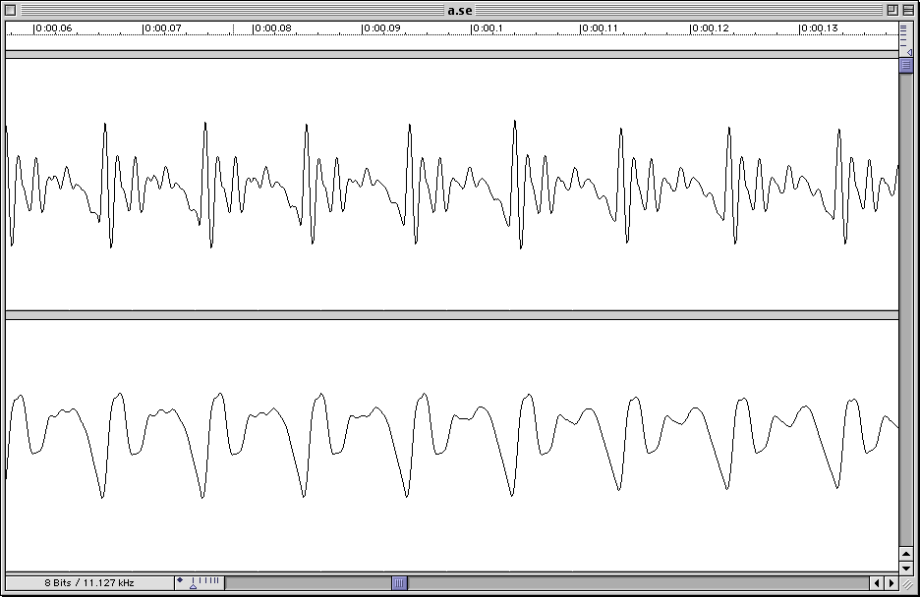
Acoustic-Level Information
Language sounds
Male Vowels (close up)
Notes:
13

Slide 14
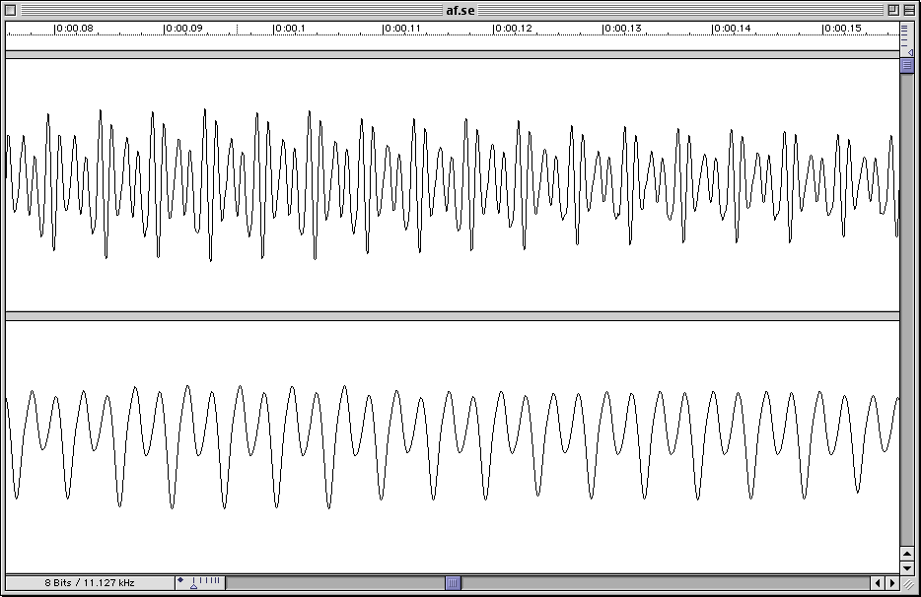
Acoustic-Level Information
Language sounds
Female Vowels (close up)
Notes:
14

Slide 15
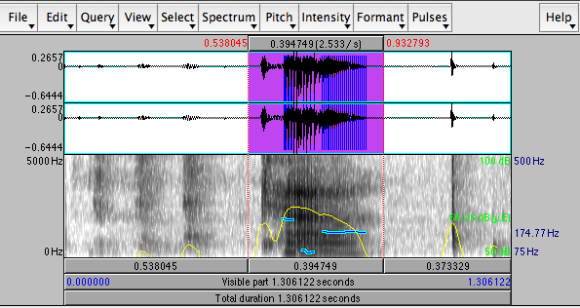
Synthesized Speech
Allows for precise control of sounds
Valuable tool for investigating perception: Praat
www.praat.org
Notes:
15

Slide 16
Acoustic-Level Information
Language sounds
Timing: Voicing
Notes:
16

Slide 17
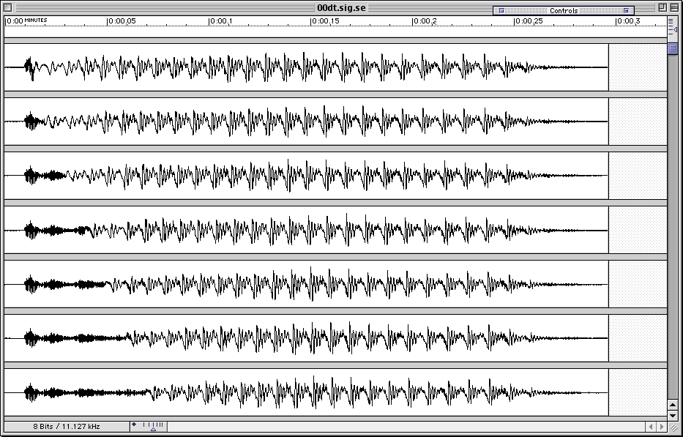
Acoustic-Level Information
Language sounds
Timing: Voice Onset Time (VOT)
60 ms
Notes:
17

Slide 18
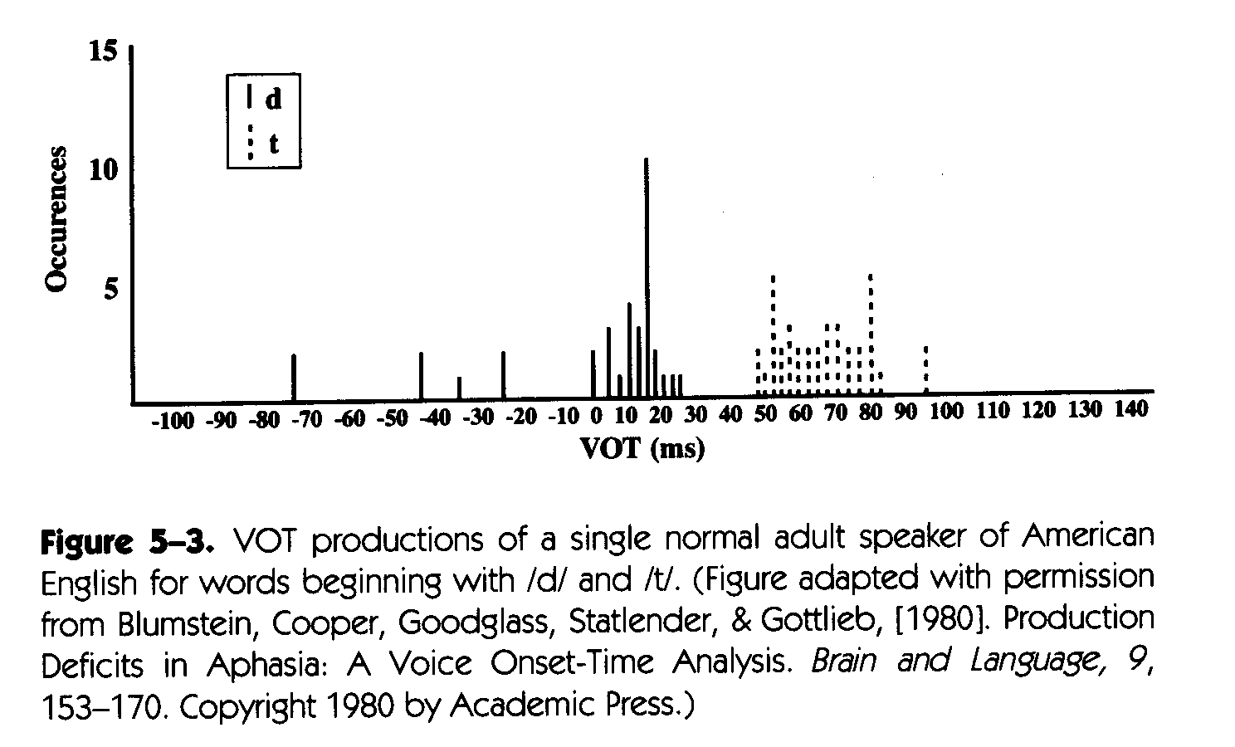
English VOT production
Not uniform - there are 2 categories (distribution is bimodal)
Perception of stimuli: 2 categories
Notes:
18

Slide 19
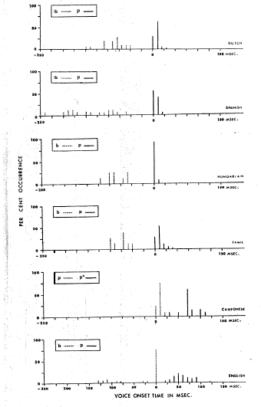
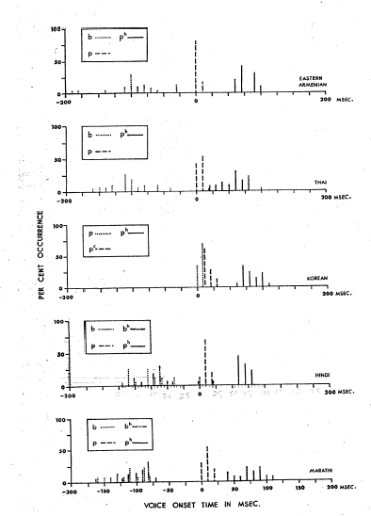
Dutch
Eastern
Armenian
Spanish
Thai
Hungarian
Korean
Tamil
Hindi
Cantonese
English
Marathi
Notes:
19

Slide 20


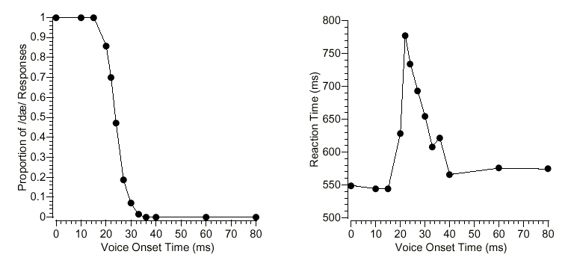
Perceiving VOT
‘Categorical Perception’: dQ vs. tQ
Longer decision time at category boundary
More uncertainty/ error at category boundary
Decision between d/t
Identification task:“Is this sound or ?”
Time to make decision
Notes:
20

Slide 21
Discrimination Task
“Are these two sounds the same or different?”
Same/Different
0ms 60ms
Same/Different
0ms 10ms
Same/Different
40ms 40ms
Notes:
21

Slide 22
Discrimination Task
“Are these two sounds the same or different?”
Same/Different
0ms 60ms
Same/Different
Why is this pair difficult?
0ms 10ms
(i) Acoustically similar?
(ii) Same Category?
Same/Different
40ms 40ms
Notes:
22

Slide 23
Discrimination Task
“Are these two sounds the same or different?”
D
0ms
20ms
D
D
20ms
40ms
T
T
40ms
60ms
T
Across-Category Discrimination is Easy
Within-Category Discrimination is Hard
Notes:
23

Slide 24
Cross-language Differences
R
L
R
L
Notes:
24

Slide 25
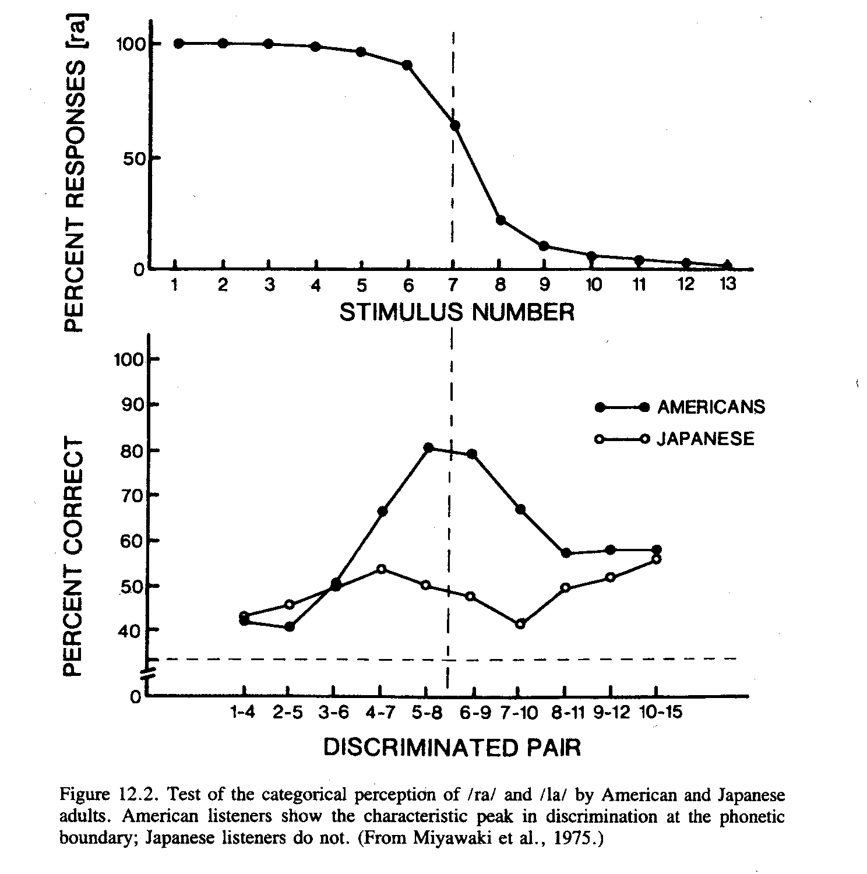
Cross-Language Differences
Miyawaki et al. 1975
Identification task:
English speakers can discriminate r and l, and seem to show a similar pattern of categorical perception to what we saw for d vs. t
R -----------------------> L
Notes:
25

Slide 26
Cross-Language Differences
Discrimination task:
English speakers have higher performance at the r/l category boundary, where one sound is perceived as r and one sound is perceived as l. Japanese speakers generally perform poorly (at chance), no matter what sounds are compared because r and l are not contrastive for them.
Miyawaki et al. 1975
Notes:
26

Slide 27
Cross-Language Differences
Hindi
dental [d]
(tip of tongue touches back of teeth)
retroflex [D]
(tongue curled so tip is behind alveolar ridge)
English [d] is usually somewhere between these
?
Notes:
27

Slide 28
Cross-Language Differences
Salish
(Native North American language):
glotalized voiceless stops
Uvular – tongue is raised against the velum
Velar – tongue is raised behind the velum
(they are actually ejectives - ejective is produced by obstructing the airflow by raising the back of the tongue against or behind the velum)
Notes:
28

Slide 29

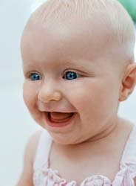
Perceiving sound contrasts
Kids…
This ability to distinguish sound contrasts extends to phonemic contrasts that are non-native. (Japanese infants can discriminate contrasts used in English but that are not used in Japanese, like r/l.) This goes for both vowels and consonants.
…vs. adults
Adults can’t, especially without training - even if the difference is quite acoustically salient.
So when is this ability lost?
And what changes from childhood to adulthood?
Notes:
29

Slide 30
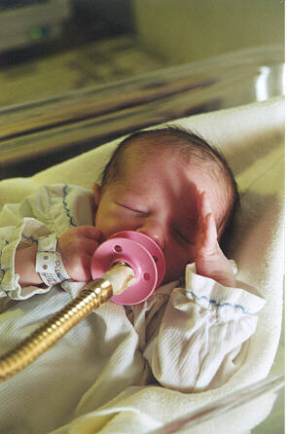
A useful indirect measurement
High Amplitude Sucking (HAS) Procedure
Infant given a pacifier that measures sucking rate
Habituation – Infant sucks to hear sound (e.g. ba) until bored.
Test – Play sound (e.g., ba or pa). Is there dishabituation?
  Infants will suck to hear sound if the sound is no longer boring.
Notes:
30

Slide 31
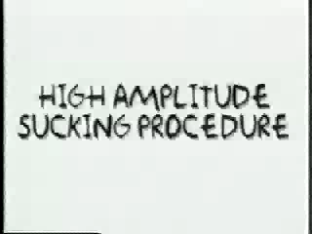
A useful indirect measurement
High Amplitude Sucking (HAS) Procedure
http://psych.rice.edu/mmtbn/language/sPerception/video/sucking_h.mov
Notes:
31

Slide 32
Testing categorical perception in infants:
Eimas et al. (1971)
BA vs. PA
Vary Voice Onset Time (VOT): time between consonant release and vocal cord vibration
BA
PA
0
20
40
60
80
VOT in milliseconds
Notes:
32

Slide 33
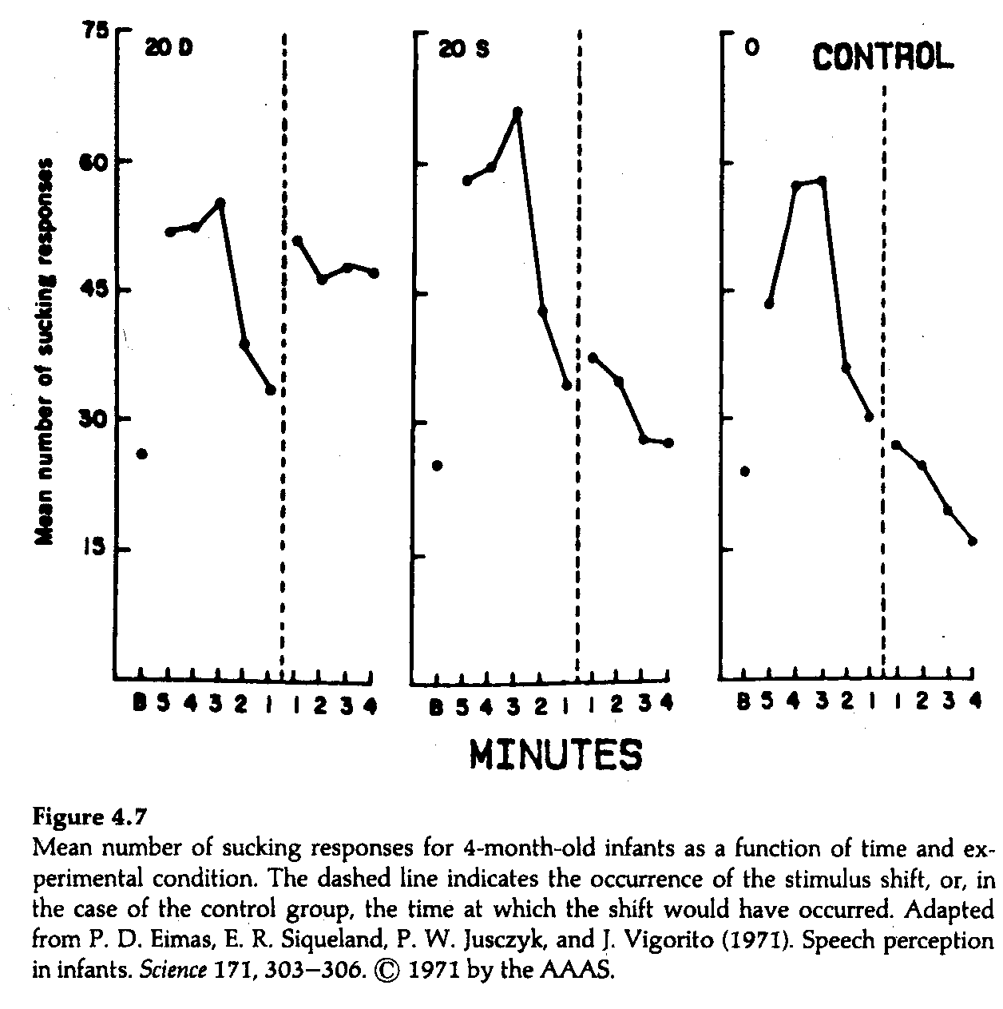
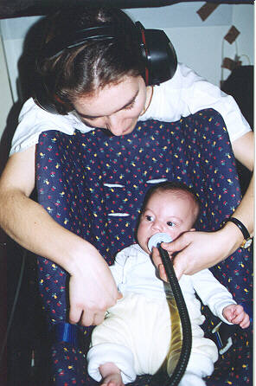

dishabituate
no
MEAN NUMBER OF SUCKING RESPONSE
no
Notes:
33

Slide 34
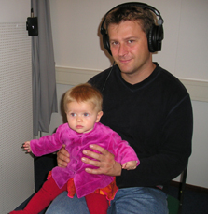
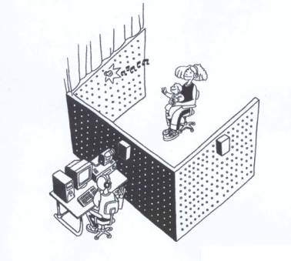
A useful indirect measurement
Head Turn Preference Procedure
Infant sits on caretaker’s lap. The wall in front of the infant has a green light mounted in the center of it. The walls on the sides of the infant have red lights mounted in the center of them, and there are speakers hidden behind the red lights.
Notes:
34

Slide 35
A useful indirect measurement
Head Turn Preference Procedure
Sounds are played from the two speakers mounted at eye-level to the left and right of the infant. The sounds start when the infant looks towards the blinking side light, and end when the infant looks away for more than two seconds.
Notes:
35

Slide 36
A useful indirect measurement
Head Turn Preference Procedure
Thus, the infant essentially controls how long he or she hears the sounds. Differential preference for one type of sound over the other is used as evidence that infants can detect a difference between the types of sounds.
Notes:
36

Slide 37
Head Turn Preference Procedure Movies
Head Turn Preference Procedure
http://psych.rice.edu/mmtbn/language/sPerception/infantHeadturn_h.html
“How Babies Learn Language”
(first part, up to 2:04)
http://www.youtube.com/watch?v=mZAuZ--Yeqo
Notes:
37

Slide 38
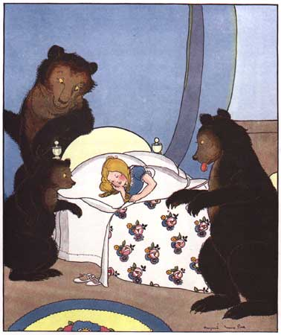
Note on infant attention:
Familiarity vs. Novelty Effects
For procedures that involve measuring where children prefer to look (such as head turn preference), sometimes children seem to have a “familiarity preference” where they prefer to look at something similar to what they habituated to. Other times, children seem to have a “novelty” preference where they prefer to look at something different to what they habituated to.
Kidd, Piantadosi, & Aslin (2010) provide some evidence that this may have to do with the informational content of the test stimulus. There may be a “Goldilocks” effect where children prefer to look at stimuli that are neither too boring nor too surprising, but are instead “just right” for learning, given the child’s current knowledge state.

Slide 39
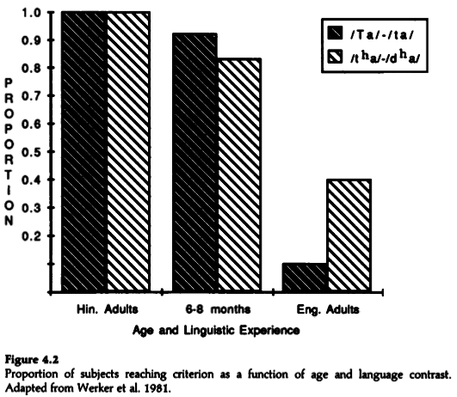
Speech Perception of Non-Native Sounds
Comparing perceptual ability
Werker et al. 1981: English-learning 6-8 month olds compared against English & Hindi adults on Hindi contrasts
Notes:
39

Slide 40
Speech Perception of Non-Native Sounds
Comparing perceptual ability
Werker et al. 1981: English-learning 6-8 month olds compared against English & Hindi adults on Hindi contrasts
Hindi adults can easily distinguish sounds that are used contrastively in their language
Notes:
40

Slide 41
Speech Perception of Non-Native Sounds
Comparing perceptual ability
Werker et al. 1981: English-learning 6-8 month olds compared against English & Hindi adults on Hindi contrasts
English adults are terrible (below chance), though there is some variation depending on which sounds are being compared
Notes:
41

Slide 42
Speech Perception of Non-Native Sounds
Comparing perceptual ability
Werker et al. 1981: English-learning 6-8 month olds compared against English & Hindi adults on Hindi contrasts
English infants between the ages of 6-8 months aren’t quite as good as Hindi adults - but they’re certainly much better than English adults! They haven’t yet learned to ignore these non-native contrasts.
Notes:
42

Slide 43
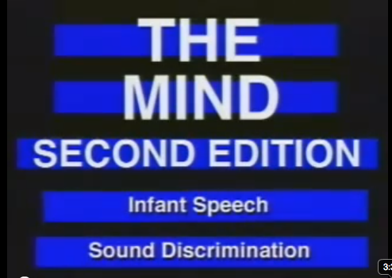
Sound-Learning Movie
Infant Speech Discrimination
http://www.youtube.com/watch?v=GSIwu_Mhl4A
Notes:
43

Slide 44
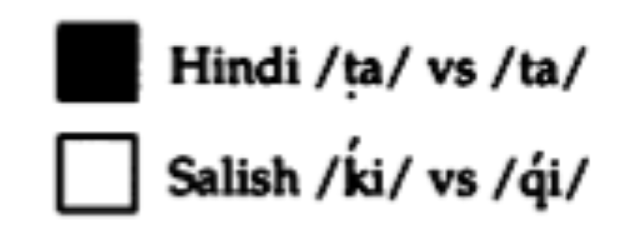
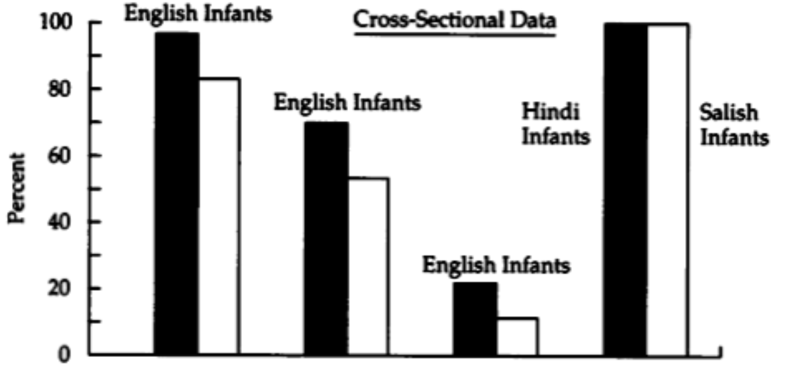
When Change Happens
But when after 6-8 months is the ability to lost? Werker & Tees (1984)
Testing ability to distinguish Salish & Hindi contrasts
Notes:
44

Slide 45
When Change Happens
But when after 6-8 months is the ability to lost? Werker & Tees (1984)
Testing ability to distinguish Salish & Hindi contrasts
Control (make sure experiment is doable by infants):
Hindi and Salish infants do perfectly
Notes:
45

Slide 46
When Change Happens
But when after 6-8 months is the ability to lost? Werker & Tees (1984)
Testing ability to distinguish Salish & Hindi contrasts
English 6-8 month-olds do well
Notes:
46

Slide 47
When Change Happens
But when after 6-8 months is the ability to lost? Werker & Tees (1984)
Testing ability to distinguish Salish & Hindi contrasts
English 8-10 month-olds do less well
Notes:
47

Slide 48
When Change Happens
But when after 6-8 months is the ability to lost? Werker & Tees (1984)
Testing ability to distinguish Salish & Hindi contrasts
English 10-12 month-olds do very poorly
Notes:
48

Slide 49
When Change Happens
When Change Happens
But when after 6-8 months is the ability to lost? Werker & Tees (1984)
Testing ability to distinguish Salish & Hindi contrasts
Implication: The ability to distinguish non-native contrasts is lost by 10-12 months. Change seems to be happening between 8-10 months.
Notes:
49

Slide 50
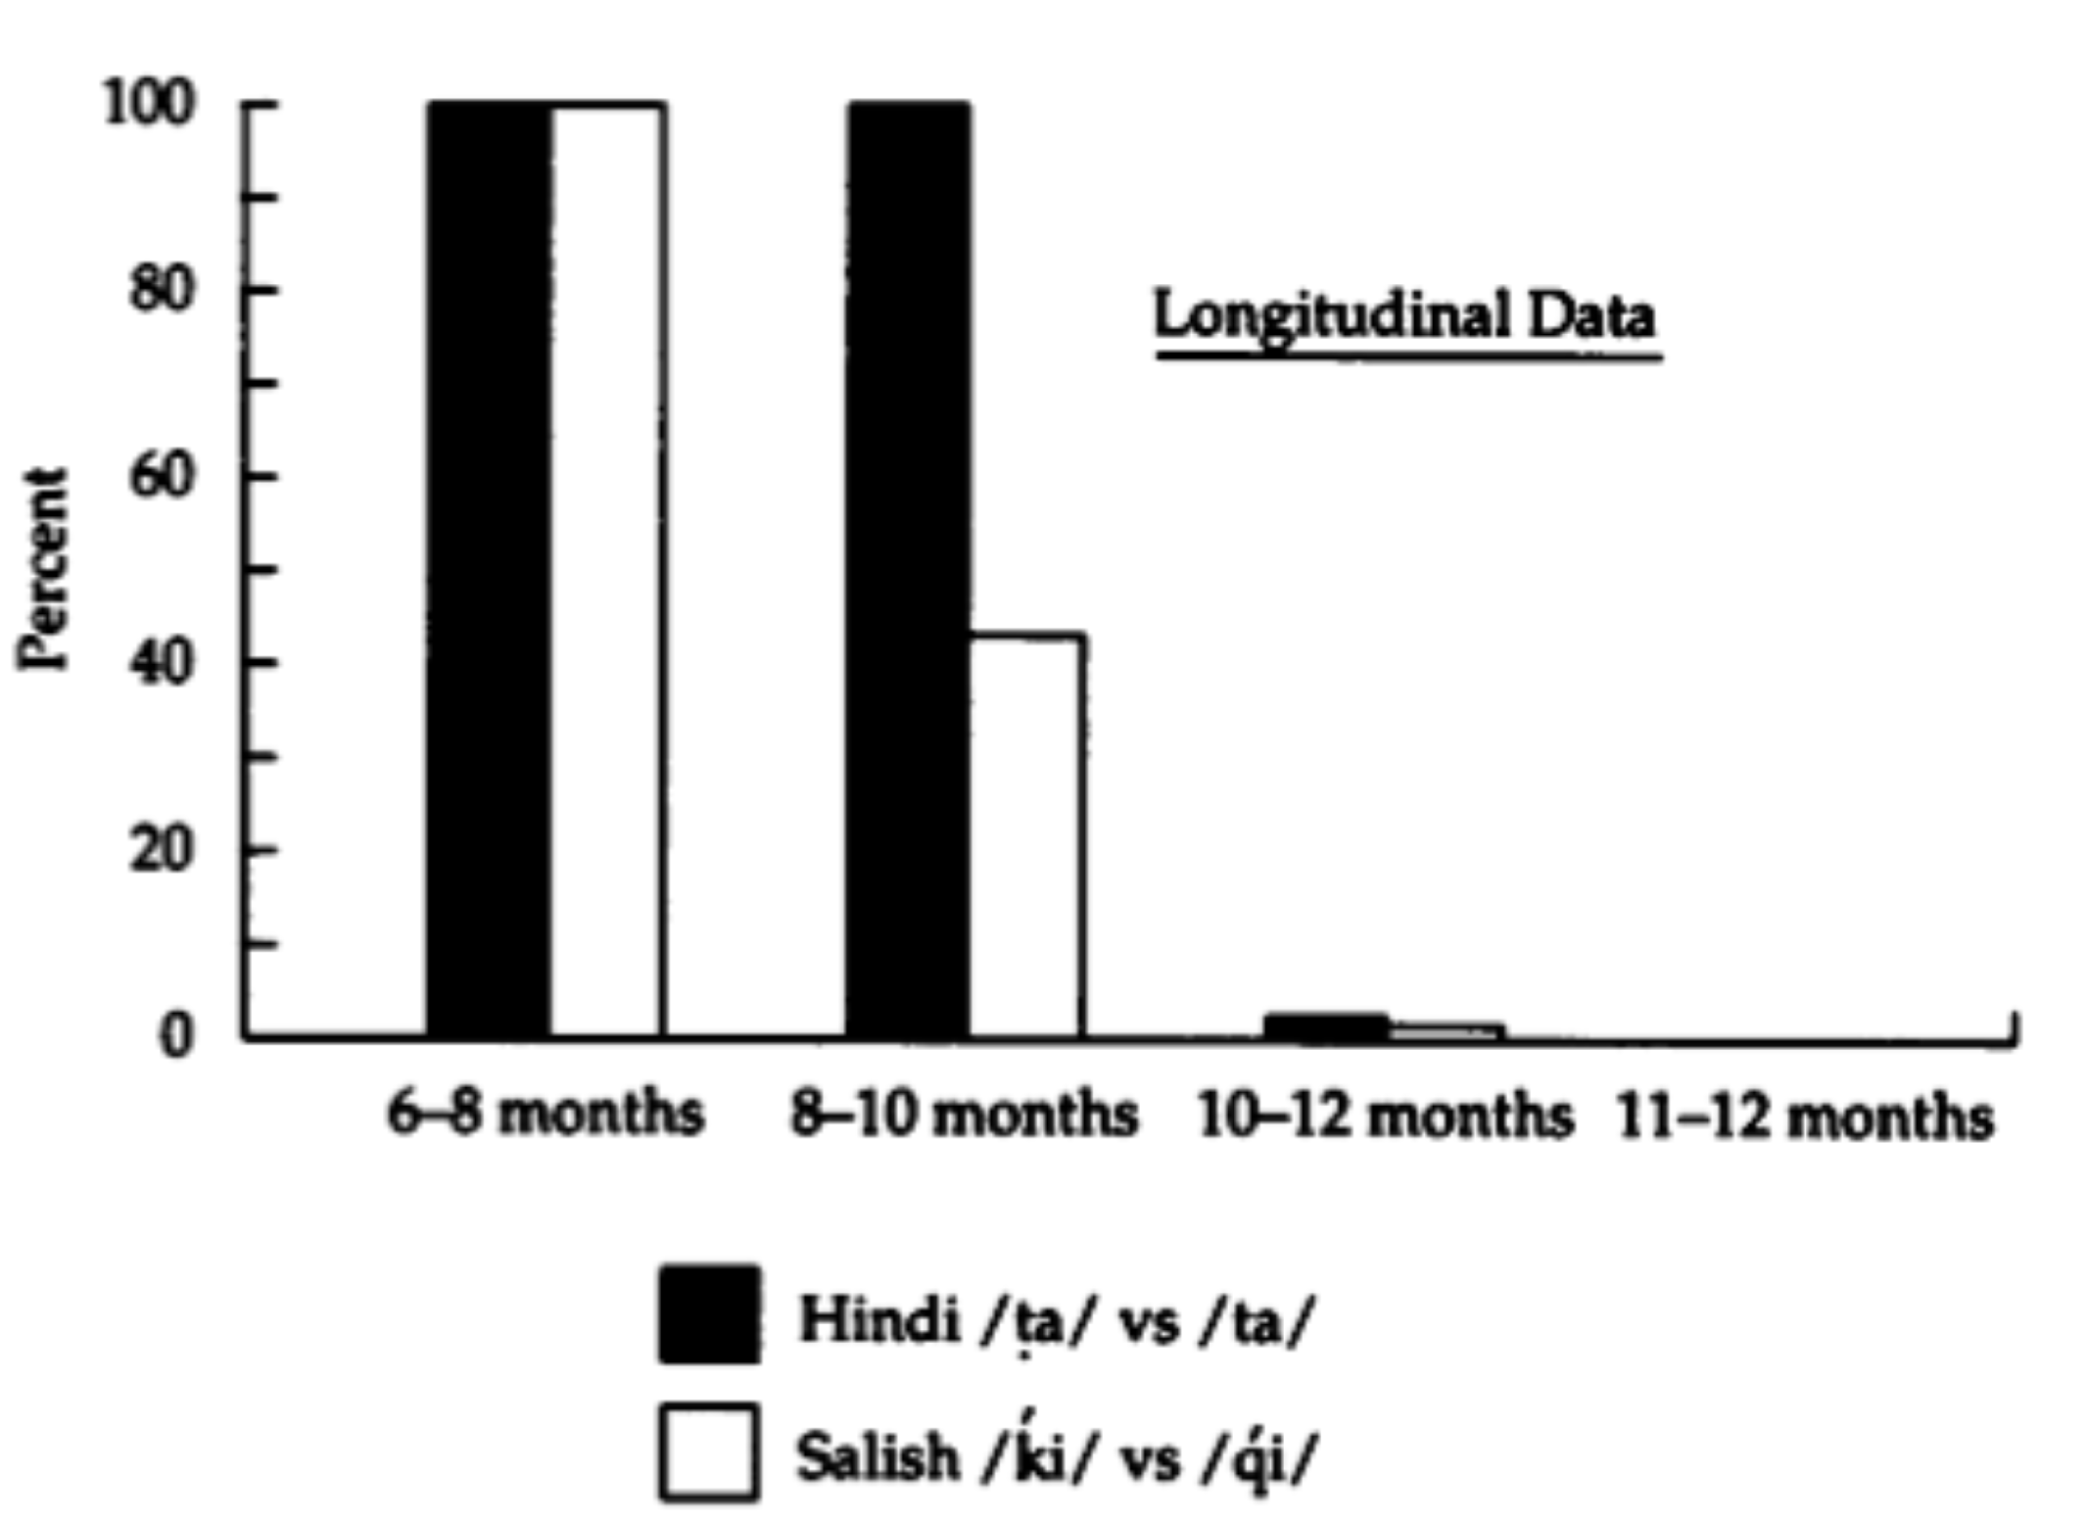
When Change Happens
But when after 6-8 months is the ability to lost? Werker & Tees (1984)
Testing ability to distinguish Salish & Hindi contrasts
Doing a longitudinal study with English infants (where the same infants are tested over time), change seems to happen somewhere around 10-12 months, depending on the sound contrast.
Yoshida et al. (2010) suggest that infants have some malleability still at 10 months, but it’s much less than at 6 or 8 months.
Notes:
50

Slide 51
Recap: Speech Perception
One task for children is to figure out the contrastive sound categories (phonemes) for their language.
Categorical perception will occur once sounds are grouped into these contrastive sound categories - even though the sounds within a category differ acoustically, these language sounds will be perceived as being the same.
Infants seem to figure out their native language phonemes around 10-12 months.
Next time: How do children do this?
Notes:
51

Slide 52
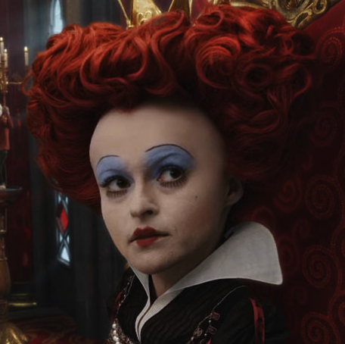
Questions?
You should be able to do up through question 10 on the sounds review questions, and up through question 4 on HW1.

