Slide 1
Psych 156A/ Ling 150: Acquisition of Language II
Lecture 10
Grammatical Categories

Slide 2
Announcements
HW2 due 5/15/12
- Remember that working in groups can be very helpful!
Please pick up HW1 if you have not yet done so
Review questions for grammatical categorization available

Slide 3
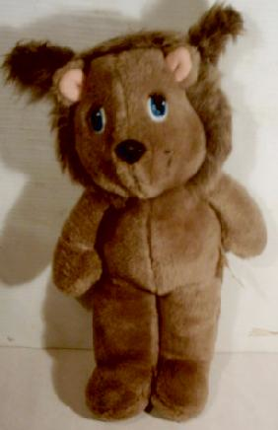
Computational Problem
Identify classes of words that behave similarly (are used in similar syntactic environments). These are grammatical categories. If you know the grammatical category of the word, then you will know how this word is used in the language. This will allow you to recognize other words that belong to the same category since they will be used the same way.
“This is a DAX.”
DAX = noun
Other nouns = bear, toy, teddy, stuffed animal, really great toy that I love so much,…

Slide 4
Grammatical Categorization
Identify classes of words that behave similarly (are used in similar syntactic environments). These are grammatical categories. If you know the grammatical category of the word, then you will know how this word is used in the language. This will allow you to recognize other words that belong to the same category since they will be used the same way.
Examples of different categories in English:
noun = goblin, kitten, king, girl
Examples of how nouns are used:
I like that goblin. Kittens are adorable.
A king said that no girls would ever solve the Labyrinth.

Slide 5
Grammatical Categorization
Identify classes of words that behave similarly (are used in similar syntactic environments). These are grammatical categories. If you know the grammatical category of the word, then you will know how this word is used in the language. This will allow you to recognize other words that belong to the same category since they will be used the same way.
Examples of different categories in English:
verb = like, are, said, solve, stand
Examples of how verbs are used:
I like that goblin. Kittens are adorable.
A king said that no girls would ever solve the Labyrinth.
Sarah was standing very close to him.

Slide 6
Grammatical Categorization
Identify classes of words that behave similarly (are used in similar syntactic environments). These are grammatical categories. If you know the grammatical category of the word, then you will know how this word is used in the language. This will allow you to recognize other words that belong to the same category since they will be used the same way.
Examples of different categories in English:
adjective = silly, adorable, brave, close
Examples of how adjectives are used:
I like the silliest goblin. Kittens are so adorable.
The king said that only brave girls would solve the Labyrinth.
Sarah was standing very close to him.

Slide 7
Grammatical Categorization
Identify classes of words that behave similarly (are used in similar syntactic environments). These are grammatical categories. If you know the grammatical category of the word, then you will know how this word is used in the language. This will allow you to recognize other words that belong to the same category since they will be used the same way.
Examples of different categories in English:
preposition = near, through, to
Examples of how prepositions are used:
I like the goblin near the king’s throne.
The king said that no girls would get through the Labyrinth.
Sarah was standing very close to him.

Slide 8
Grammatical Categorization
Identify classes of words that behave similarly (are used in similar syntactic environments). These are grammatical categories. If you know the grammatical category of the word, then you will know how this word is used in the language. This will allow you to recognize other words that belong to the same category since they will be used the same way.
“This is a DAX.”
“He is SIBing.”
DAX = ??
SIB = ??
“He is very BAV.”
BAV = ??
“He should sit GAR the other dax.”
GAR = ??

Slide 9
Grammatical Categorization
Identify classes of words that behave similarly (are used in similar syntactic environments). These are grammatical categories. If you know the grammatical category of the word, then you will know how this word is used in the language. This will allow you to recognize other words that belong to the same category since they will be used the same way.
“This is a DAX.”
“He is SIBing.”
DAX = noun
SIB = verb
“He is very BAV.”
BAV = adjective
“He should sit GAR the other dax.”
GAR = preposition

Slide 10
Categorization: How?
How might children initially learn what categories words are?
Idea 1: Deriving Categories from Semantic Information =
Semantic Bootstrapping Hypothesis (Pinker 1984)
Children can initially determine a word’s category by observing what kind of entity in the world it refers to.

Slide 11
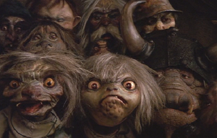
Categorization: How?
How might children initially learn what categories words are?
Idea 1: Deriving Categories from Semantic Information =
Semantic Bootstrapping Hypothesis (Pinker 1984)
Children can initially determine a word’s category by observing what kind of entity in the world it refers to.
objects, substance = noun action = verb
(goblins, glitter) (steal, sing)
property = adjective
(shiny, stinky)
The word’s meaning is then linked to innate grammatical category knowledge (nouns are objects/substances, verb are actions, adjectives are properties)

Slide 12
Semantic Bootstrapping Hypothesis: Problem
Mapping rules are not perfect
Ex: not all action-like words are verbs
“bouncy”, “a kick”
action-like meaning, but they’re not verbs
Ex: not all property-like words are adjectives
“they are shining brightly”, “they glitter”
seem to be referring to properties, but these aren’t adjectives

Slide 13
Categorization: How?
Idea 2: Distributional Learning
Children can initially determine a word’s category by observing the linguistic environments in which words appear.
Noun
Kittens are adorable.
Verb
Sarah was standing very close to him.
I like the silliest goblin.
Adjective
The king said that no girls would get through the Labyrinth.
Preposition

Slide 14
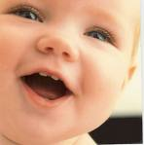
Are children sensitive to distributional information?
Children are sensitive to the distributional properties of their native language when they’re born (Shi, Werker, & Morgan 1999).
15-16 month German infants can determine novel words are nouns, based on the distributional information around the novel words (Höhle et al. 2004)
18-month English infants can track distributional information like “is…-ing” to signal that a word is a verb (Santelmann & Jusczyk 1998)

Slide 15
Mintz 2003: Is distributional information enough?
How do we know in child-directed speech (which is the linguistic data children encounter)…
What distributional information children should pay attention to?
(2) If the available distributional information will actually correctly categorize words?

Slide 16
Mintz 2003: What data should children pay attention to?
“…question is how the learner is to know which environments are important and which should be ignored. Distributional analyses that consider all the possible relations among words in a corpus of sentences would be computationally unmanageable at best, and impossible at worst.”
One idea: local contexts
“…by showing that local contexts are informative, these findings suggested a solution to the problem of there being too many possible environments to keep track of: focusing on local contexts might be sufficient.”

Slide 17
Mintz 2003: Frequent Frames
Idea: What categorization information is available if children track frequent frames?
Frequent frame: X___Y
where X and Y are words that frame another word
and appear frequently in the child’s linguistic environment
Examples: the__is can___him
the king is… can trick him…
the goblin is… can help him…
the girl is… can hug him…

Slide 18
Mintz 2003: Samples of Child-Directed Speech
Data representing child’s linguistic environment:
6 corpora of child-directed speech from the CHILDES database, which contains transcriptions of parents interacting with their children.
Corpus (sg.), corpora (pl). = a collection of data
[from Latin body, a “body” of data]

Slide 19
Mintz 2003: Defining “Frequent”
Definition of “frequent” for frequent frames:
Frames appearing a certain number of times in a corpus
“The principles guiding inclusion in the set of frequent frames were that frames should occur frequently enough to be noticeable, and that they should also occur enough to include a variety of intervening words to be categorized together…. a pilot analysis with a randomly chosen corpus, Peter, determined that the 45 most frequent frames satisfied these goals and provided good categorization.”
Set of frequent frames = 45 most frequent frames

Slide 20
Mintz 2003: Defining “Frequent”
Example of deciding which frames were frequent:
Frame How often it occurred in the corpus
the___is 600 times
a___is 580 times
she__it 450 times
…
(45) they__him 200 times
(46) we___have 199 times
…
These frames considered “frequent”

Slide 21
Mintz 2003: Testing the Categorization Ability of Frequent Frames
Try out frequent frames on a corpus of child-directed speech.
Frame (1): the___is
Transcript: “…the radio is in the way…but the doll is…and the teddy is…”
radio, doll, teddy are placed into the same category by the___is
Frame (13): you___it
Transcript: “…you draw it so that he can see it… you dropped it on purpose!…so he hit you with it…”
draw, dropped, with are placed into the same category by you___it

Slide 22
Mintz 2003: Determining the success of frequent frames
Precision = # of words identified correctly as Category within frame
# of words identified as Category within frame
Recall = # of words identified correctly as Category within frame
# of words that should have been identified as Category

Slide 23
Mintz 2003: Determining the success of frequent frames
Precision = # of words identified correctly as Category within frame
# of words identified as Category within frame
Recall = # of words identified correctly as Category within frame
# of words that should have been identified as Category
Frame: you___it
Category: draw, dropped, with (similar to Verb so compare to Verb)
# of words correctly identified as Verb = 2 (draw, dropped)
# of words identified as Verb = 3 (draw, dropped, with)
Precision for you___it = 2/3

Slide 24
Mintz 2003: Determining the success of frequent frames
Precision = # of words identified correctly as Category within frame
# of words identified as Category within frame
Recall = # of words identified correctly as Category within frame
# of words that should have been identified as Category
Frame: you___it
Category: draw, dropped, with (similar to Verb so compare to Verb)
# of words correctly identified as Verb = 2 (draw, dropped)
# of words should be identified as Verb = all verbs in corpus (play, sit, draw, dropped, ran, kicked, …)

Slide 25
Mintz 2003: Determining the success of frequent frames
Precision = # of words identified correctly as Category within frame
# of words identified as Category within frame
Recall = # of words identified correctly as Category within frame
# of words that should have been identified as Category
Frame: you___it
Category: draw, dropped, with (similar to Verb so compare to Verb)
# of words correctly identified as Verb = 2
# of words should be identified as Verb = all verbs in language
Recall = 2/all (much smaller number)

Slide 26
Mintz 2003: Some actual frequent frame results
Frame: you___it
Category includes:
put, want, do, see, take, turn, taking, said, sure, lost, like, leave, got, find, throw, threw, think, sing, reach, picked, get, dropped, seen, lose, know, knocked, hold, help, had, gave, found, fit, enjoy, eat, chose, catch, with, wind, wear, use, took, told, throwing, stick, share, sang, roll, ride, recognize, reading, ran, pulled, pull, press, pouring, pick, on, need, move, manage, make, load, liked, lift, licking, let, left, hit, hear, give, flapped, fix, finished, drop, driving, done, did, cut, crashed, change, calling, bring, break, because, banged

Slide 27
Mintz 2003: Some actual frequent frame results
Frame: the___is
Category includes:
moon, sun, truck, smoke, kitty, fish, dog, baby, tray, radio, powder, paper, man, lock, lipstick, lamb, kangaroo, juice, ice, flower, elbow, egg, door, donkey, doggie, crumb, cord, clip, chicken, bug, brush, book, blanket, mommy

Slide 28
Mintz 2003: How successful frequent frames were
Precision: Above 90% for all corpora (high) = very good!
Interpretation: When a frequent frame clustered words together into category, they often did belong together. (Nouns were put together, verbs were put together, etc.)
Recall: Around 10% for all corpora (very low) = maybe not as good…
Interpretation: A frequent frame made lots of little clusters, rather than being able to cluster all the words into one category. (So, there were lots of Noun-ish clusters, lots of Verb-ish clusters, etc.)

Slide 29
Mintz 2003: How successful frequent frames were
Precision: Above 90% for all corpora (high) = very good!
Recall: Around 10% for all corpora (very low) = maybe not as good…
Only a few errors within a cluster
Lots of little clusters instead of one big cluster per category

Slide 30
Mintz 2003: Getting better recall
How could we form just one category of Verb, Noun, etc.?
Observation: Many frames overlap in the words they identify.
the__is the__was a___is that___is …
dog dog dog cat
cat cat goblin goblin
king king king king
girl teddy girl teddy
What about putting clusters together that have a certain number of words in common?

Slide 31
Mintz 2003: Getting better recall
How could we form just one category of Verb, Noun, etc.?
Observation: Many frames overlap in the words they identify.
the__is the__was a___is that___is …
dog dog dog cat
cat cat goblin goblin
king king king king
girl teddy girl teddy

Slide 32
Mintz 2003: Getting better recall
How could we form just one category of Verb, Noun, etc.?
Observation: Many frames overlap in the words they identify.
the__is , the__was a___is that___is …
dog dog cat
cat goblin goblin
king king king
girl girl teddy
teddy

Slide 33
Mintz 2003: Getting better recall
How could we form just one category of Verb, Noun, etc.?
Observation: Many frames overlap in the words they identify.
the__is/was a___is that___is …
dog dog cat
cat goblin goblin
king king king
girl girl teddy
teddy

Slide 34
Mintz 2003: Getting better recall
How could we form just one category of Verb, Noun, etc.?
Observation: Many frames overlap in the words they identify.
the__is/was, a___is that___is …
dog goblin cat
cat goblin
king king
girl teddy
teddy

Slide 35
Mintz 2003: Getting better recall
How could we form just one category of Verb, Noun, etc.?
Observation: Many frames overlap in the words they identify.
the/a__is/was that___is …
dog goblin cat
cat goblin
king king
girl teddy
teddy

Slide 36
Mintz 2003: Getting better recall
How could we form just one category of Verb, Noun, etc.?
Observation: Many frames overlap in the words they identify.
the/a/that__is/was
dog teddy
cat goblin
king
girl
Recall goes up to 91% (very high) = very good!
Precision stays above 90% (very high) = very good!

Slide 37
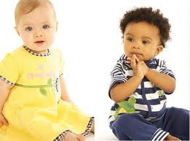
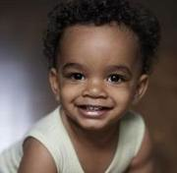
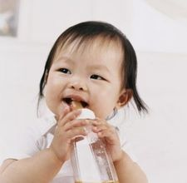
Experimental support for frequent frames
“Another important difference…adults will categorize words in an artificial language based on their occurrence within frames…whereas bigram regularity alone has failed to produce categorization in artificial grammar experiments, without additional cues…” - Mintz 2003
Also, Mintz (2006) shows that 12-month-olds are sensitive to frequent frames in an experimental setup

Slide 38
Cross-linguistic Application?
“The fundamental notion is that a relatively local context defined by frequently co-occurring units can reveal a target word’s category…[here] the units were words and the frame contexts were defined by words that frequently co-occur. In other languages, a failure to find frequent word frames could trigger an analysis of co-occurrence patterns at a different level of granularity, for example, at the level of sub-lexical morphemes. The frequently co-occurring units in these languages are likely to be the inflectional morphemes which are limited in number and extremely frequent.” – Mintz 2003
Western Greenlandic
Notes:
38

Slide 39
Cross-linguistic Application?
Some work done for French (Chemla et al. 2009), Spanish (Weisleder & Waxman 2010), Chinese (Cai 2006, Xiao, Cai, & Lee 2006), German (Wang et al. 2010, Stumper et al. 2011), Turkish (Wang et al. 2010)
Very similar results: high precision, low recall (before aggregation)
However, for Turkish and German, it’s better to have FFs at the morpheme (rather than whole word) level
However, other work in Dutch (Erkelens 2008, Liebbrandt & Powers 2010) suggests that FFs don’t fare as well, especially when they surround function words (like “the” and “a”).
Notes:
39

Slide 40
Mintz 2003: Recap
Frequent frames are non-adjacent co-occurring words with one word in between them. (ex: the___is)
They are likely to be information young children are able to track, based on experimental studies.
When tested on realistic child-directed speech, frequent frames do very well at grouping words into clusters which are very similar to actual grammatical categories like Noun and Verb.
Frequent frames could be a very good strategy for children to use when they try to learn the grammatical categories of words.

Slide 41
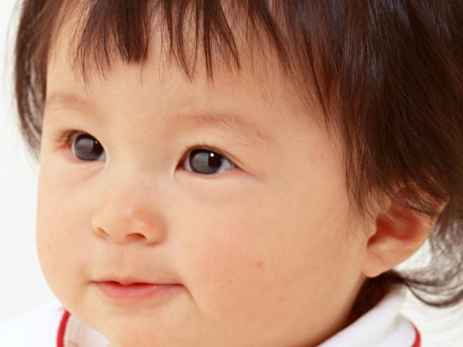
Wang & Mintz 2008: Simulating children using frequent frames
“…the frequent frame analysis procedure proposed by Mintz (2003) was not intended as a model of acquisition, but rather as a demonstration of the information contained in frequent frames in child-directed speech…Mintz (2003) did not address the question of whether an actual learner could detect and use frequent frames to categorize words…”

Slide 42
Wang & Mintz 2008: Simulating children using frequent frames
“This paper addresses this question with the investigation of a computational model of frequent frame detection that incorporates more psychologically plausible assumptions about the memor[y] resources of learners.”
Computational model: a program that simulates the mental processes occurring in a child. This requires knowing what the input and output are, and then testing the algorithms that can take the given input and transform it into the desired output.

Slide 43
Considering Children’s Limitations
Memory Considerations
Children possess limited memory and cognitive capacity and cannot track all the occurrences of all the frames in a corpus.
Memory retention is not perfect: infrequent frames may be forgotten.
The Model’s Operation
Only 150 frame types (and their frequencies) are held in memory
Forgetting function: frames that have not been encountered recently are less likely to stay in memory than frames that have been recently encountered
Notes:
43

Slide 44
Wang & Mintz (2008): How the model works
Child encounters an utterance (e.g. “You read the story to mommy.”)
Child segments the utterance into frames:
You read the story to mommy.
you X the
read X story
the X to
story X mommy
Frames:
you___the, read___story, the___to, story___mommy
Notes:
44

Slide 45
Wang & Mintz (2008): How the model works
In the beginning, there is nothing in the learner’s memory.
Memory Activation
Processing Step 1

Slide 46
Wang & Mintz (2008): How the model works
If memory is not full, a newly-encountered frame is added to the memory and its initial activation is set to 1.
Memory Activation
you___the 1.0
Processing Step 1
Notes:
46

Slide 47
Wang & Mintz (2008): How the model works
The forgetting function is simulated by the activation for each frame in memory decreasing by 0.0075 after each processing step.
Memory Activation
you___the 0.9925
Forgetting function

Slide 48
Wang & Mintz (2008): How the model works
When a new frame is encountered, the updating depends on whether the memory is already full or not. If it is not and the frame has not already been encountered, the new frame is added to the memory with activation 1.
Memory Activation
read___story 1.0
you___the 0.9925
Processing Step 2 (read___story)

Slide 49
Wang & Mintz (2008): How the model works
When a new frame is encountered, the updating depends on whether the memory is already full or not. If it is not and the frame has not already been encountered, the new frame is added to the memory with activation 1.
Memory Activation
read___story 0.9925
you___the 0.9850
Forgetting function

Slide 50
Wang & Mintz (2008): How the model works
When a new frame is encountered, the updating depends on whether the memory is already full or not. If it is not and the frame has not already been encountered, the new frame is added to the memory with activation 1.
Memory Activation
the___to 1.0
read___story 0.9925
you___the 0.9850
Processing step 3 (the___to)

Slide 51
Wang & Mintz (2008): How the model works
When a new frame is encountered, the updating depends on whether the memory is already full or not. If it is not and the frame has not already been encountered, the new frame is added to the memory with activation 1.
Memory Activation
the___to 0.9925
read___story 0.9850
you___the 0.9775
Forgetting function

Slide 52
Wang & Mintz (2008): How the model works
When a new frame is encountered, the updating depends on whether the memory is already full or not. If it is not and the frame has not already been encountered, the new frame is added to the memory with activation 1.
Memory Activation
story___mommy 1.0
the___to 0.9925
read___story 0.9850
you___the 0.9775
Processing step 4 (story___mommy)

Slide 53
Wang & Mintz (2008): How the model works
When a new frame is encountered, the updating depends on whether the memory is already full or not. If it is not and the frame has not already been encountered, the new frame is added to the memory with activation 1.
Memory Activation
story___mommy 0.9925
the___to 0.9850
read___story 0.9775
you___the 0.9700
Forgetting function

Slide 54
Wang & Mintz (2008): How the model works
If the frame is already in memory because it was already encountered, activation for that frame increases by 1.
Memory Activation
story___mommy 0.9925
the___to 0.9850
read___story 0.9775
you___the 0.9700
Processing step 5: (you____the)

Slide 55
Wang & Mintz (2008): How the model works
If the frame is already in memory because it was already encountered, activation for that frame increases by 1.
Memory Activation
story___mommy 0.9925
the___to 0.9850
read___story 0.9775
you___the 1.9700
Processing step 5: (you____the)

Slide 56
Wang & Mintz (2008): How the model works
If the frame is already in memory because it was already encountered, activation for that frame increases by 1.
Memory Activation
you___the 1.9700
story___mommy 0.9925
the___to 0.9850
read___story 0.9775
Processing step 5: (you____the)

Slide 57
Wang & Mintz (2008): How the model works
If the frame is already in memory because it was already encountered, activation for that frame increases by 1.
Memory Activation
you___the 1.9625
story___mommy 0.9850
the___to 0.9775
read___story 0.9700
Forgetting function

Slide 58
Wang & Mintz (2008): How the model works
Eventually, since the memory only holds 150 frames, the memory will become full.
Memory Activation
story___mommy 4.6925
the___to 3.9850
read___story 3.9700
you___the 2.6925
… …
she___him 0.9850
we__it 0.7500
Memory after processing step 200

Slide 59
Wang & Mintz (2008): How the model works
At this point, if a frame not already in memory is encountered, it replaces the frame with the least activation, as long as that activation is less than 1.0.
Memory Activation
story___mommy 4.6925
the___to 3.9850
read___story 3.9700
you___the 2.6925
… …
she___him 0.9850
we__it 0.7500
Processing step 201: because___said

Slide 60
Wang & Mintz (2008): How the model works
At this point, if a frame not already in memory is encountered, it replaces the frame with the least activation, as long as that activation is less than 1.0.
Memory Activation
story___mommy 4.6925
the___to 3.9850
read___story 3.9700
you___the 2.6925
… …
she___him 0.9850
we__it 0.7500
Processing step 201: because___said

Slide 61
Wang & Mintz (2008): How the model works
At this point, if a frame not already in memory is encountered, it replaces the frame with the least activation, as long as that activation is less than 1.
Memory Activation
story___mommy 4.6925
the___to 3.9850
read___story 3.9700
you___the 2.6925
… …
because___said 1.0000
she___him 0.9850
Processing step 201: because___said

Slide 62
Wang & Mintz (2008): How the model works
Eventually, however, all the frames in memory will have been encountered often enough that their activations are greater than 1.
Memory Activation
story___mommy 9.6925
the___to 8.9850
read___story 8.9700
you___the 5.6925
… …
we___her 3.9700
she___him 2.9850
Memory after processing step 5000

Slide 63
Wang & Mintz (2008): How the model works
At this point, no change is made to memory since the new frame’s activation of 1 would be less than the least active frame in memory.
Memory Activation
story___mommy 9.6925
the___to 8.9850
read___story 8.9700
you___the 5.6925
… …
we___her 3.9700
she___him 2.9850
Processing step 5001 (because___him)

Slide 64
Wang & Mintz (2008): How the model works
The forgetting function is then invoked.
Memory Activation
story___mommy 9.6850
the___to 8.9775
read___story 8.9625
you___the 5.6850
… …
we___her 3.9625
she___him 2.9775
Forgetting function

Slide 65
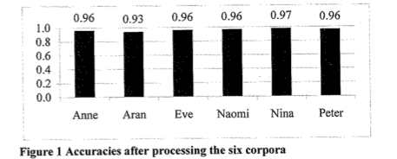
Wang & Mintz (2008): How the model did
Using same corpora for input as Mintz (2003)
(6 from CHILDES: Anne, Aran, Even, Naomi, Nina, Peter)
The model’s precision was above 0.93 for all six corpora.
This is very good!
When the model decided a word belonged in a particular category (Verb, Noun, etc.) it usually did.

Slide 66
Wang & Mintz (2008): Conclusions
“…our model demonstrates very effective categorization of words. Even with limited and imperfect memory, the learning algorithm can identify highly informative contexts after processing a relatively small number of utterances, thus yield[ing] a high accuracy of word categorization. It also provides evidence that frames are a robust cue for categorizing words.”

Slide 67
Wang & Mintz (2008): Recap
While Mintz (2003) showed that frequent frame information is useful for categorization, it did not demonstrate that children - who have constraints like limited memory and less cognitive processing power than adults - would be able to effectively use this information.
Wang & Mintz (2008) showed that a model using frequent frames in a psychologically plausible way (that is, a way that children might identify and use frequent frames) was able to have the same success at identifying the grammatical category that a word is.

Slide 68
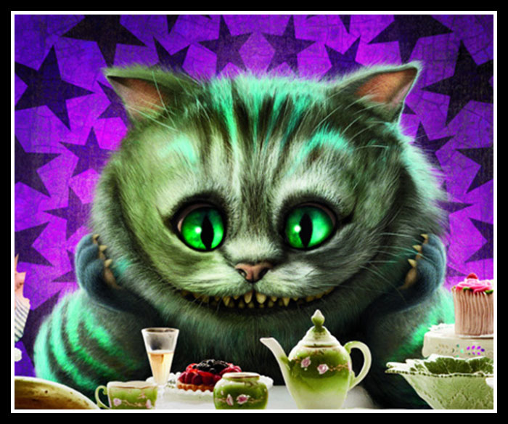
Questions?
Use this time to work on HW2 and the review questions.

