Slide 1
Psych 156A/ Ling 150: Acquisition of Language II
Lecture 1
Introduction to Language Acquisition

Slide 2
Administrivia
Instructor:
Lisa Pearl, Department of Cognitive Sciences
lpearl@uci.edu
http://www.socsci.uci.edu/~lpearl
Office Hours: W, 1:30-3:00pm in SBSG 2314
Teaching Assistant:
Lawrence Phillips, Department of Cognitive Sciences
lawphill@uci.edu
Office Hours: M & T, 12-1:30pm in SBSG 2221

Slide 3
Administrivia
Class web page:
http://www.socsci.uci.edu/~lpearl/courses/psych156A_2012spring/index.html
Accessible from EEE, as well. Contains overview (including office hours), schedule, readings, course assignments, and grading policies.

Slide 4
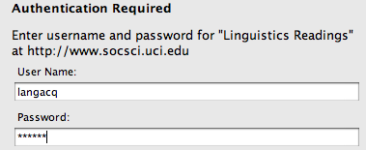
Administrivia
Important to access readings & some reference material
Click on readings in schedule page
user name = langacq
user password = models
Lecture notes do not require
a password

Slide 5
Administrivia
Assignments
Homework:
Three throughout the quarter. Collaboration is allowed and highly encouraged. In fact, take a minute to introduce yourself to some people around you who might form a homework/study group with. You may turn in one assignment per group of collaborators – just make sure the names of all the collaborators are on it.

Slide 6
Administrivia
Assignments
Homework Advice:
Homework assignments are usually available as soon as we begin discussing the relevant topics. HW1 is already available on the website. The optimal strategy is to be working on the relevant homework problems as we discuss the topics in class.
Review questions are also available for each topic, but you are not required to do them. They are just there to help you review the material (and are a great way to study for exams).

Slide 7
Administrivia
Assignments
Homework:
Late homework will be accepted according to the late policy listed in the assignments section on the class webpage. If you cannot turn in the homework on time, take advantage of the policy to get some credit for your assignment. Seriously.

Slide 8
Administrivia
Midterm Exam
There will be an online midterm exam on 5/8/12, available through EEE. It will cover the material in weeks 1-5. There will be a midterm review in class 5/3/12. Being able to answer the review questions for the relevant topics is the best way to prepare for the exam.
The midterm exam will be open-note, but non-collaborative.
If you are found collaborating with other classmates during the midterm exam, you will receive a 0.
For details of the online exam policy and procedure, see the course webpage. We will also go over these during the midterm review.
http://www.socsci.uci.edu/~lpearl/courses/psych156A_2012spring/assignments.html#exams

Slide 9
Administrivia
Final Exam
There will be an online final exam on 6/14/12, available through EEE. It will cover the material in weeks 1-10, with a strong focus on the material in weeks 6 - 10. Review questions will be available for each topic covered in class, and there will be a final exam review in class on 6/7/12. Exam questions will come from the homeworks and the review questions.
The final exam will be open-note, but non-collaborative.
If you are found collaborating with other classmates during the final exam, you will receive a 0.
For details of the online exam policy and procedure, see the course webpage. We will also go over these during the final review.
http://www.socsci.uci.edu/~lpearl/courses/psych156A_2012spring/assignments.html#exams

Slide 10
Administrivia
Grades
Homework: 50%
Midterm: 20%
Final Exam: 30%
Your grades will be determined by approximately this scale (available on the webpage):
96-100: A+ 84-88: B+ 72-76: C+ …
92-96: A 80-84: B 68-72: C
88-92: A- 76-80: B- 64-68: C-

Slide 11
Administrivia
Extra Credit
You can earn up to 3 percentage points of extra credit three ways. (See the class web page under the “assignments” tab for more details.)
Participate as a human subject in a language science experiment game.
Participate as a human subject in social science experiments for up to 3 hours (half an hour = half a percentage point).
(3) Write a four page paper about a topic in language acquisition.
http://www.socsci.uci.edu/~lpearl/courses/psych156A_2012spring/assignments.html#extra_credit

Slide 12
Administrivia
Schedule
“This is our wonderfully ambitious schedule. We’ll attempt to keep with it, but it is subject to modification.”
Topics:
Introduction (4/3/12 - 4/5/12) [2]
Sounds & Sounds of words (4/10/12 - 4/17/12) [3]
Words (4/19/12 - 5/1/12) [4]
Midterm review & Midterm (5/3/12 - 5/8/12)
Categories & Phrases (5/10/12 - 5/12/12) [2]
Poverty of the stimulus (5/17/12 - 5/24/12) [3]
Sentences & Language structure (5/29/12 - 6/5/12) [3]
Final review & Final (6/7/12 - 6/14/12)

Slide 13
What is language?
A language is a system of signals, such as voice sounds, gestures or written symbols, that encode or decode information.
Human languages are usually referred to as natural languages, and the science of studying them is linguistics.
The term "animal languages" is often used for non-human languages. Most researchers agree that these are not as complex or expressive as human language; they may better be described as animal communication. Some researchers argue that there are significant differences separating human language from the communication of other animals, and that the underlying principles are unrelated.

Slide 14
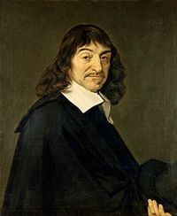
Language is Special
“It is a very remarkable fact that there are none … without even excepting idiots, that they cannot arrange different words together, forming of them a statement by which they make known their thoughts; while on the other hand, there is no other animal, however perfect and fortunately circumstanced it may be, which can do the same.”
René Descartes

Slide 15
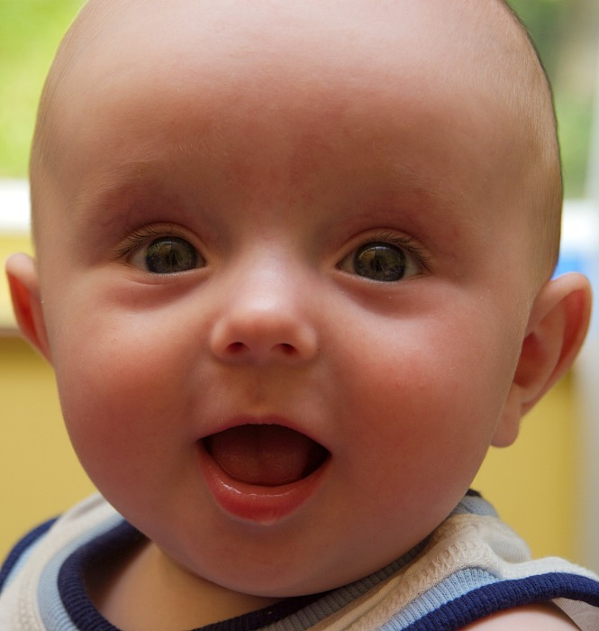
Knowledge of Language
It’s so natural for us to produce and comprehend language that we often don’t think about what an accomplishment this is.
Or how we learned language
in the first place.

Slide 16
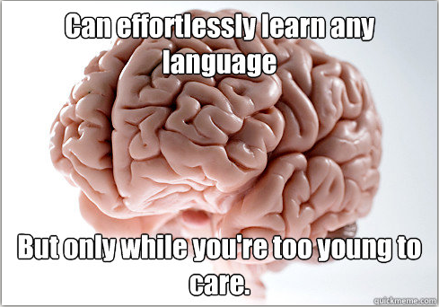
The mystery of language acquisition
http://www.quickmeme.com/meme/36f39x/

Slide 17
“The Linguistic Genius of Babies”
http://www.ted.com/talks/patricia_kuhl_the_linguistic_genius_of_babies.html
(up through 10:07 is relevant)

Slide 18
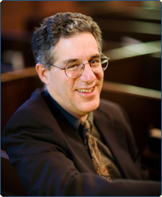
Language is Special
“For the moment, the main thing is to appreciate how hard a problem this is. The fact that we can talk (and cats can’t) seems so obvious that it hardly bears mention. But just because it’s obvious doesn’t mean it’s easy to explain. Think of another perfectly obvious, well-known phenomenon: the fact that metals turn red when you heat them. Why does this happen? It could be otherwise - they might just as well turn green or not change color at all. It’s a simple phenomenon, easily observable, but the explanation isn’t simple at all. It turns out to involve at the very least the theories of electromagnetic radiation and quantum mechanics, two of the more amazing intellectual advances in the past century. So it is, I want to suggest, with the human ability to use language.” - Ray Jackendoff, 1994

Slide 19
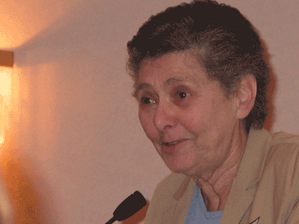
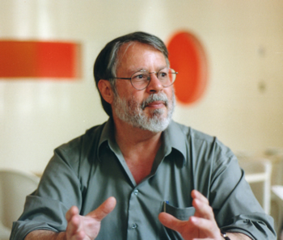
Language is Special
“What is so special about language? Maybe nothing if you are a snail or a camphor tree. But language is paramount among the capacities that characterize humans, setting us off from even the most perfectly formed and functioning of the other beasts on earth; so, as a matter of species pride – if nothing else – we would hold up language as a marker of our humanity and thus a focus of our scientific interest.” (Gleitman & Liberman 1991: xix)

Slide 20
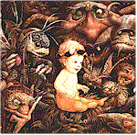
About Language
Language is a complex system of knowledge that all children learn by listening to native speakers in their surrounding environment.
It includes sound structure, word structure, word meaning, sentence structure, mapping from sentence structure to meaning, unspoken rules of conversation…
Notes:
20

Slide 21
About Language
Language is a complex system of knowledge that all children learn by listening to native speakers in their surrounding environment.
It includes sound structure, word structure, word meaning, sentence structure, mapping from sentence structure to meaning, unspoken rules of conversation…
Stress pattern
gob lins
Individual sounds (in IPA)
g a b l I n z
Notes:
21

Slide 22
About Language
Language is a complex system of knowledge that all children learn by listening to native speakers in their surrounding environment.
It includes sound structure, word structure, word meaning, sentence structure, mapping from sentence structure to meaning, unspoken rules of conversation…
goblin (plural) = goblin + s
gob lins
g a b l I n z
Notes:
22

Slide 23
About Language
Language is a complex system of knowledge that all children learn by listening to native speakers in their surrounding environment.
It includes sound structure, word structure, word meaning, sentence structure, mapping from sentence structure to meaning, unspoken rules of conversation…
goblins
goblin (plural) = goblin + s
gob lins
g a b l I n z
Notes:
23

Slide 24
About Language
Language is a complex system of knowledge that all children learn by listening to native speakers in their surrounding environment.
It includes sound structure, word structure, word meaning, sentence structure, mapping from sentence structure to meaning, unspoken rules of conversation…
Goblins like children.
goblins
goblin (plural) = goblin + s
gob lins
g a b l I n z
Notes:
24

Slide 25
About Language
Language is a complex system of knowledge that all children learn by listening to native speakers in their surrounding environment.
It includes sound structure, word structure, word meaning, sentence structure, mapping from sentence structure to meaning, unspoken rules of conversation…
Don’t goblins like children?
Goblins like children.
goblins
goblin (plural) = goblin + s
gob lins
g a b l I n z
Notes:
25

Slide 26
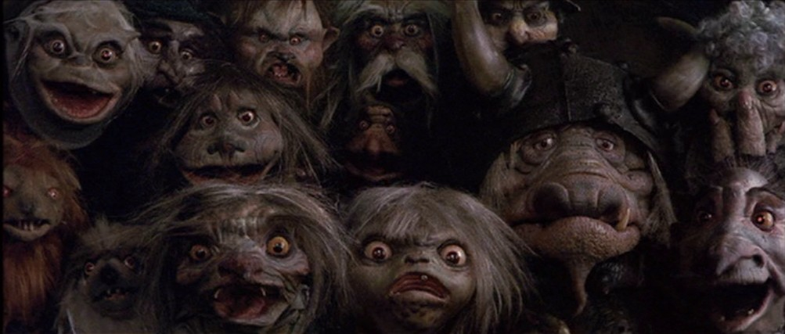
Some Terminology
Phonology: sounds and sound system of the language
Lexicon & Lexical Semantics: Words and associated knowledge (word forms, word meanings, etc.)
Morphology: system for combining units of meaning together (goblin + [plural] = goblins)
g a b l I n z
gob lins
goblins =
(not koblins)
Notes:
26

Slide 27
Some Terminology
Syntax: system for combining words into sentences
Pragmatics: knowledge of language use
Goblins like children.
Don’t goblins like children? = surprise if the answer is ‘no’
(expectation is that the answer is ‘yes’)
Use this question format to show expectation of a ‘yes’ answer.
Notes:
27

Slide 28
Kids Do Amazing Things
Much of the linguistic system is already known by age 3.
…when kids can’t tie their own shoes
or reliably recognize “4”.
What kids are doing: extracting patterns and making generalizations from the surrounding data mostly without explicit instruction.
Terminology: Patterns or “rules” of language = grammar
Notes:
28

Slide 29
A learning analogy: Set
Here are some cards - they have some salient properties associated with them: number of items, shape of items, color of items, fill of items.

Slide 30
A learning analogy: Set
Task: Find Sets.
Here’s one:
What generalizations might you make about Sets?

Slide 31
A learning analogy: Set
Task: Find Sets.
Here’s one:
What generalizations might you make about Sets?
Set = all shapes, fills, and number of items the same?

Slide 32
A learning analogy: Set
Task: Find Sets.
Here’s another one:
Does this fit the generalization?
Set = all shapes, fills, and number of items the same?

Slide 33
A learning analogy: Set
Task: Find Sets.
Here’s another one:
Does this fit the generalization?
Set = all shapes, fills, and number of items the same?
Set = all shapes and fills the same?

Slide 34
A learning analogy: Set
Task: Find Sets.
Here’s another one:
What about this one?
Set = all shapes, fills, and number of items the same?
Set = all shapes and fills the same?

Slide 35
A learning analogy: Set
Task: Find Sets.
Here’s another one:
What about this one?
Set = all shapes, fills, and number of items the same?
Set = all shapes and fills the same?
Set = all fills the same?

Slide 36
A learning analogy: Set
Task: Find Sets.
Are these Sets?

Slide 37
A learning analogy: Set
Task: Find Sets.
Are these Sets?
Set = all fills the same?
Yes
Yes
No

Slide 38
A learning analogy: Set
Task: Find Sets.
Are these Sets?
Set = all fills the same?
Yes
√
Yes
Yes
Yes
√
No
No
√

Slide 39
A learning analogy: Set
Task: Find Sets.
Here are some more examples of sets:

Slide 40
A learning analogy: Set
Task: Find Sets.
Here are some more examples of sets:
Set = all fills the same?
√
√
We need a different generalization…
X

Slide 41
The Grammar of Set
Yes
No

Slide 42
Back to Kids & Language
Children infer rules with this amount of complexity (and more!) from examples of language. And sometimes, even when there’s noise (misleading examples in the input).
Noise Analogy: “All these are Sets.”
noise
not really a set
but presented to child as if it were

Slide 43
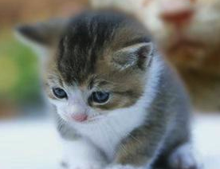
How do we know they’re not only imitating or being taught?
Imitation certainly is useful for learning some aspects of language, such as learning that the sequence of sounds “cat” refers to a furry, purring pet.
However, children can’t learn how to understand and produce full sentences by imitating what they hear and repeating it word for word.
Why not?
One reason: Most sentences are novel – you understand and produce them on the fly, and may never have heard them before.

Slide 44
How do we know they’re not only imitating or being taught?
Also, it turns out that children are bad at imitating sentences where they don’t know some of the words (so how could they learn those words by imitating them?):
“The cat is hungry” becomes “Cat hungry.”
In addition, children don’t often repeat word-for-word what adults around them say.

Slide 45
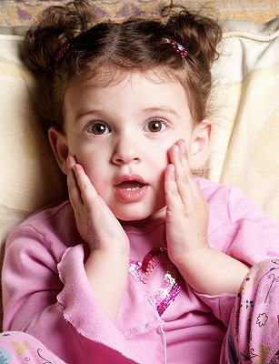
How do we know they’re not only imitating or being taught?
(From Martin Braine)
Child: Want other one spoon, Daddy.
Father: You mean, you want the other spoon.
Child: Yes, I want other one spoon, please Daddy.
Father: Can you say “the other spoon”?
Child: Other…one…spoon.
Father: Say “other”.
Child: Other.
Father: “Spoon.”
Child: Spoon.
Father: “Other spoon.”
Child: Other…spoon. Now give me other one spoon?
Notes:
45

Slide 46
How do we know they’re not only imitating or being taught?
It’s also unlikely children learn by being explicitly taught. This is because once we go beyond the most superficial things (like “cat” is a furry, purring pet), most of our knowledge is subconscious. We know it – but we don’t know how we know it or why it’s so.

Slide 47
Knowledge of Language & Hidden Rules
Some examples from language:
You know that…
…strop is a possible word of English, while stvop isn’t.
Notes:
47

Slide 48
Knowledge of Language & Hidden Rules
Some examples from language:
You know that…
…to ask about “Jack” in the sentence
“You think that Jack did it”,
you can’t ask it this way:
“Who do you think that did it?”
(Instead: “Who do you think did it?”)
Notes:
48

Slide 49
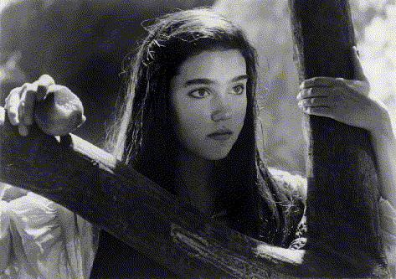
Knowledge of Language & Hidden Rules
Some examples from language:
You know that…
…In “She ate the peach while Sarah was reading”, she ≠Sarah
but she can be Sarah in all of these:
Sarah ate the peach while she was reading.
While she was reading, Sarah ate the peach.
While Sarah was reading, she ate the peach.
Notes:
49

Slide 50
Knowledge of Language & Hidden Rules
Some examples from language:
You know that…
…the ‘s’ in ‘cats’ sounds different from the ‘s’ in goblins
cats: ‘s’ = /s/
goblins: ‘s’ = /z/
Notes:
50

Slide 51
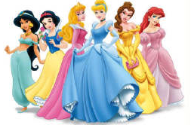
Knowledge of Language & Hidden Rules
Some examples from language:
You know that…
… contracted forms like “wanna” and “gonna” can’t always replace their respective full forms “want to” and “going to”.
You get to choose who you will rescue.
“Who do you want to rescue?”
“Who do you wanna rescue?”
You get to choose who will do the rescuing.
“Who do you want to do the rescuing?”
* “Who do you wanna do the rescuing?”

Slide 52
Knowledge of Language & Hidden Rules
Some examples from language:
You know that…
… contracted forms like “wanna” and “gonna” can’t always replace their respective full forms “want to” and “going to”.
You get to choose who you will rescue.
“Who do you want to rescue?”
“Who do you wanna rescue?”
You get to choose who will do the rescuing.
“Who do you want to do the rescuing?”
* “Who do you wanna do the rescuing?”

Slide 53
Knowledge of Language & Hidden Rules
Some examples from language:
You know that…
… contracted forms like “wanna” and “gonna” can’t always replace their respective full forms “want to” and “going to”.
You get to choose who you will rescue.
“Who are you going to rescue?”
“Who are you gonna rescue?”
“I’m going to the witch’s lair to rescue her.”
* “I’m gonna the witch’s lair to rescue her.”

Slide 54
Knowledge of Language & Hidden Rules
Some examples from language:
You know that…
… contracted forms like “wanna” and “gonna” can’t always replace their respective full forms “want to” and “going to”.
You get to choose who you will rescue.
“Who are you going to rescue?”
“Who are you gonna rescue?”
“I’m going to the witch’s lair to rescue her.”
* “I’m gonna the witch’s lair to rescue her.”

Slide 55
Linguistic productivity means we need rules
“The expressive variety of language use implies that a language user’s brain contains unconscious grammatical principles” - Jackendoff (1994)
Example: Most sentences we have never seen or used before, but we can still understand them.
Question: Can speakers simply memorize all the possible sentences of a language the way they learn the vocabulary of their language? Not if there are an infinite number of them…

Slide 56
Linguistic infinity
Hoggle has two jewels.
Hoggle has three jewels.
Hoggle has four jewels.
…
Hoggle has forty-three million and five jewels.
…
One (dumb) way to get infinity

Slide 57
Linguistic creativity
What sentence lists include this sentence?
Through dangers untold and hardships unnumbered, I have fought my way here to the castle beyond the goblin city to take back the child you have stolen, for my will is as strong as yours and my kingdom is as great.

Slide 58
Linguistic infinity
The point: our minds store words and meanings and the patterns into which they can be placed (grammar).
Sentence Patterns:
Hoggle has n jewels.
An X is not a Y.
Since an X is not a Y, a Z is not a W.

Slide 59
The argument for mental grammar
“In short, in order for us to be able to speak and understand novel sentences, we have to store in our heads not just the words of our language but also the patterns of sentences possible in our language. These patterns, in turn, describe not just patterns of words but also patterns of patterns. Linguists refer to these patterns as the rules of language stored in memory; they refer to the rules as the mental grammar of the language, or grammar for short.” - Jackendoff (1994)

Slide 60
Linguistic productivity means we need rules
Infinite number of phrases & sentences
Large but finite number of words
Smaller amount of morphemes (ex: -ing, -s)
Several dozens of sounds (phonemes) (ex: /s/, /z/)

Slide 61
Phonemes
Basic perceptual units of which speech is composed (Liberman, 1970)
Units that are used to build morphemes
Languages have a finite inventory of these units.
They are not units of meaning.
They are contrastive: changing a phoneme can change meaning (pig vs big).

Slide 62
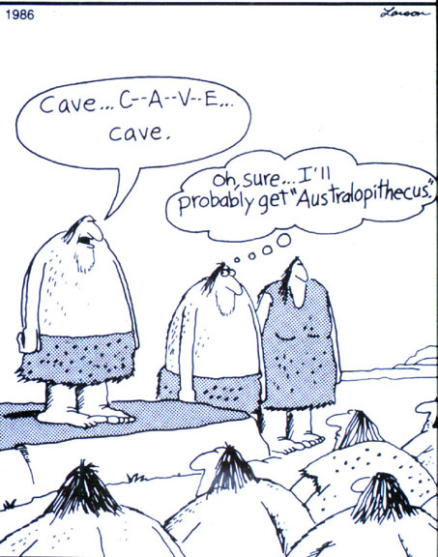
Structure permits creativity
We are capable of
combining existing
phonemes to form
new words
“email”, “IM”, “xerox”
Also, screennames!

Slide 63
Morphemes
Morphemes are the smallest meaningful units of language
Free morphemes may stand alone
mail, movie, sensation, mother
Bound (usually grammatical) morphemes cannot
ing, -s, -ed
Morphemes combine to form the words of a language.
Ex: He’s a regifter! (re + gift +er)
Combination is rule-governed: “Regifter” is okay but not
*Reergift, *Erregift, *Ergiftre, *Gifterre, *giftreer.

Slide 64
Structure permits creativity
We are capable of combining existing morphemes using existing morphological rules
COMPOUNDING
e + mail, goblin + king, fantasy + movie + watcher
DERIVATIONAL
re + gift, sensation + al
INFLECTIONAL
sing → singing, sings

Slide 65
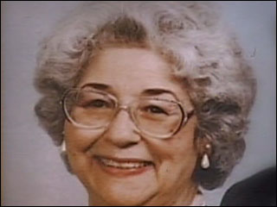
Compounding
mother
grandmother
great-grandmother
great-great-grandmother
great-great-great-grandmother
…

Slide 66
Derivational morphemes
sensation
sensational
sensationalize
sensationalization
sensationalizational
sensationalizationalize

Slide 67
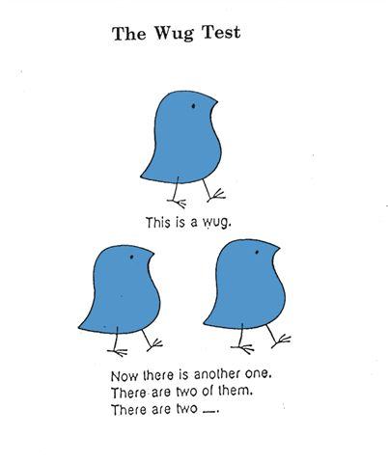
Inflectional morphemes

Slide 68
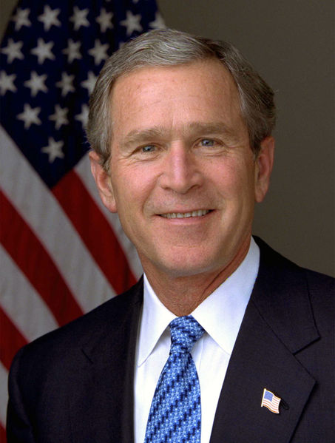
Structure permits creativity
We are capable of combining existing
morphemes/words into new sentences
I know what I believe. I will continue to articulate what I believe and what I believe - I believe what I believe is right.

Slide 69
Recap
Children learn (hard) things about language that are not easy to explain.
Children don’t just imitate what they’ve heard - they’re trying to figure out the patterns of their native language. Also, they may not notice or respond to explicit correction.
The creativity and expressivity of language suggests that there is an underlying structured system that produces language as its output.
Notes:
69

Slide 70
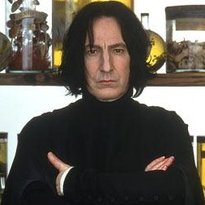
Questions?
You should be able to do up through question 4 on the introduction review questions.

