Slide 1
Psych 156A/ Ling 150: Acquisition of Language II
6/7/2012
Final Exam Review

Slide 2
Final Exam
Final Exam: 6/14/2012
1:30 – 3:30pm
HH178 (this room) OR SBSG G241
We will be holding office hours next week at our normal times

Slide 3
Part of Speech Learning
Two ideas:
Semantic Bootstrapping Hypothesis
PoS matches (roughly) real world semantics
nouns → objects, states
verbs → actions
adjectives → properties
But only roughly…
a kick (verb-like, but a noun)
function words (a, the, of, but…)

Slide 4
Part of Speech Learning
Another idea:
Frequent Frames
the _____ is you _____ it
a _____ is they _____ her
that _____ was can _____ him
Proposed in Mintz (2003), simulated in Wang & Mintz (2008)

Slide 5
Language Structure
Phrases
Grammaticality judgments
Ambiguous/Unambiguous data
Principles & Parameters

Slide 6
Testing Hypotheses
C
B
1, 3, 2, 6, 4, 3
7 8
9 10
5 6
1 2
3 4
A

Slide 7
Bayesian Learning
C
B
D = 1, 3, 2, 6, 4, 3
7 8
9 10
5 6
1 2
3 4
A
P(A|D) = P(D|A) P(A) / P(D)

Slide 8
Bayesian Learning
C
B
D = 1, 3, 2, 6, 4, 3
7 8
9 10
5 6
1 2
3 4
A
P(D|A) = P(1|A) * P(3|A) * P(2|A) * P(6|A) * P(4|A) * P(3|A)
= ¼ * ¼ * ¼ * 0 * ¼ * ¼
= 0

Slide 9
Bayesian Learning
C
B
D = 1, 3, 2, 6, 4, 3
7 8
9 10
5 6
1 2
3 4
A
P(D|B) = P(1|B) * P(3|B) * P(2|B) * P(6|B) * P(4|B) * P(3|B)
= 1/6 * 1/6 * 1/6 * 1/6 * 1/6 * 1/6 * 1/6
= 1/(6^5) = 1/7776 = .0001286

Slide 10
Bayesian Learning
C
B
D = 1, 3, 2, 6, 4, 3
7 8
9 10
5 6
1 2
3 4
A
P(D|C) = P(1|C) * P(3|C) * P(2|C) * P(6|C) * P(4|C) * P(3|C)
= 1/10 * 1/10 * 1/10 * 1/10 * 1/10 * 1/10 * 1/10
= 1/(10^5) = 1/100000 = .00001

Slide 11
Bayesian Learning
C
B
D = 1, 3, 2, 6, 4, 3
7 8
9 10
5 6
1 2
3 4
A
P(D|A) = 0 P(D|B) = .0001286 P(D|C) = .00001
P(A) = 1/3 P(B) = 1/3 P(C) = 1/3
P(D) = 0*1/3 + .0001286*1/3 + .00001*1/3
= .0000462

Slide 12
Bayesian Learning
C
B
D = 1, 3, 2, 6, 4, 3
7 8
9 10
5 6
1 2
3 4
A
P(D|A) = 0 P(D|B) = .0001286 P(D|C) = .00001
P(A) = 1/3 P(B) = 1/3 P(C) = 1/3
P(D) = .0000462
P(A|D) = 0 * 1/3 / .0000462 = 0

Slide 13
Bayesian Learning
C
B
D = 1, 3, 2, 6, 4, 3
7 8
9 10
5 6
1 2
3 4
A
P(D|A) = 0 P(D|B) = .0001286 P(D|C) = .00001
P(A) = 1/3 P(B) = 1/3 P(C) = 1/3
P(D) = .0000462
P(B|D) = .0001286 * 1/3 / .0000462 = .9278

Slide 14
Bayesian Learning
C
B
D = 1, 3, 2, 6, 4, 3
7 8
9 10
5 6
1 2
3 4
A
P(D|A) = 0 P(D|B) = .0001286 P(D|C) = .00001
P(A) = 1/3 P(B) = 1/3 P(C) = 1/3
P(D) = .0000462
P(B|D) = .0001286 * 1/3 / .0000462 = .9278
P(C|D) = .00001 * 1/3 / .0000462 = .07215

Slide 15
Bayesian Learning
C
B
D = 7
But… you already saw 2
7 8
9 10
5 6
1 2
3 4
A
Calculate P(H|2) for each hypothesis
P(A|2) = 15/31 P(B|2) = 10/31 P(C|2) = 6/31
Use these posteriors as the new prior for the new datapoint

Slide 16
Bayesian Learning
C
B
D = 7
But… you already saw 2
7 8
9 10
5 6
1 2
3 4
A
P(A|2) = P(2|A) * P(A) / P(D)
= (¼ * 1/3 ) / (31/180) = 15/31
P(B|2) = P(2|B) * P(B) / P(D)
= (1/6 * 1/3 ) / (31/180) = 10/31
P(C|2) = P(2|C) * P(C) / P(D)
= (1/10 * 1/3 ) / (31/180) = 6/31
P(D) = (1/4 * 1/3) + (1/6 * 1/3) + (1/10 * 1/3) = 31/180

Slide 17
Bayesian Learning
C
B
D = 7
But… you already saw 2
7 8
9 10
5 6
1 2
3 4
A
P(A|2) = 15/31 P(B|2) = 10/31 P(C|2) = 6/31
P(A|7,2) = P(7|A) * P(A|2) / P(D)
= 0 * 15/31 / P(D)
= 0

Slide 18
Bayesian Learning
C
B
D = 7
But… you already saw 2
7 8
9 10
5 6
1 2
3 4
A
P(A|2) = 15/31 P(B|2) = 10/31 P(C|2) = 6/31
P(B|7,2) = P(7|B) * P(B|2) / P(D)
= 0 * 10/31 / P(D)
= 0

Slide 19
Bayesian Learning
C
B
D = 7
But… you already saw 2
7 8
9 10
5 6
1 2
3 4
A
P(A|2) = 15/31 P(B|2) = 10/31 P(C|2) = 6/31
P(C|7,2) = P(7|C) * P(C|2) / P(D)
= 1/10 * 6/31 / P(D)
= 1/10 * 6/31 / (1/10 * 6/31 + 0 + 0)
= 1

Slide 20
Parameters
Review Questions: Structure
Question #10:
Suppose we have a parameter Q, we don’t know what structures match that parameter though. We think maybe A, B, C & D connect to Q, but aren’t sure. Q can only take two values, x1 and x2
a) A, B, and C tend to show x1 while D shows z1, which structures are connected to parameter Q?

Slide 21
Parameters
Review Questions: Structure
Question #10:
Suppose we have a parameter Q, we don’t know what structures match that parameter though. We think maybe A, B, C & D connect to Q, but aren’t sure. Q can only take two values, x1 and x2
b) If Q really does have value x1 which structures (A,B,C,D) are likely to also have value x1?

Slide 22
Parameters
Review Questions: Structure
Question #10:
Suppose we have a parameter Q, we don’t know what structures match that parameter though. We think maybe A, B, C & D connect to Q, but aren’t sure. Q can only take two values, x1 and x2
c) Children rarely see structure C, but often see A, B and D. If A & B show x1, and D shows z1, given your answer to (b) what value should the infant suppose for structure C?

Slide 23
Experiments
Dewar & Xu (2010)
Examine overhypotheses (abstract generalizations based on limited data with apparent regularities)
Gerken (2006)
How do children generalize?
Children don’t generalize from AAdi stimuli to AAB
Pearl & Mis (2011)
Baker (1978) assumes only unambiguous data is informative
Can learn anaphoric one using all ambiguous data if we include data from other pronouns too!

Slide 24
Experiments
Thompson & Newport (2007)
Adults can learn phrases using transitional probability (TP)
Hudson, Kam & Newport (2005)
Adults match inconsistent input with inconsistent output
Children generalize to the most frequent input type
Hudsom, Kam & Newport (2009)
Adults will generalize if one input is dominant
But children in this case generalize one determiner and use it almost always

Slide 25
Psych 156A/ Ling 150: Acquisition of Language II
5/3/2012
Midterm Review

Slide 26
Marr’s 3 Levels
Any problem can be decomposed into 3 levels:
Computational level
What’s the problem to be solved?
Algorithmic level
What (abstract) set of rules solves the problem?
Implementational level
How are those rules physically implemented?

Slide 27
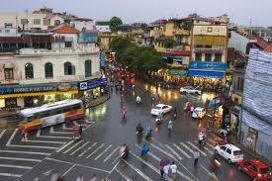
Computational Level
Abstract Problem:
How do we regulate traffic at an intersection?
Goal:
Direct lanes of traffic to avoid congestion/accidents

Slide 28
Algorithmic Level
What kind of rules can we use?
Let Lane go whenever X cars are waiting?
Let Lane go every X minutes?
Let 1 car at a time go through the intersection?
Make one direction always yield to the other?

Slide 29
Implementational Level
How do we physically implement the rule?
Set up a stop light
Set up a blinking stop light
Put up a stop sign
Have someone direct traffic
Put up nothing and have drivers implement the rules themselves!

Slide 30
Transitional Probability
TP(AB) = P(AB|A) = # of times you saw AB / # of times you saw A
ka/ko/si
ko/li/ja
ja/ko
li/je/vo
TP(ko/si) = # of times ko/si / # of times ko
TP(ja/vo) = # of times ja/vo / # of times ja

Slide 31
TP Minima
TP can be though of like a tide
Every time the TP is at “low tide” we put a boundary
0.7
0.65
0.55
0.5
0.45
0.4
0.35
0.3
0.3
0.2
0.15

Slide 32
Precision & Recall
I wonder how well I can segment this sentence today
Iwonder how well Ican seg ment this sen tencetoday

Slide 33
Precision & Recall
I wonder how well I can segment this sentence today
Iwonder how well Ican seg ment this sen tencetoday
Precision:
# of correct / # guessed
3 correct / 9 guessed

Slide 34
Precision & Recall
I wonder how well I can segment this sentence today
Iwonder how well Ican seg ment this sen tencetoday
Recall:
# of correct / # true words
3 correct / 10 true

Slide 35
Stress-based Segmentation
how WELL can a STRESS based LEARNER SEGment THIS?
If we assume Stress-INITIAL syllables:
How WELLcana STRESSbased LEARNER SEGment THIS?
Precision = 3/6 Recall = 3/9

Slide 36
Stress-based Segmentation
how WELL can a STRESS based LEARNER SEGment THIS?
If we assume Stress-FINAL syllables:
HowWELL canaSTRESS basedLEARNER SEG mentTHIS?
Precision = 0/5 Recall = 0/9

Slide 37
Bayesian Learning
All (statistical) learning is a form of INFERENCE
We have data…
But which hypothesis is true?
P(H|D) ?
P(H | D) = P(D | H) * P(H) / P(D)
posterior
likelihood
prior
prob. of data

Slide 38
Cross-Situational Learning
Use information across trials to identify a word/meaning mapping
Scene 1: “dugme” “lutka” “prozor”
Object 1 Object 2 Object 3
Scene 2: “lutka” “zid” “prozor”
Object 1 Object 3 Object 4

Slide 39
Cross-Situational Learning
Scene 1: “dugme” “lutka” “prozor”
Object 1 Object 2 Object 3
Scene 2: “lutka” “zid” “prozor”
Object 1 Object 3 Object 4
P(H|D) = P(D|H) * P(H) / P(D)
Posterior = likelihood * prior / prob. of data
P(lutka == 1) = ¼ Prior (let’s call this H1)
P(D | H1) = 1 Likelihood
P(D) = P(H1)*P(D|H1) + P(H2)*P(D|H2) + P(H3)*P(D|H3)…
P(H1 | D) = P(D | H1) * P(H1) / P(D)

Slide 40
Suspicious Coincedence
Three hypotheses:
Superordinate: “mammal”
Basic: “dog”
Subordinate: “beagle”
H1
H2
H3
Given a picture of a beagle:
P(data|H3) = 1/# of beagles
> P(data|H2) = 1/# of dogs
> P(data|H1) = 1/# of mammals

Slide 41
Contrastive Sounds
A pair of sounds are contrastive if:
Switching the sounds changes the MEANING
In English:
“food”: [f u d] ← Contrastive
“rude”: [r u d]
In German:
“street”: [s t R a s ə] ← Not contrastive
“street”: [s t r a s ə]

Slide 42
Learning Sounds
Maintenance & Loss Theory:
If you use a distinction in your language
Keep it
If you don’t use it
Ignore the distinction
Functional Reorganization:
Create a filter between acoustics and phonemes
If you hear a language sound
Impose filter to ignore non-native distinctions
If you hear a non-language sound
Don’t impose the filter

Slide 43
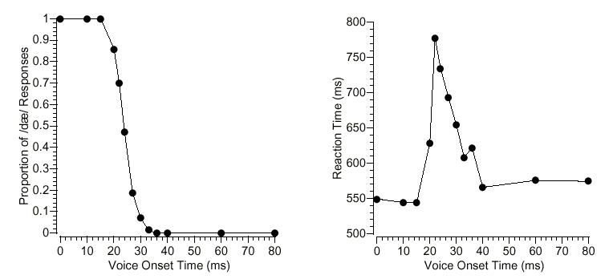
Sound Identification

Slide 44
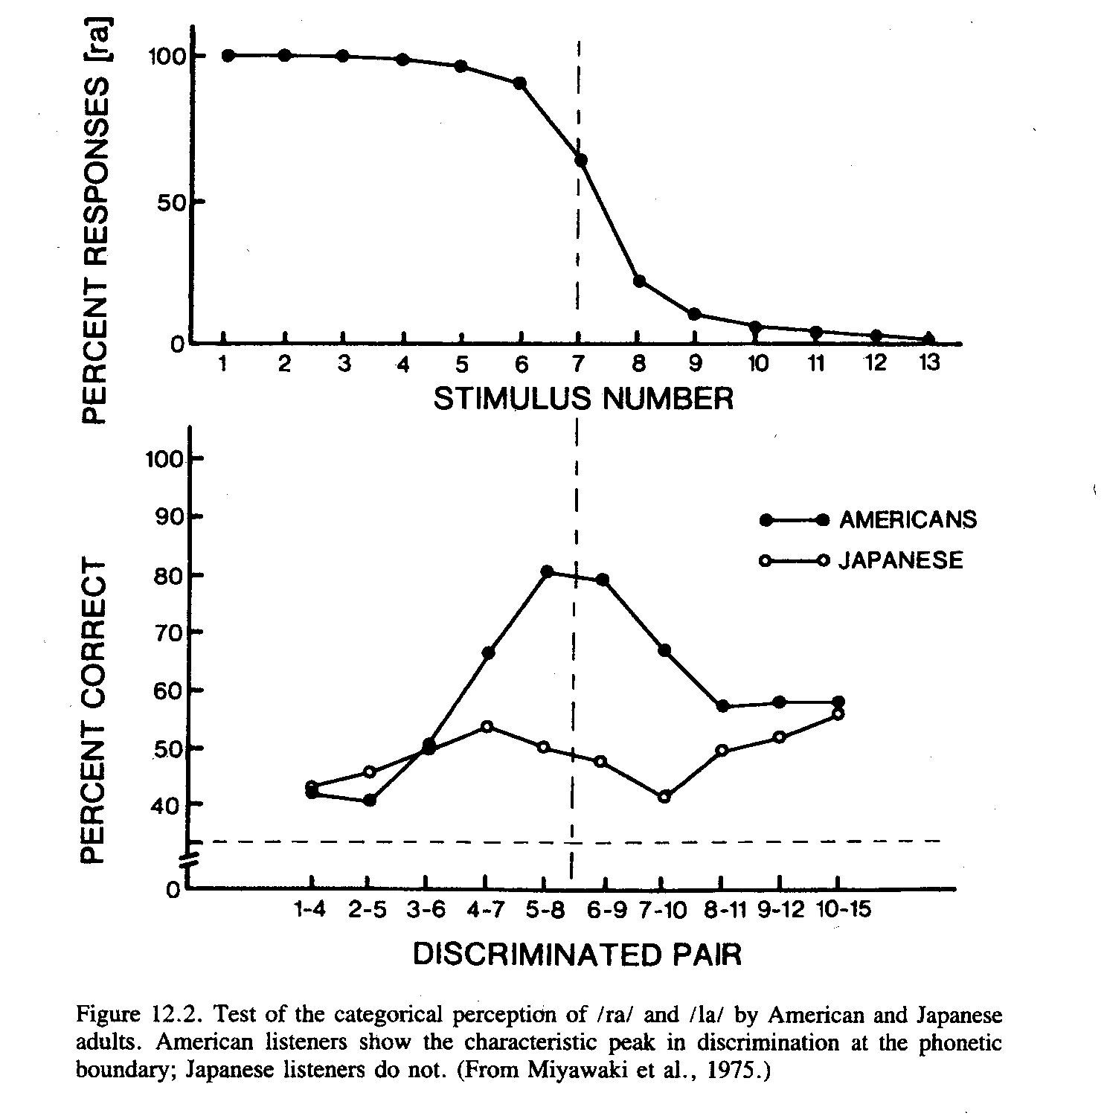
Sound Discrimination

